Slide 1
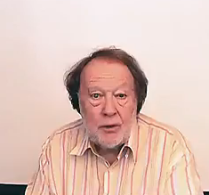
PHRASAL
VERBS

