Slide 1
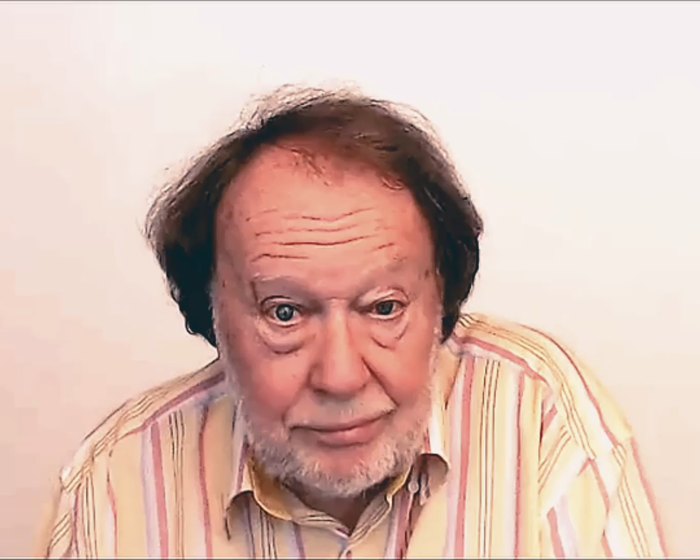
DESCRIBING
AND
EXPLAINING

