Slide 1
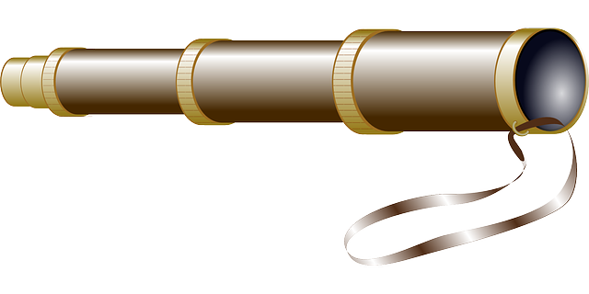

THE HISTORYSCOPE

Slide 2
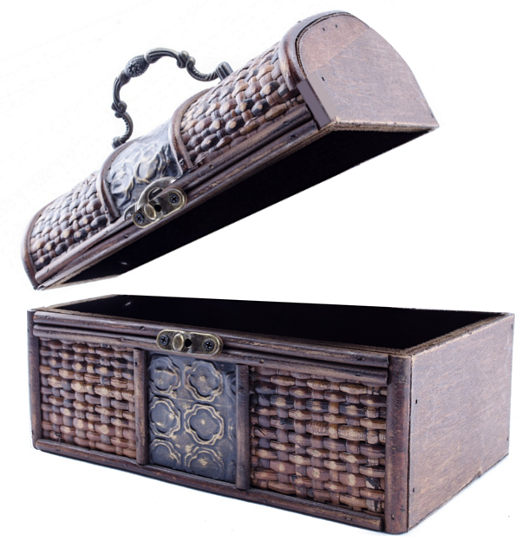
CONTEXT

Slide 3
CONTEXT

Slide 4
CONTEXT
RESPONDING

Slide 5
HOME
RESPONDING

Slide 6
HOME

Slide 7
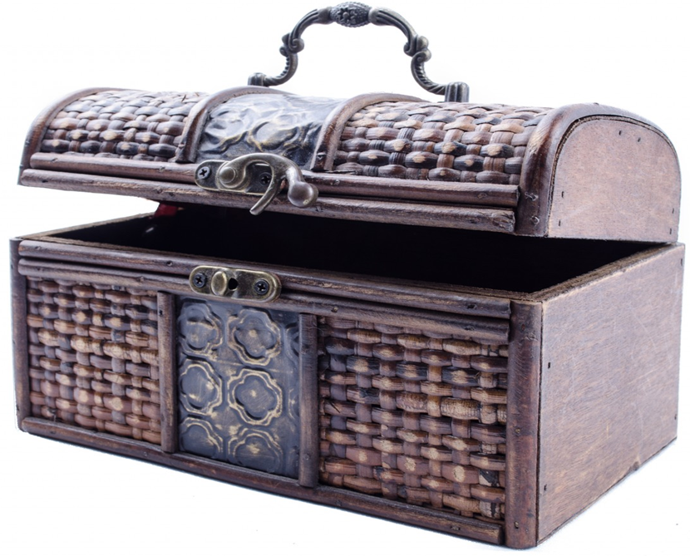


Slide 8


Slide 9
HOME

Slide 10
SCHOOL

Slide 11
WORK

Slide 12
PLANET

Slide 13
TOOLS

Slide 14
BUSINESS

Slide 15
YOUR
BODY

