Slide 1

CONTEXTS

Slide 2

WHAT ARE…
CONTEXTS
?
CHECK THIS WORD

Slide 3

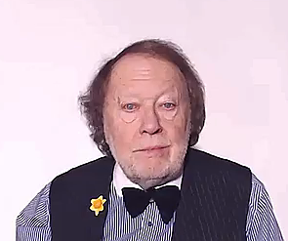
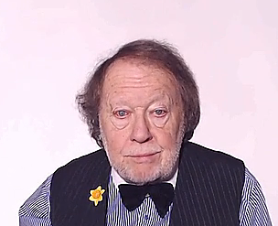
CONTEXTS
All the aspects which define something
are the
CONTEXT

Slide 4
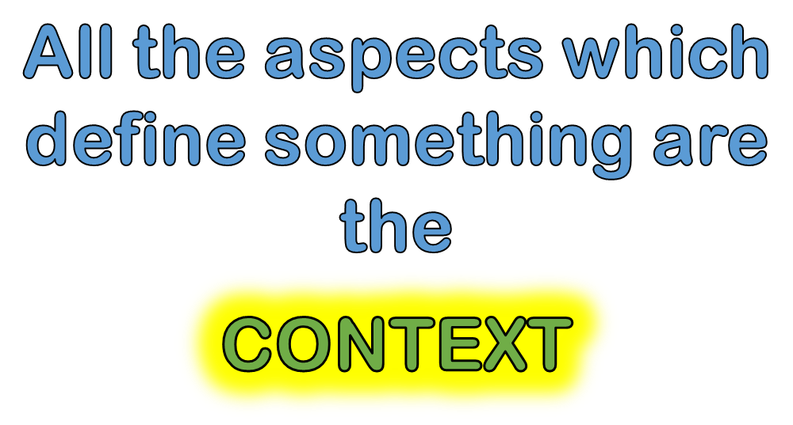
REMEMBER THIS!

Slide 5
KEY WORDS

Slide 6

CHECK THESE WORDS IN YOUR LANGUAGE
KEY WORDS
ACTIVITY HAPPENING
EVENT
CIRCUMSTANCES
EVENT ELEMENTS
THE DEFINING ASPECTS
OF A CHANGE
SITUATION

Slide 7










ARTS

Slide 8
Typical contexts
HOME
HAPPINESS
FAMILY
FRIENDS

Slide 9
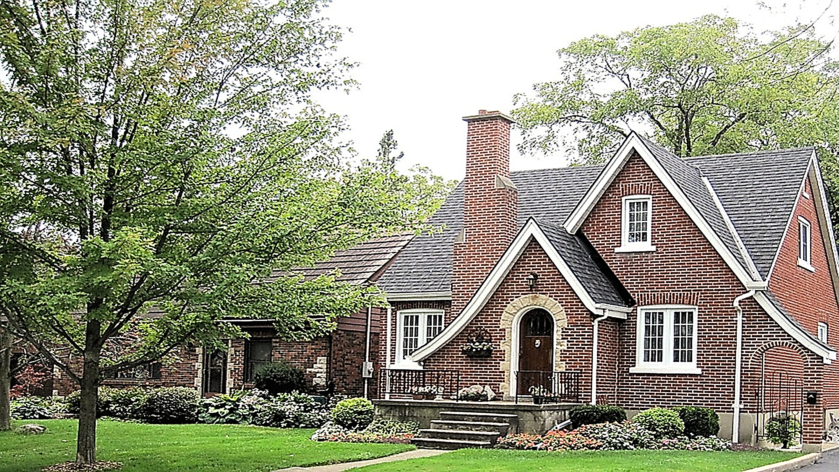
HOME

Slide 10

HAPPY PEOPLE

Slide 11

FRIENDS

Slide 12
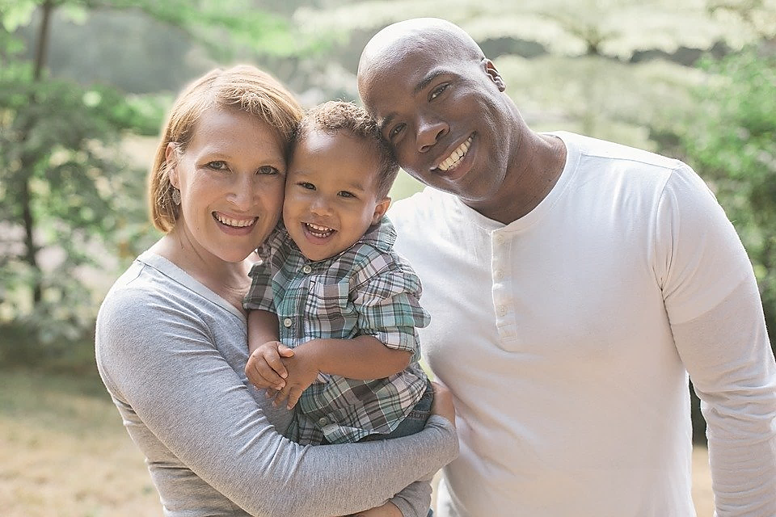
FAMILY

Slide 13
Typical contexts
INFORMATION
PEACE
SCIENCES
LOVE
ARTS
BUSINESS

Slide 14

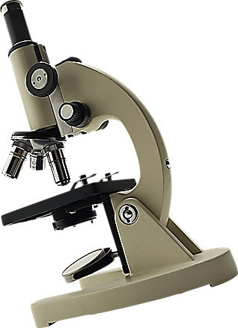

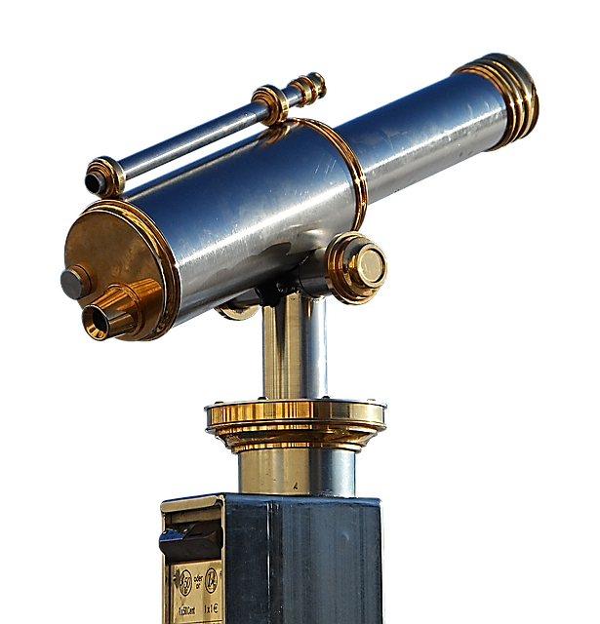
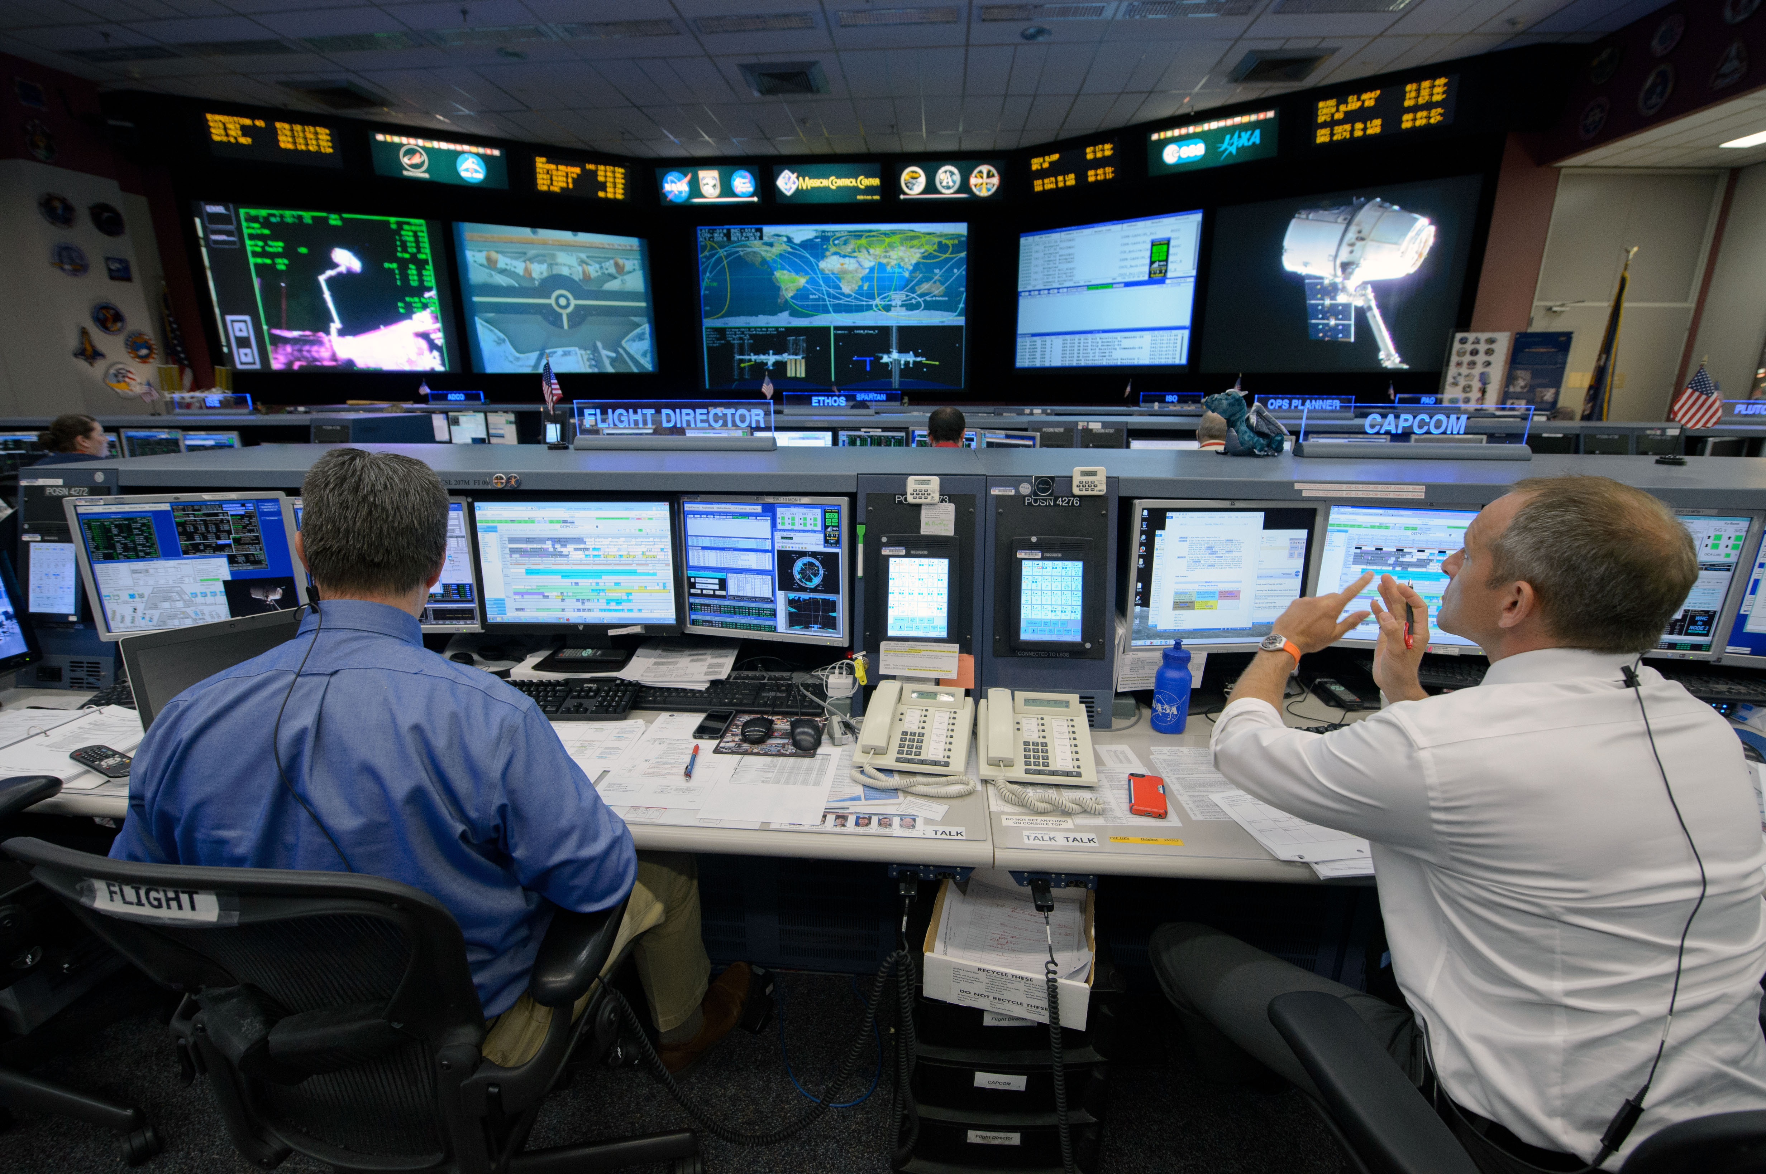
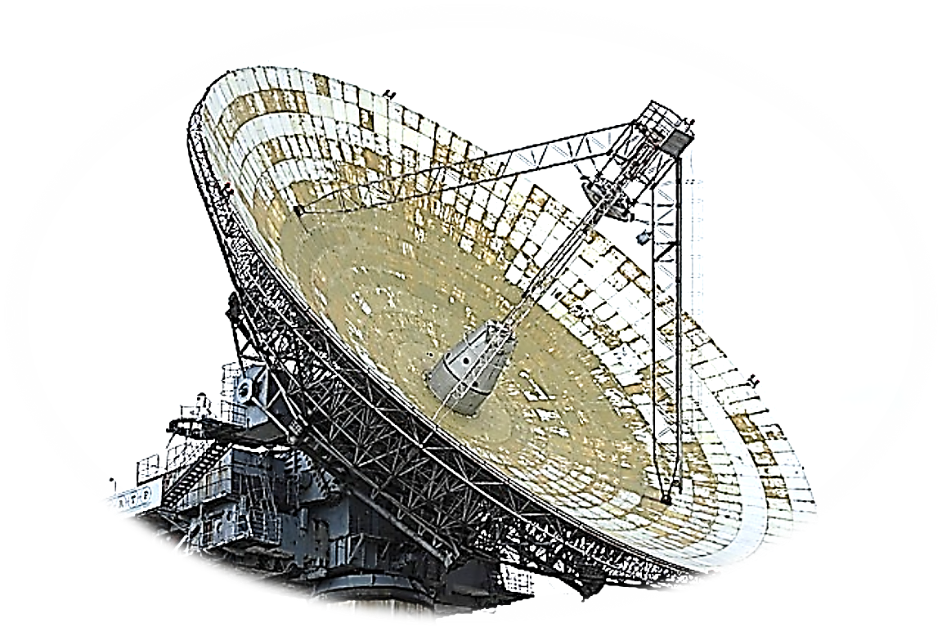
INFORMATION
INFORMATION CONTROL
CENTRE

Slide 15




SCIENCES

Slide 16

ARTS

Slide 17

PEACE

Slide 18
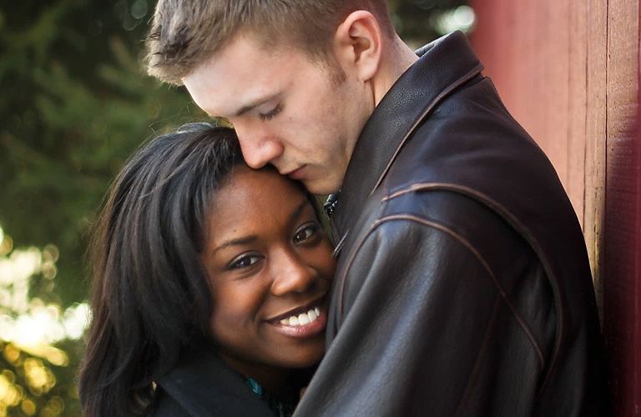
LOVE

Slide 19

BUSINESS

Slide 20
BUSINESS

Slide 21




Slide 22

KEY WORDS
KEY WORDS
KEY WORDS

Slide 23


EVENT

Slide 28
KEY WORDS
AREA AROUND US
MINUTES AFTER HOURS AFTER DAYS AFTER YEARS
ACTIVITY HAPPENING

Slide 29

KEY WORDS
EVENT
ACTIVITY HAPPENING
CIRCUMSTANCES
EVENT ELEMENTS
THE DEFINING ASPECTS OF
A CHANGE
SITUATION

Slide 30
Circumstances (usually plural) are the facts that are connected with and affect a situation, an event or an action. A situation is all the things that are happening at a particular time and in a particular place. (OALD)
If one person is listening to another, this is what is happening, not really the facts about what is happening.
There is sometimes overlap;for example, the situation is/circumstances are that a tourist, lost, has asked for directions and is listening to the response. It's difficult to make a sharp difference there.

Slide 31
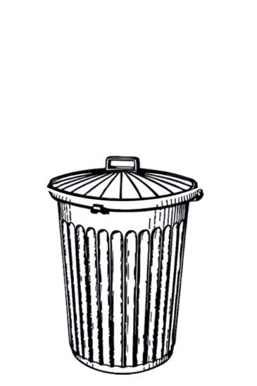

Slide 32



Slide 34
EVENT

Slide 35
EVENT

Slide 37


KEY WORDS

Slide 38


Slide 40


Slide 41
EVENT

Slide 42


Slide 46

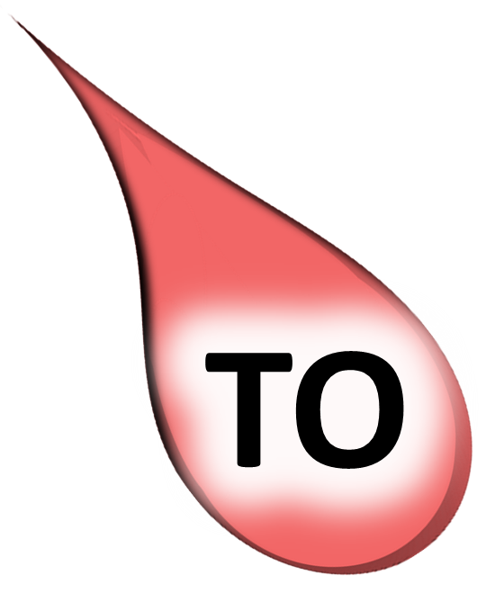
EVENT

Slide 47
EVENT

Slide 48


Slide 50
EVENT
EVENT

Slide 51
EVENT

Slide 52


Slide 53
EVENT

Slide 54


WORDS
WORDS

Slide 55
WORDS
WORDS

Slide 56
WORDS
WORDS

Slide 57
WORDS
WORDS

Slide 58
WORDS
WORDS

Slide 59
WORDS
WORDS

Slide 66
The circumstances in which an event happens- a setting.
The set of circumstances or facts that surround a particular event or situation.
The situation within which something exists or happens, and that can help explain it
The context of an idea or event is the general situation that relates to it, and helps it to be understood
Context can be background information that removes ambiguity or confusion

Slide 67
SITUATION
EVENT
CIRCUMSTANCES

Slide 68
CONTEXTS OF LIFE

Slide 70
CONTEXT EXAMPLES

Slide 73
SCIENCES

Slide 74
SCIENCES

Slide 76
SCIENCES

Slide 77

SOME WAYS WE COMMUNICATE
TO EXPRESS
TO TELL
TO INFORM
SPEAK A THOUGHT OR FEELING
PERSONAL DIRECT PRIVATE
FACTUAL NEUTRAL FORMAL
STOP THE VIDEO WHILE YOU CHECK

Slide 84
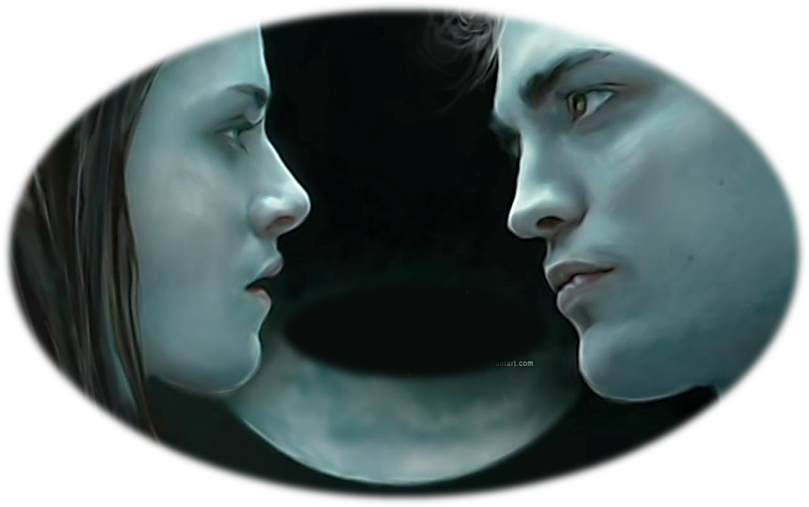
LOVE

Slide 85
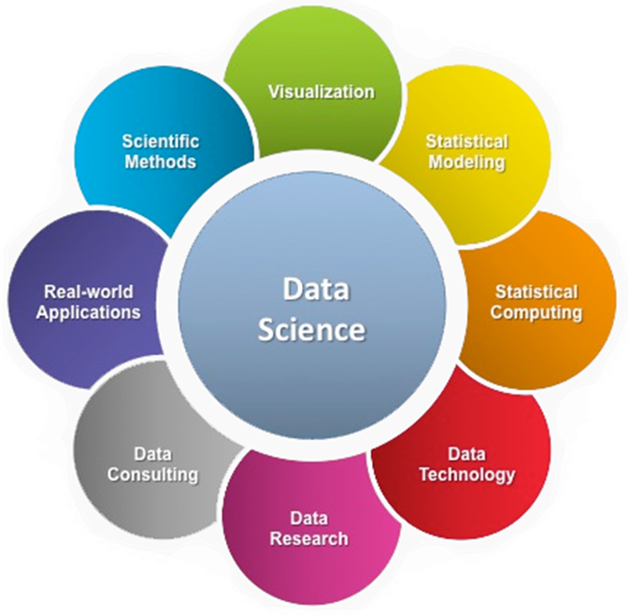


PROCESSING CENTRE

Slide 86


Slide 87
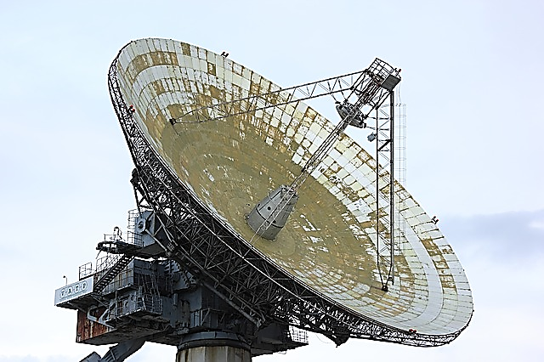

Slide 88



Slide 89
KEY WORDS

Slide 90
SOME WAYS WE COMMUNICATE
TO EXPRESS
TO TELL
TO INFORM
SPEAK A THOUGHT OR FEELING
PERSONAL DIRECT PRIVATE
FACTUAL NEUTRAL FORMAL
STOP THE VIDEO WHILE YOU CHECK

Slide 91



SPACE
TIME
EVENT

