Slide 1


WHAT ARE…
CONTEXTS
?
CHECK THIS WORD

Slide 2
KEY WORDS

Slide 3





KEY WORDS
EVENT
SITUATION

Slide 4

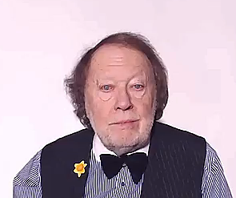
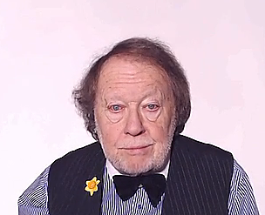
CONTEXTS
All the aspects which define something
are the
CONTEXT

Slide 5
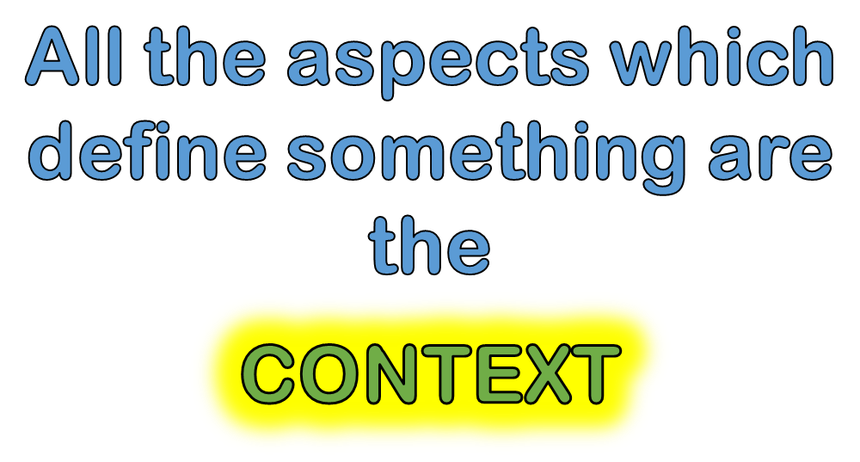
REMEMBER THIS!

Slide 6
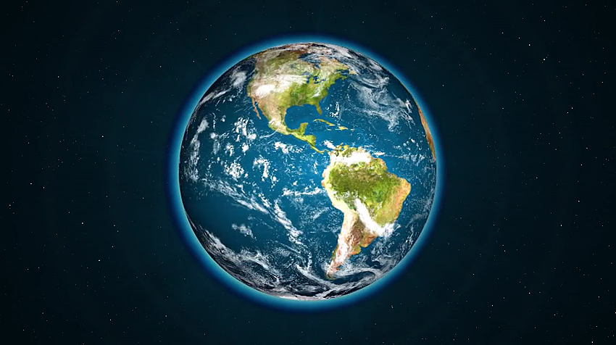









ARTS

Slide 7
Typical contexts
HOME
HAPPINESS
FAMILY
FRIENDS

Slide 8
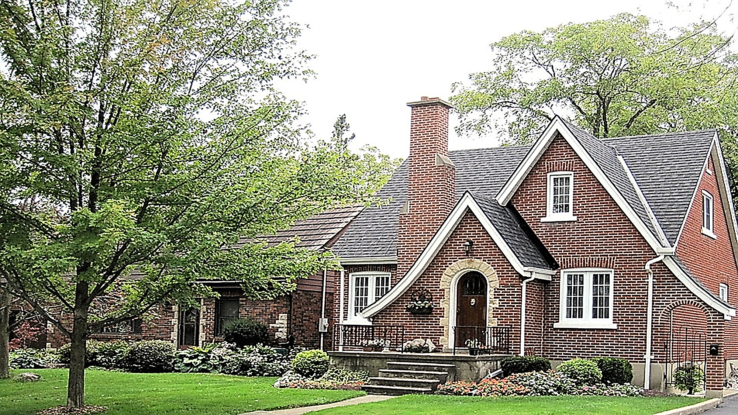
HOME

Slide 9

HAPPY PEOPLE

Slide 10

FRIENDS

Slide 11
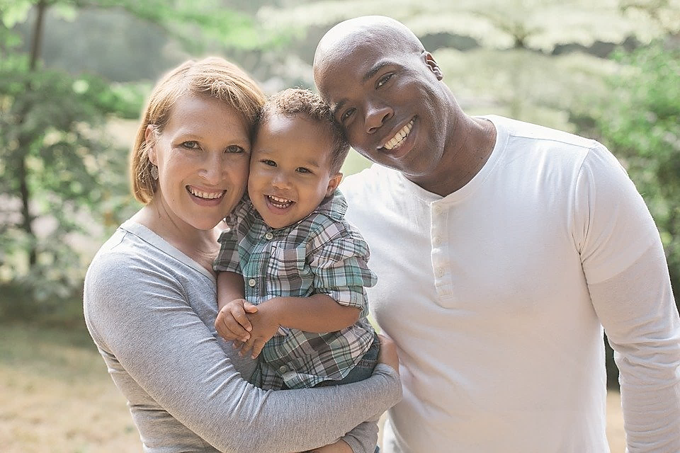
FAMILY

Slide 12
Typical contexts
INFORMATION
PEACE
SCIENCES
LOVE
ARTS
BUSINESS

Slide 13

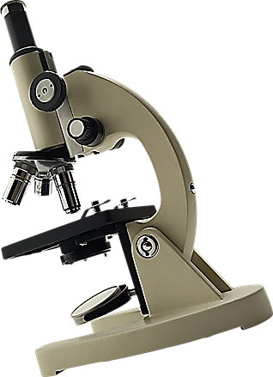

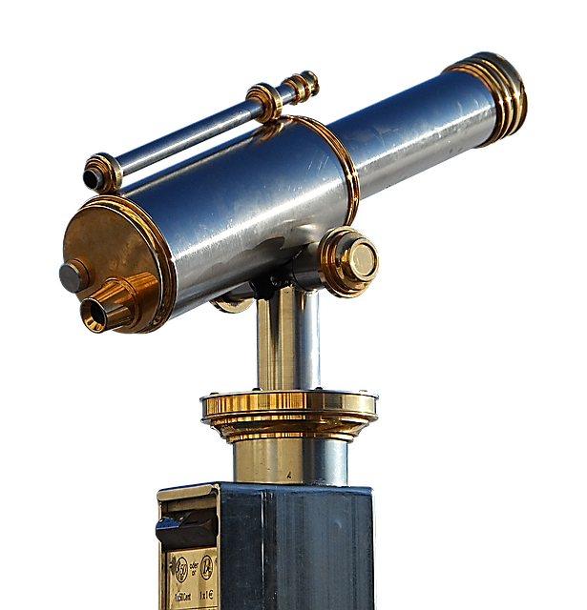
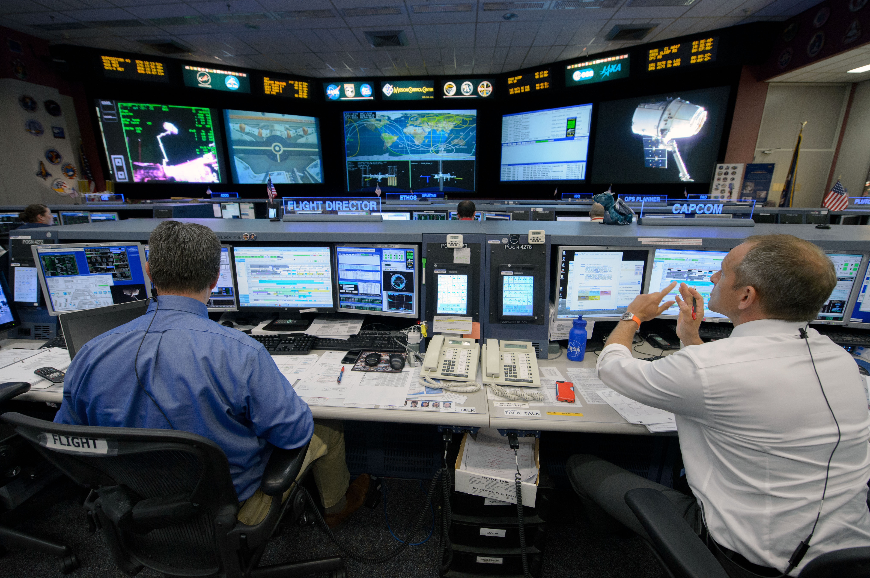
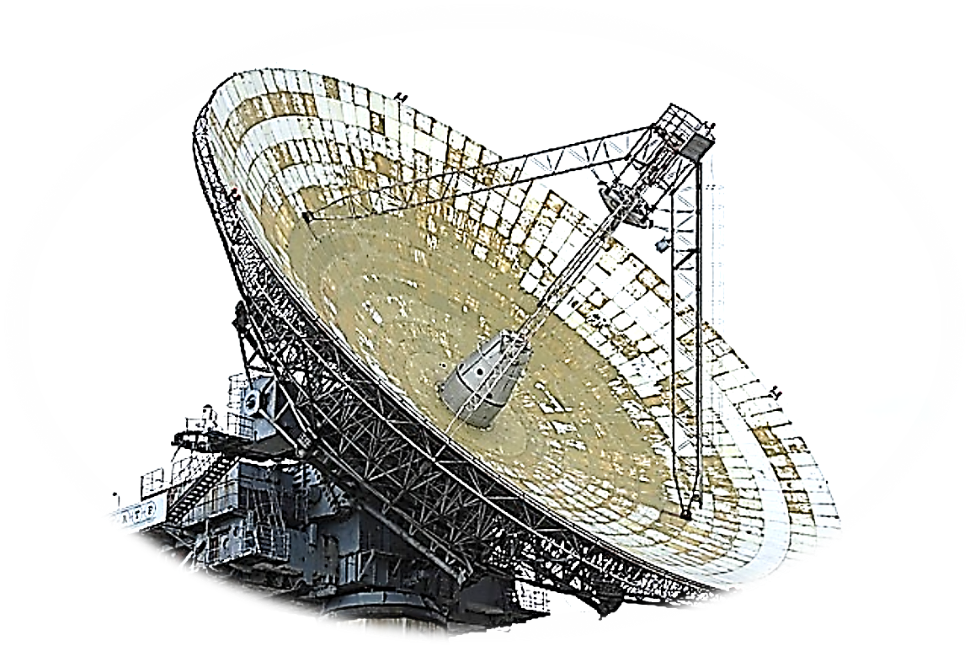
INFORMATION
INFORMATION CONTROL
CENTRE

Slide 14




SCIENCES

Slide 15

ARTS

Slide 16

PEACE

Slide 17
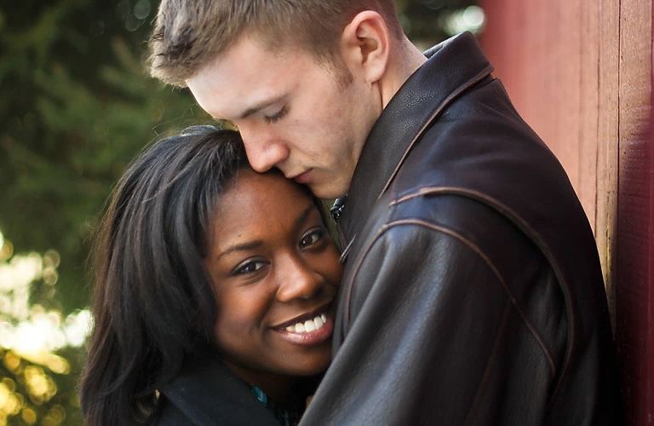
LOVE

Slide 18

BUSINESS

Slide 19

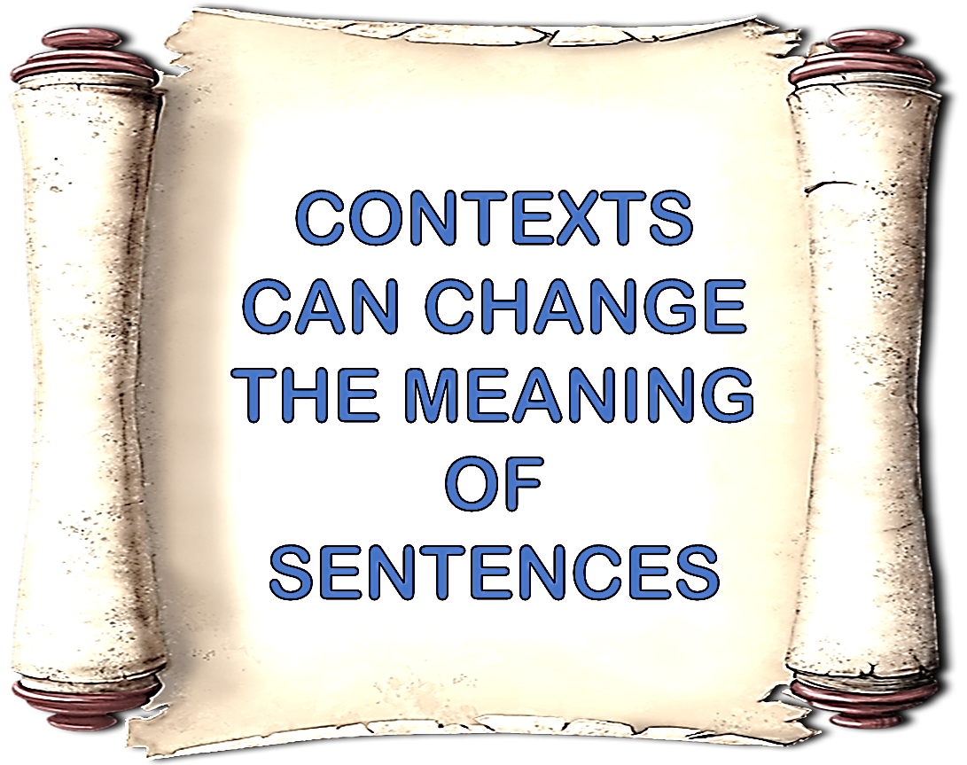

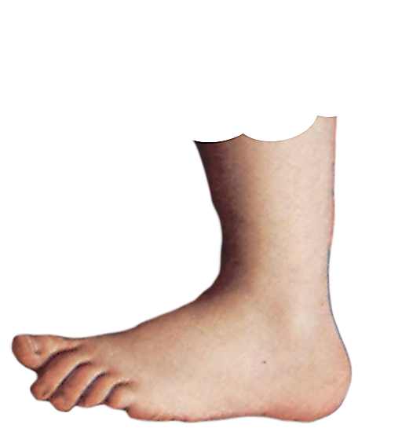
ENGLISH LANGUAGE STUDY
FOOTNOTE
FOOTNOTE

Slide 20
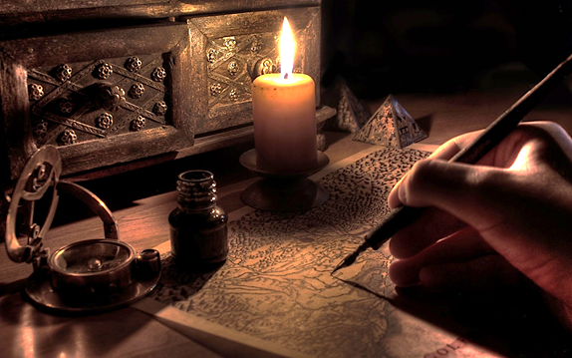

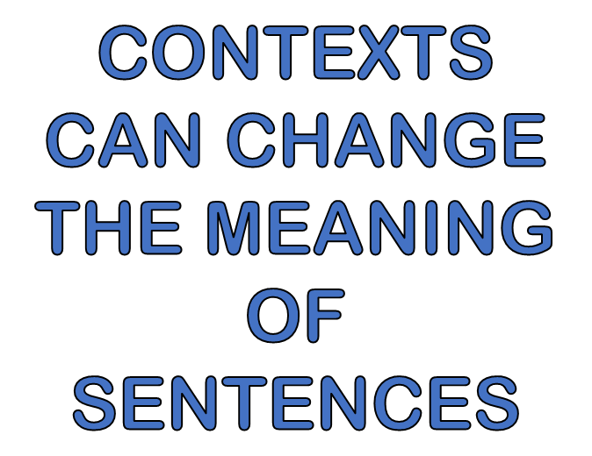
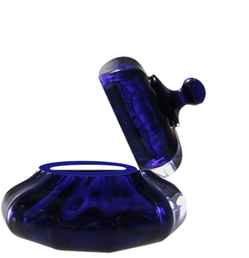

Slide 21
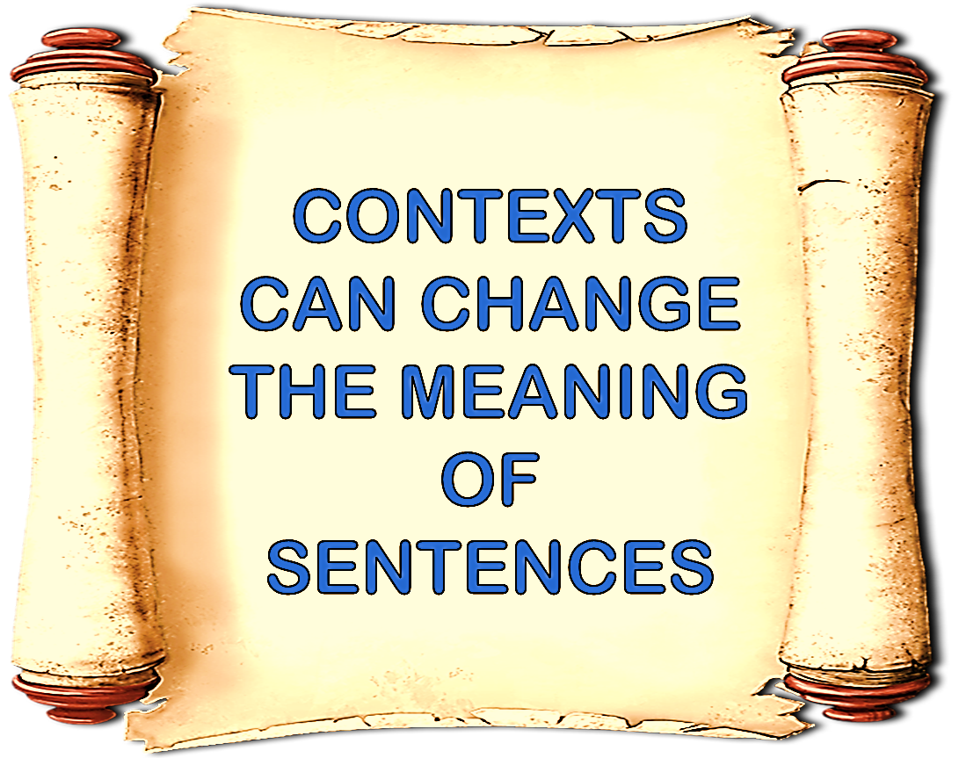

Slide 22
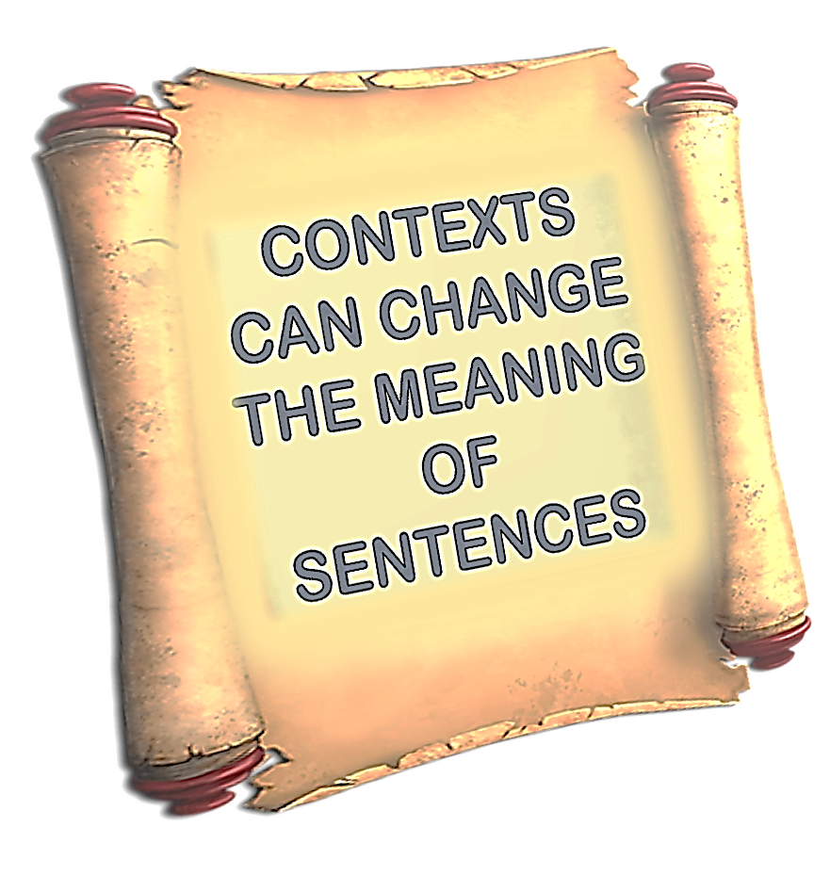

Slide 24


Slide 25
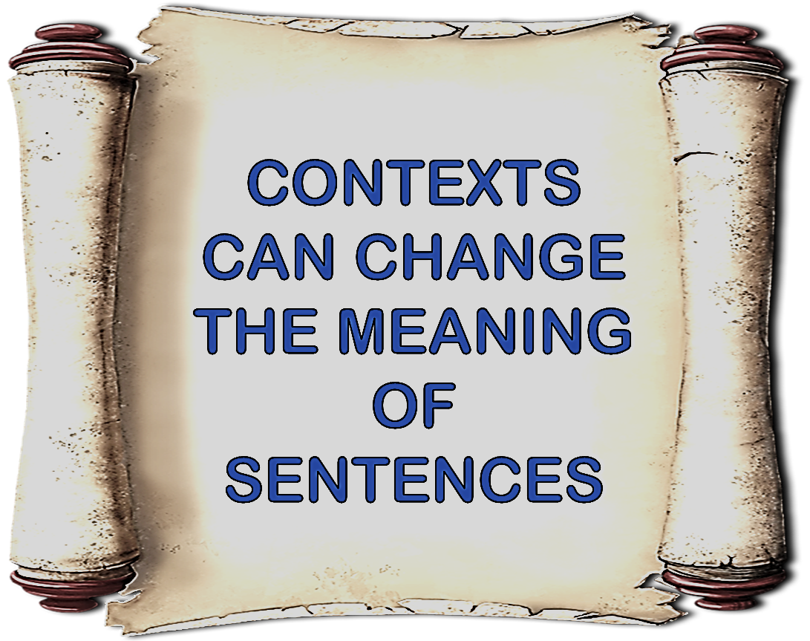

Slide 29


Slide 30
CONTEXTS CAN CHANGE THE MEANING OF SENTENCES

Slide 31


