Slide 1
TALKING HEAD

Slide 2


CONCEPTS

Slide 3
CONTEXTS

Slide 4

LIKE

Slide 5
WANT

Slide 6
WOULD
LIKE

Slide 7
WOULD
PREFER

Slide 8
WOULD
RATHER

Slide 9
PREFER

Slide 10
WOULD
LIKE
LIKE
WOULD
PREFER
PREFER

Slide 11
WOULD
RATHER
WANT

Slide 13
PREFERENCES!
I LIKE
I WOULD LIKE
I PREFER
I WOULD RATHER
I WANT
GENERAL
SPECIFIC
X
X
DIRECT

Slide 14
PREFERENCES!
DO YOU LIKE..?
WOULD YOU LIKE..?
DO YOU PREFER..?
WOULD YOU RATHER..?
DO YOU WANT..?
GENERAL
SPECIFIC
X
X
DIRECT

Slide 15
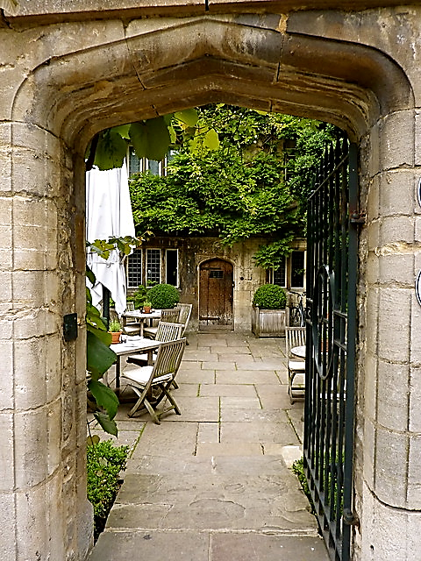
TEATIME IN OXFORD
WHAT
WOULD YOU LIKE?

Slide 16
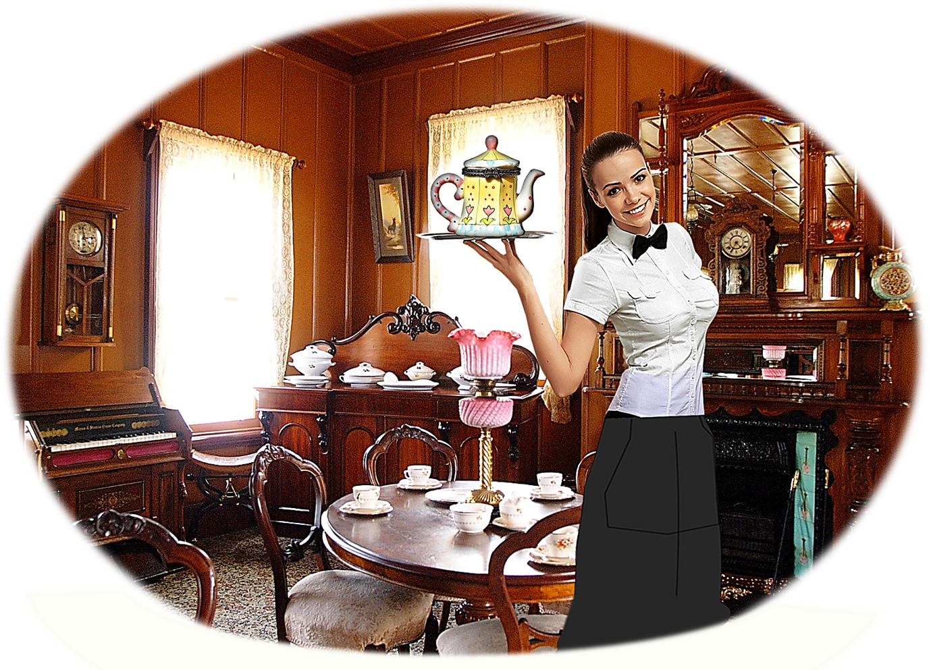
TEATIME IN OXFORD
WELCOME
TO
THE OLD TEA SHOP!

Slide 17

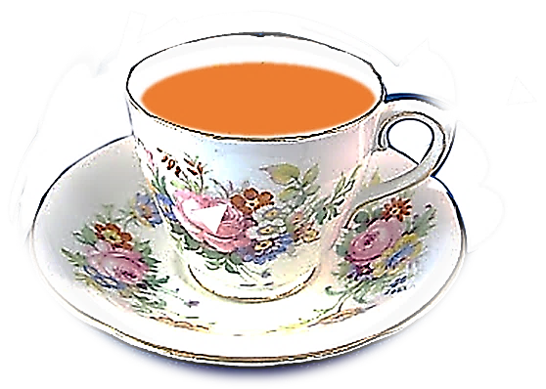

TEA
COFFEE

Slide 18
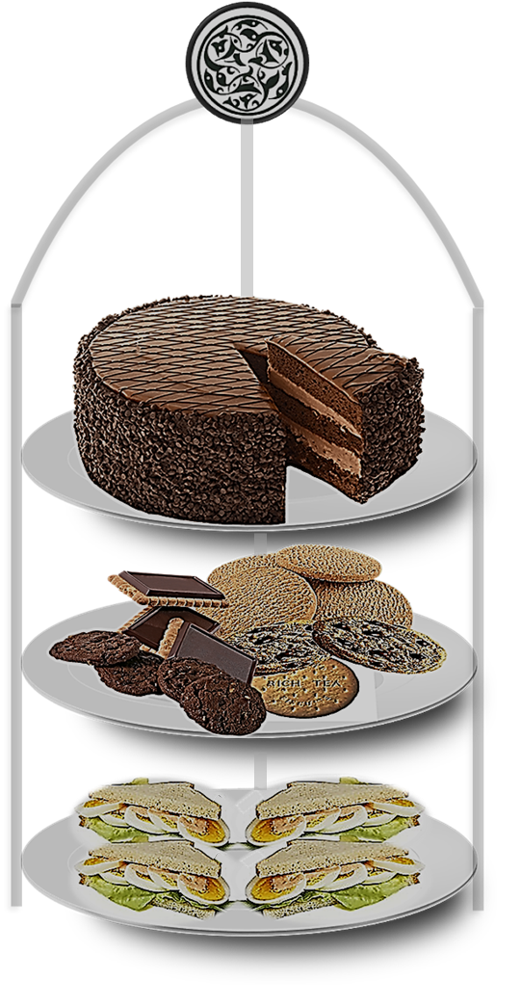
CHOCOLATE CAKE
BISCUITS
SANDWICHES

Slide 19

I LIKE
I WOULD LIKE
I PREFER
I WOULD RATHER
I WANT

Slide 20
LATER IN THE RESTAURANT

Slide 21
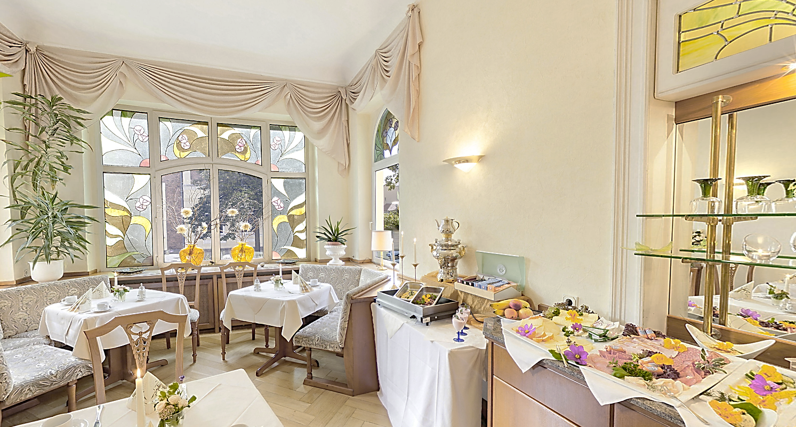
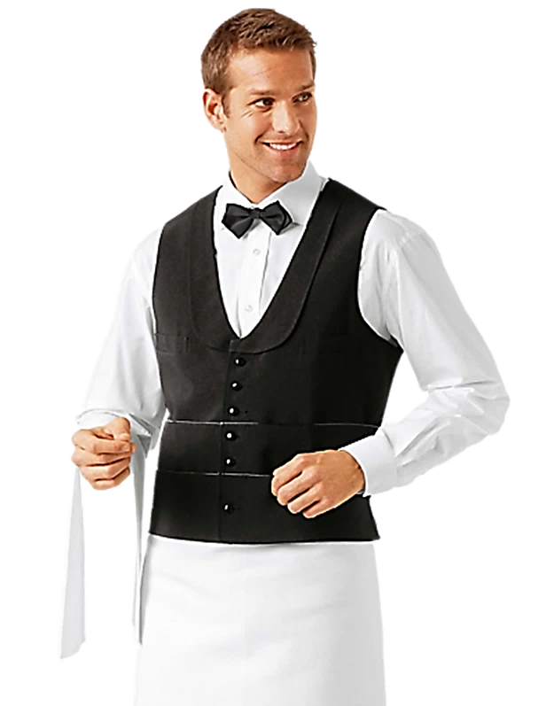
LATER IN THE RESTAURANT

Slide 22
LATER IN THE RESTAURANT

Slide 23




AFTER DINNER IN THE BAR

Slide 24
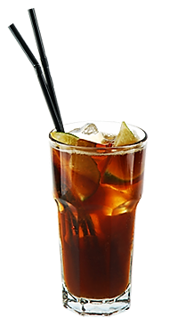

AFTER DINNER IN THE BAR

Slide 25
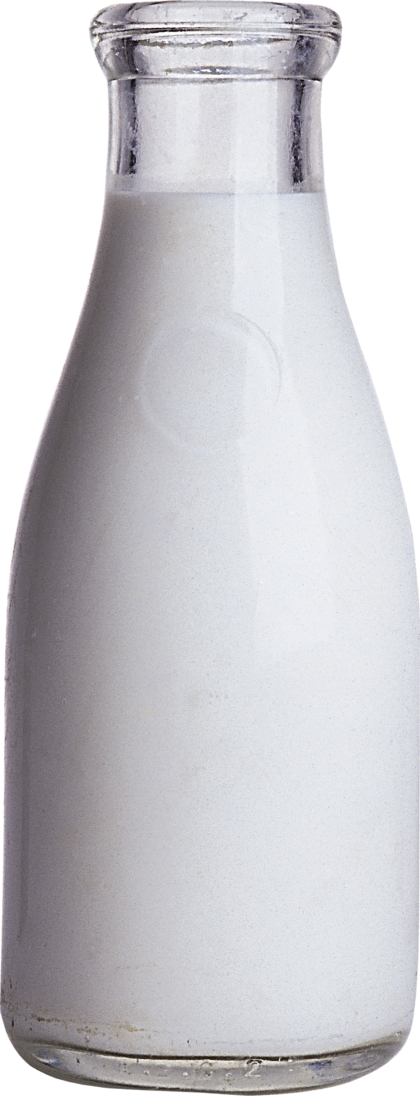
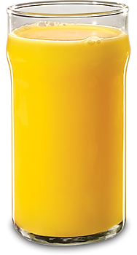
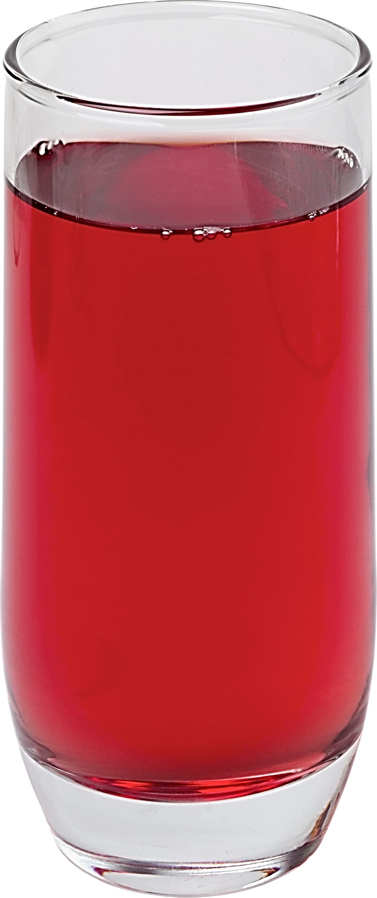

Slide 26
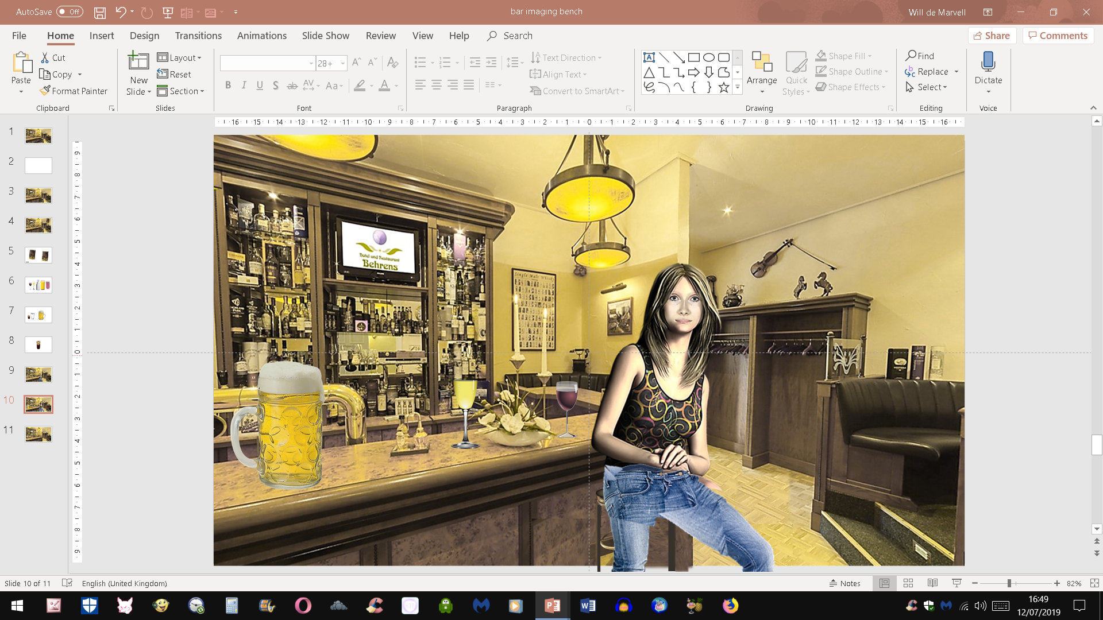

Slide 27
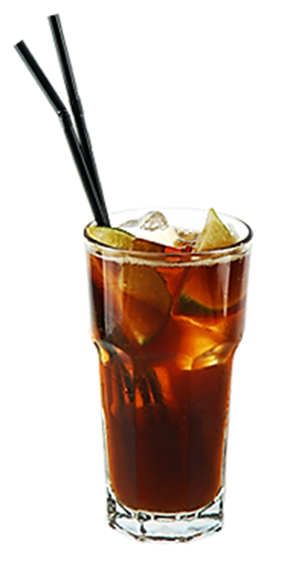
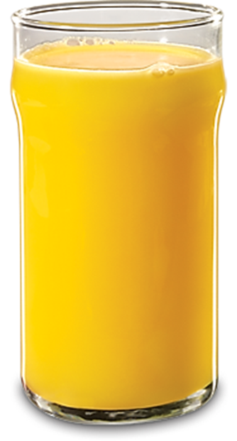
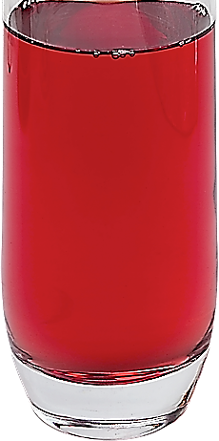

Slide 29
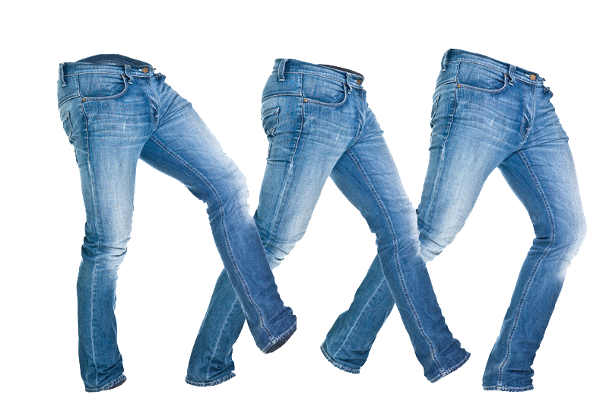

Slide 32

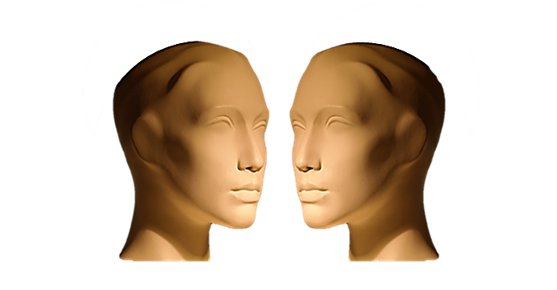


TYPICAL DIALOGUE
JUST LISTEN...

Slide 33
AFTER DINNER IN THE BAR

Slide 34
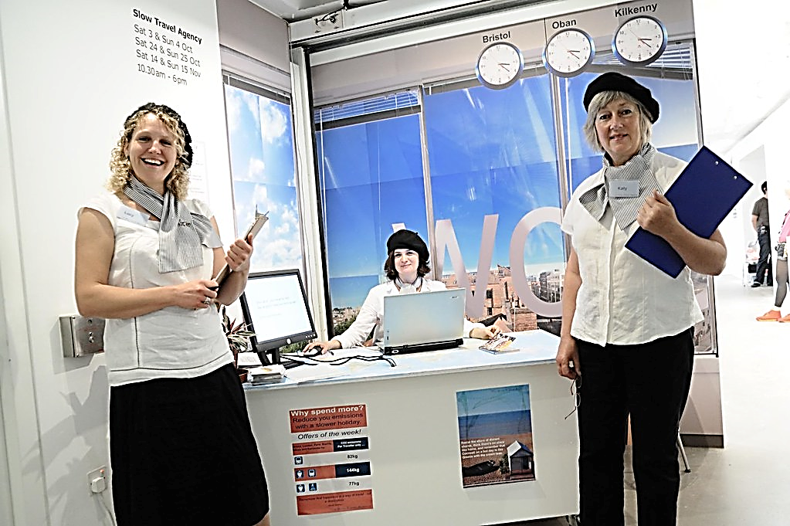
NEXT DAY AT THE TRAVEL AGENCY

Slide 35
WHERE WOULD YOU LIKE TO TRAVEL?

Slide 36
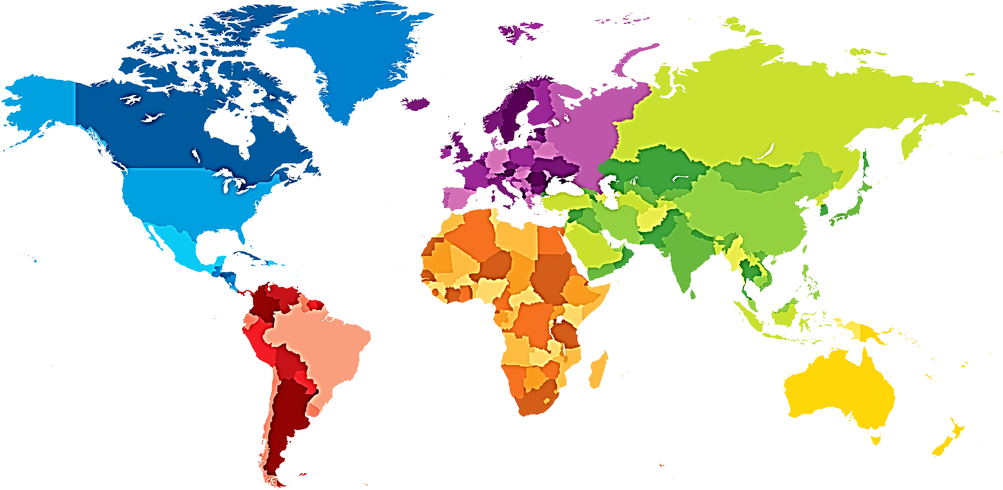
WHERE WOULD YOU LIKE TO TRAVEL?
WOULD YOU LIKE TO GO TO CHINA?
WOULD YOU LIKE TO GO TO EUROPE?
WOULD YOU LIKE TO GO TO NORTH AMERICA?
WOULD YOU LIKE TO GO TO INDIA?
WOULD YOU LIKE TO GO TO SOUTH AMERICA?
WOULD YOU LIKE TO GO TO AUSTRALIA?
WOULD YOU LIKE TO GO TO AFRICA?

Slide 39
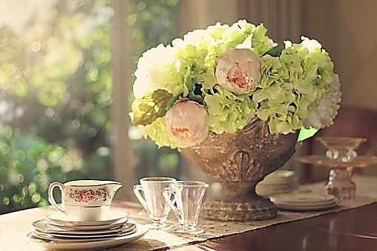

Slide 40
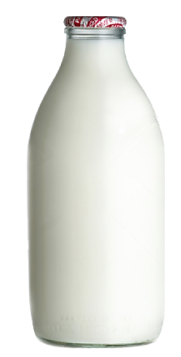
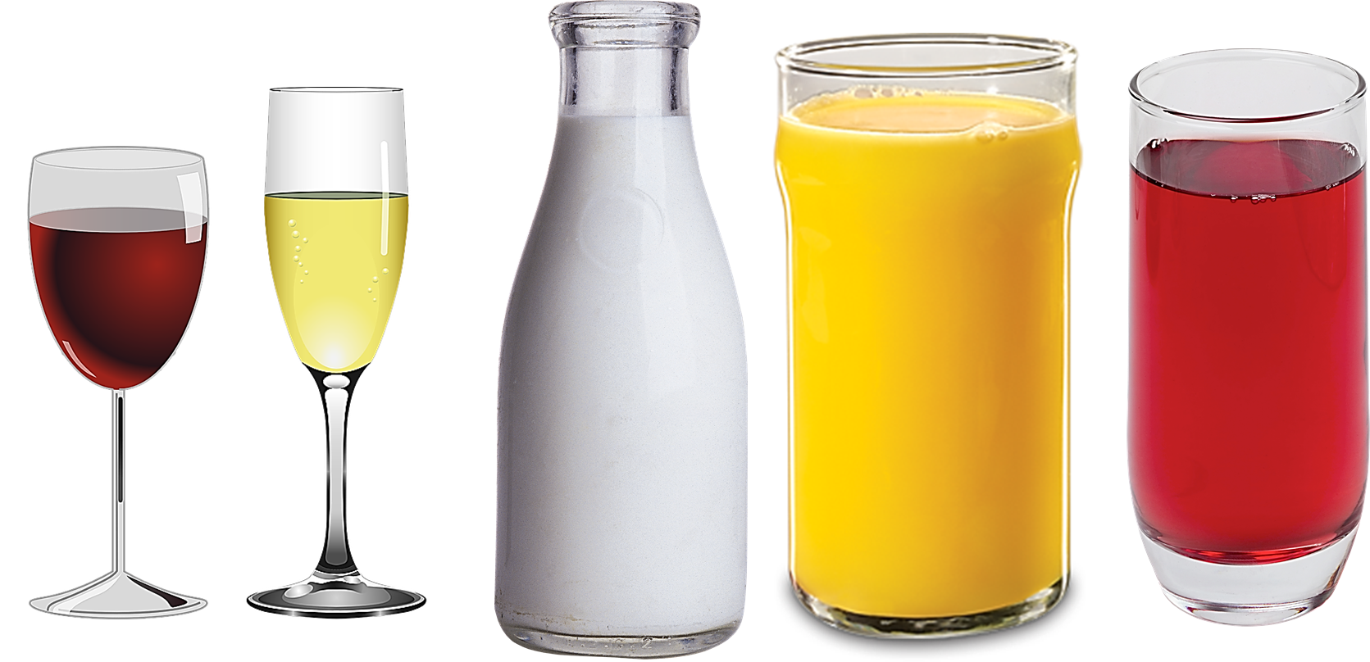

Slide 41


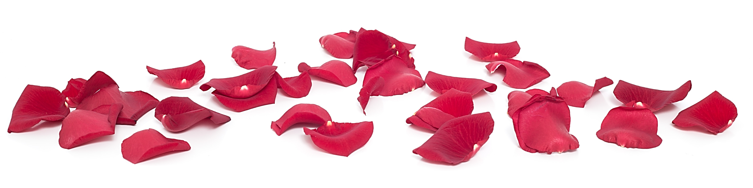
PREFERENCES!

Slide 42
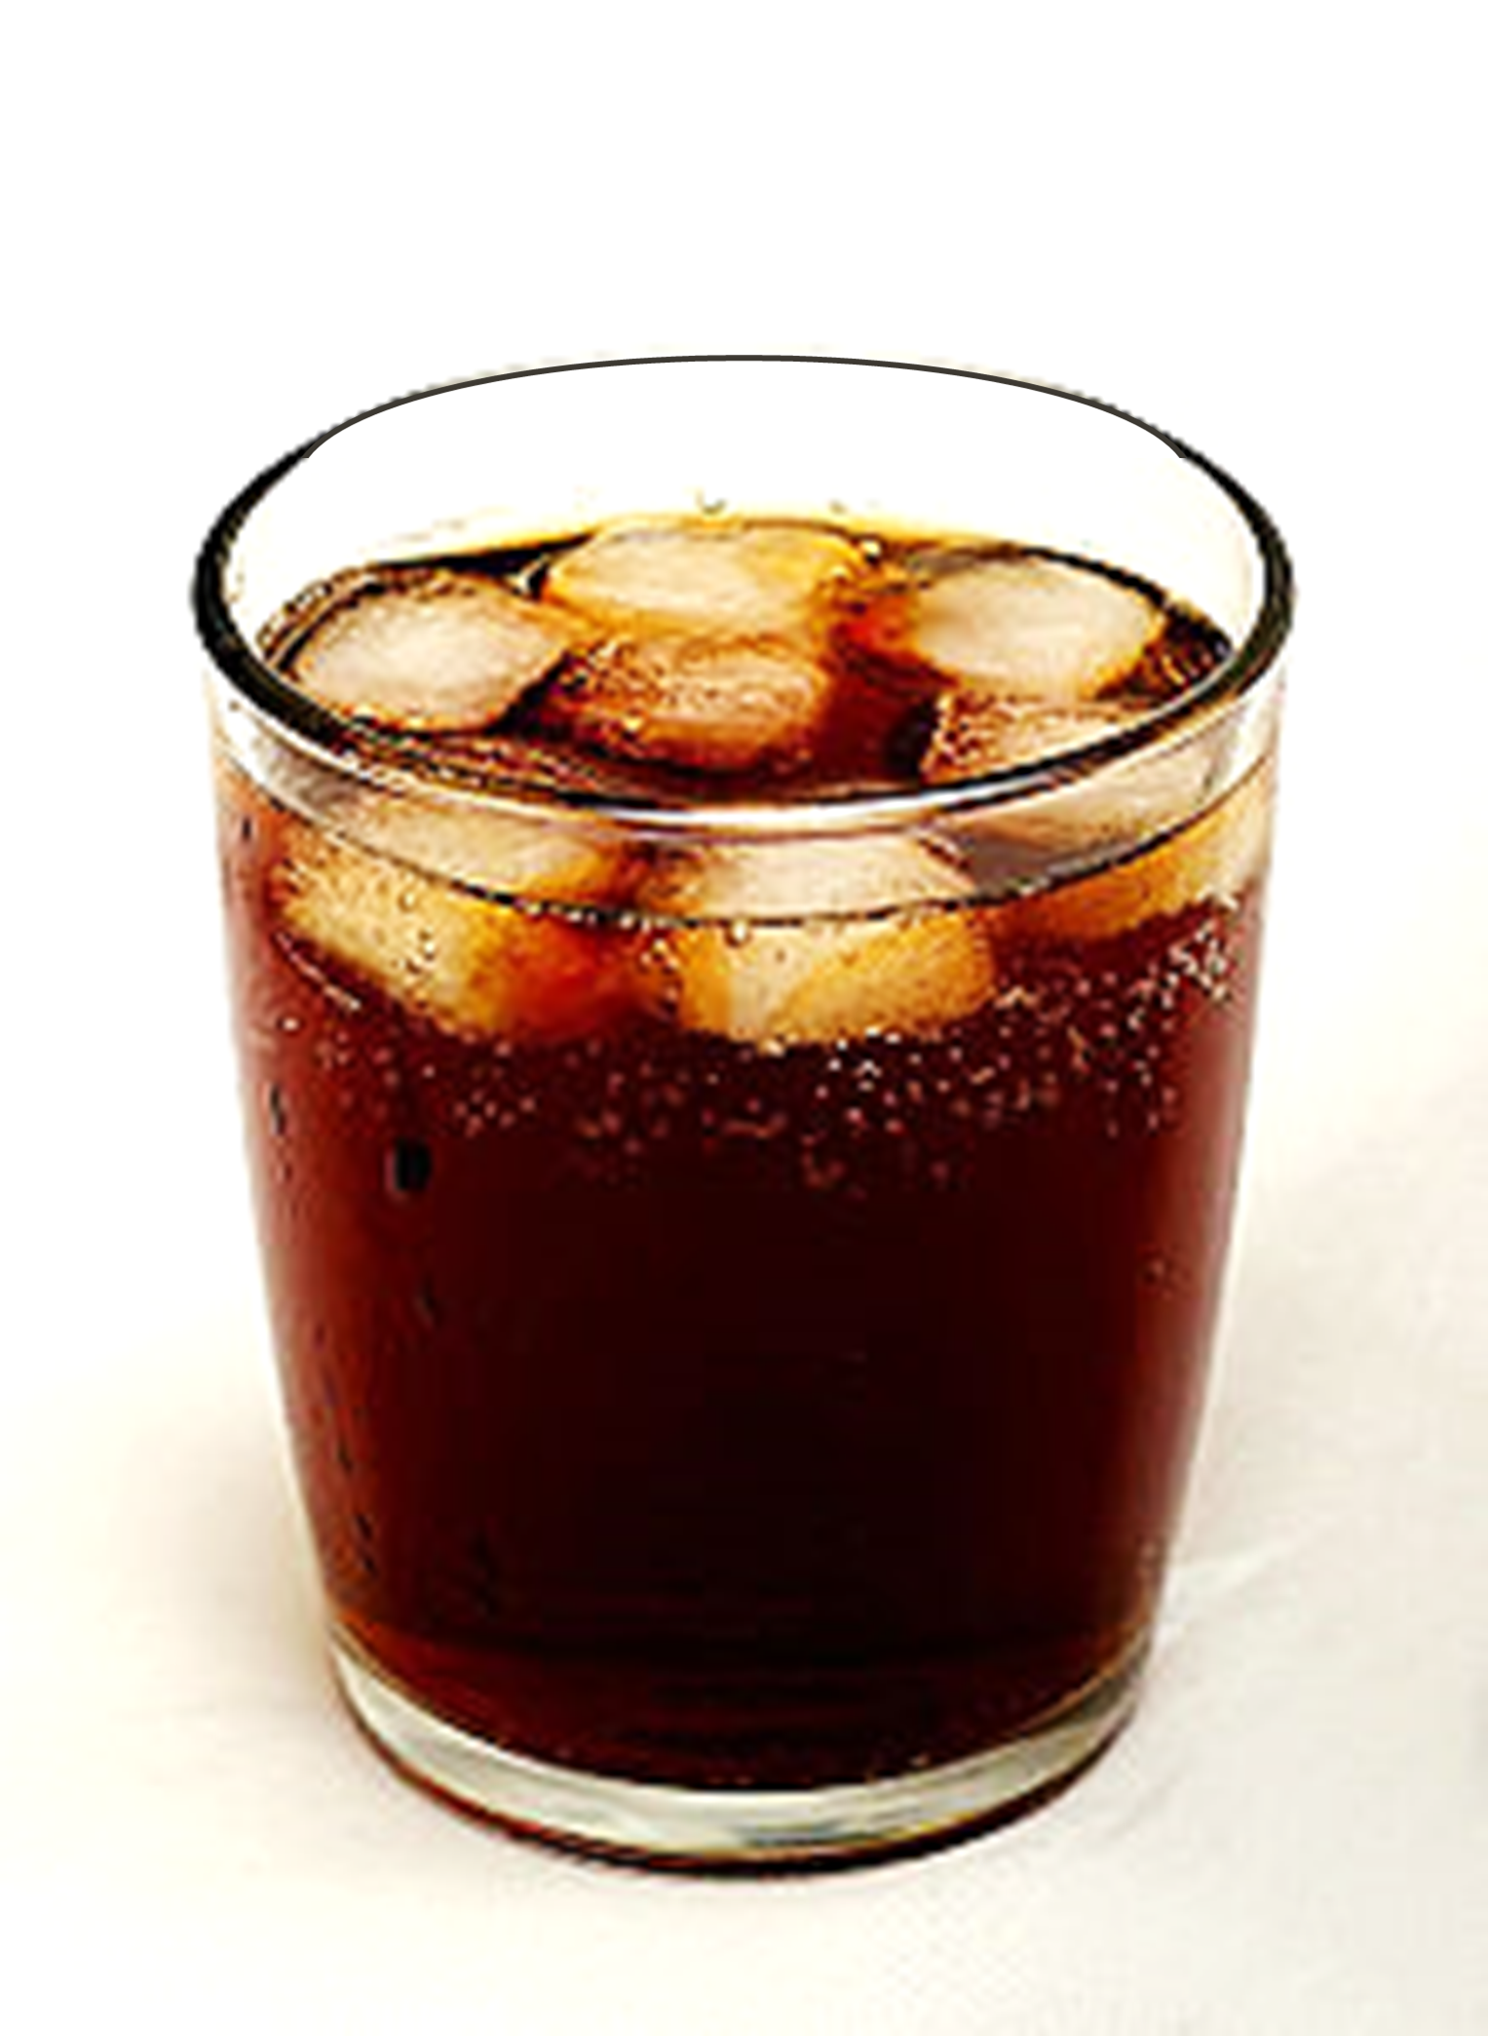

Slide 43
CONCEPTS

Slide 44
CONCEPTS

Slide 45



Slide 46



PREFERENCES!
CONTEXTS

