Slide 1

LIKE
PREFER
WOULD RATHER
WOULD PREFER
WANT
WOULD LIKE

Slide 2







Slide 3
PREFER
LIKE

Slide 4
PREFER
LIKE

Slide 5

LIKE
WOULD LIKE

Slide 6





Slide 8
TALKING HEAD

Slide 9


CONCEPTS

Slide 10
CONTEXTS

Slide 11

LIKE

Slide 12
WOULD
LIKE

Slide 13
WOULD
PREFER

Slide 14
WOULD
RATHER

Slide 15
PREFER

Slide 16
WOULD
PREFER

Slide 17
WOULD
RATHER

Slide 19


PREFERENCES!

Slide 20
PREFERENCES!

Slide 21


PREFERENCES!

Slide 22
PREFERENCES!

Slide 23
PREFERENCES!

Slide 24






WOULD RATHER

Slide 25

PREFERENCES!

Slide 26


Slide 28
PREFERENCES!
I LIKE
I WOULD LIKE
I PREFER
I WOULD RATHER
I WANT
GENERAL
SPECIFIC
X
X
DIRECT

Slide 29
PREFERENCES!
DO YOU LIKE..?
WOULD YOU LIKE..?
DO YOU PREFER..?
WOULD YOU RATHER..?
DO YOU WANT..?
GENERAL
SPECIFIC
X
X
DIRECT

Slide 30
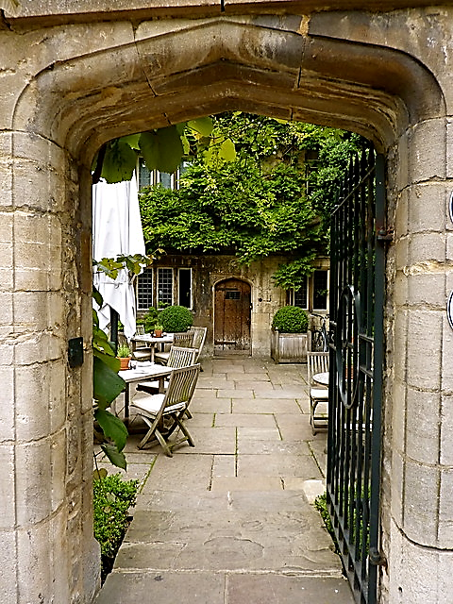
TEATIME IN OXFORD
WHAT
WOULD YOU LIKE?

Slide 31
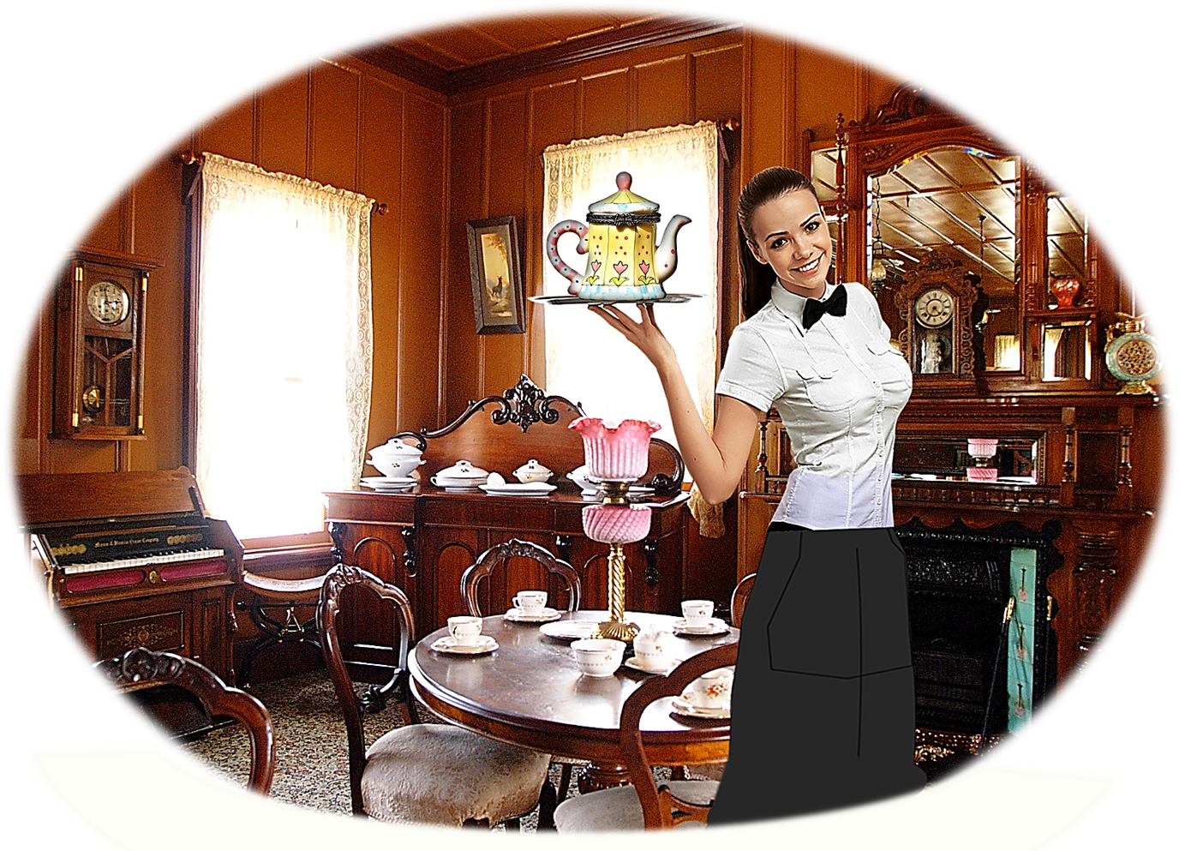
TEATIME IN OXFORD

Slide 32

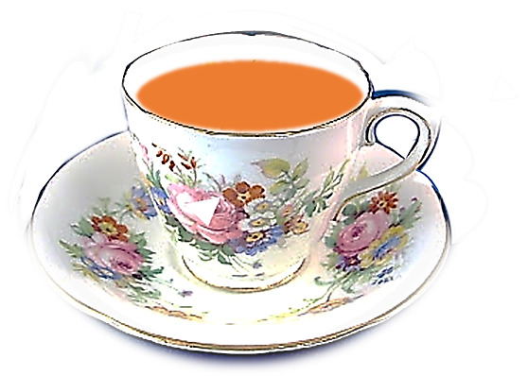

TEA
COFFEE

Slide 33
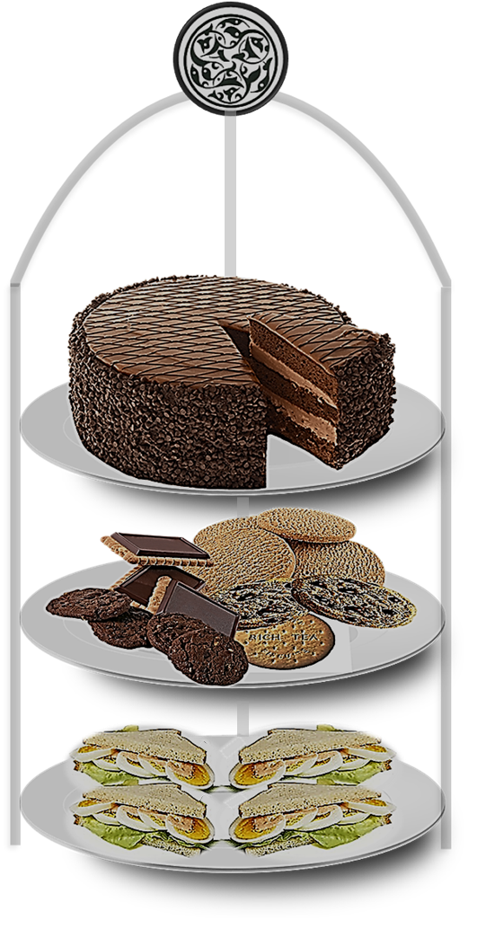
CHOCOLATE CAKE
BISCUITS
SANDWICHES

Slide 34

I LIKE
I WOULD LIKE
I PREFER
I WOULD RATHER
I WANT

Slide 35
LATER IN THE RESTAURANT

Slide 36
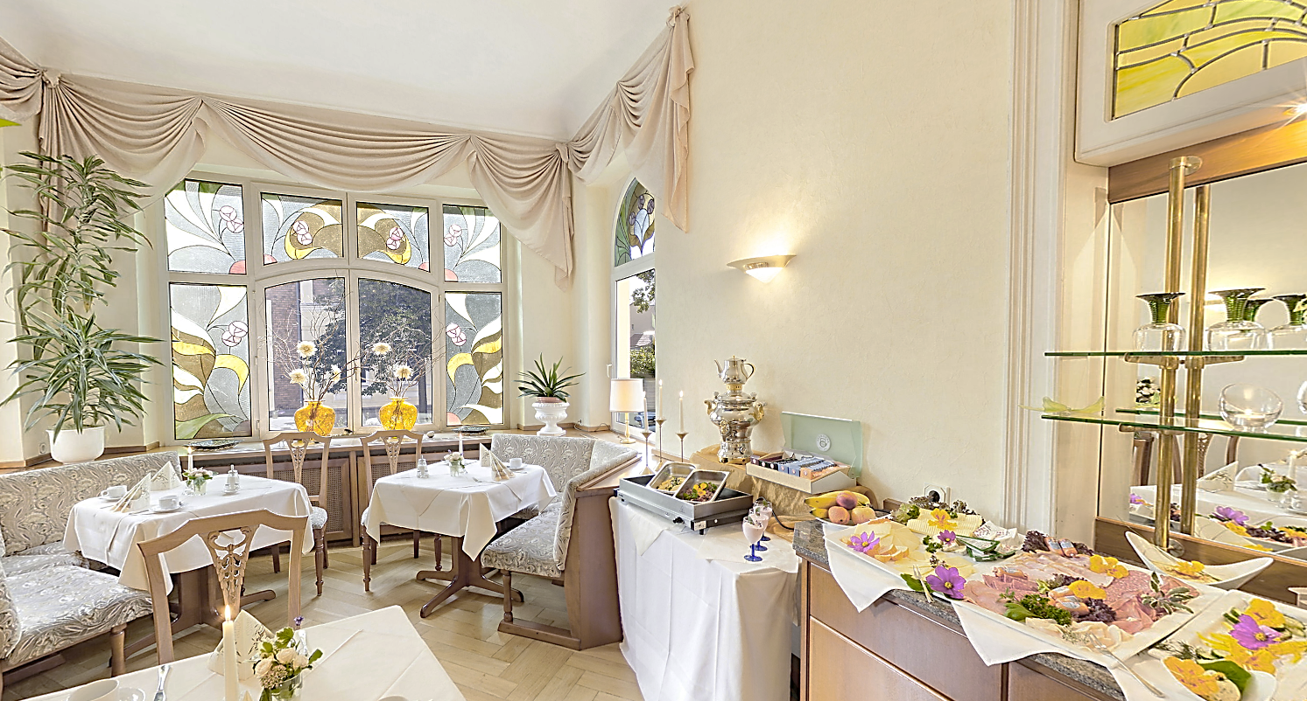
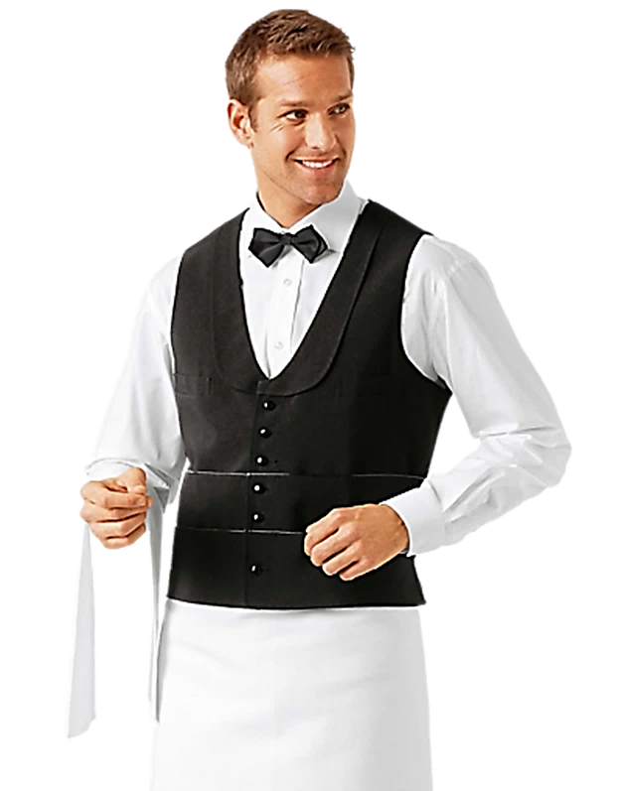
LATER IN THE RESTAURANT

Slide 37




AFTER DINNER IN THE BAR

Slide 38
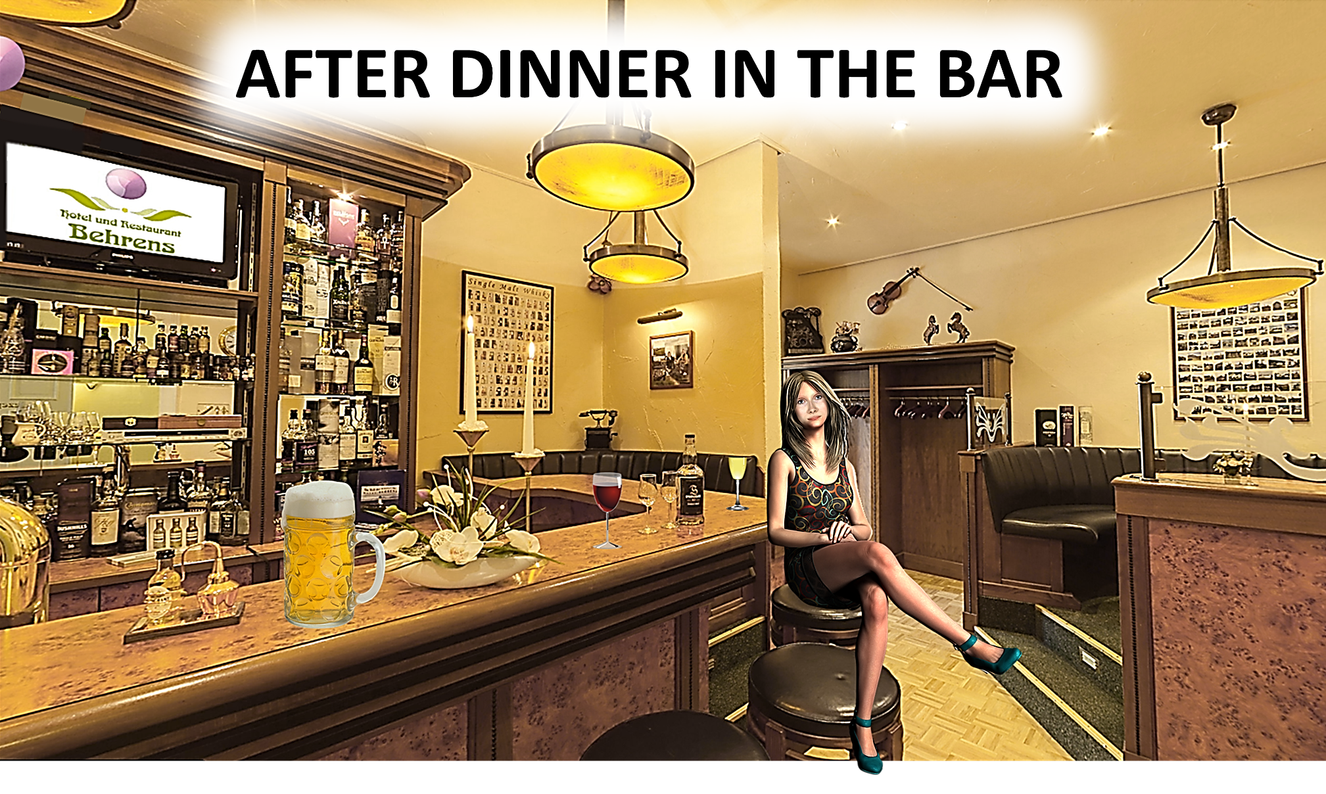

Slide 39
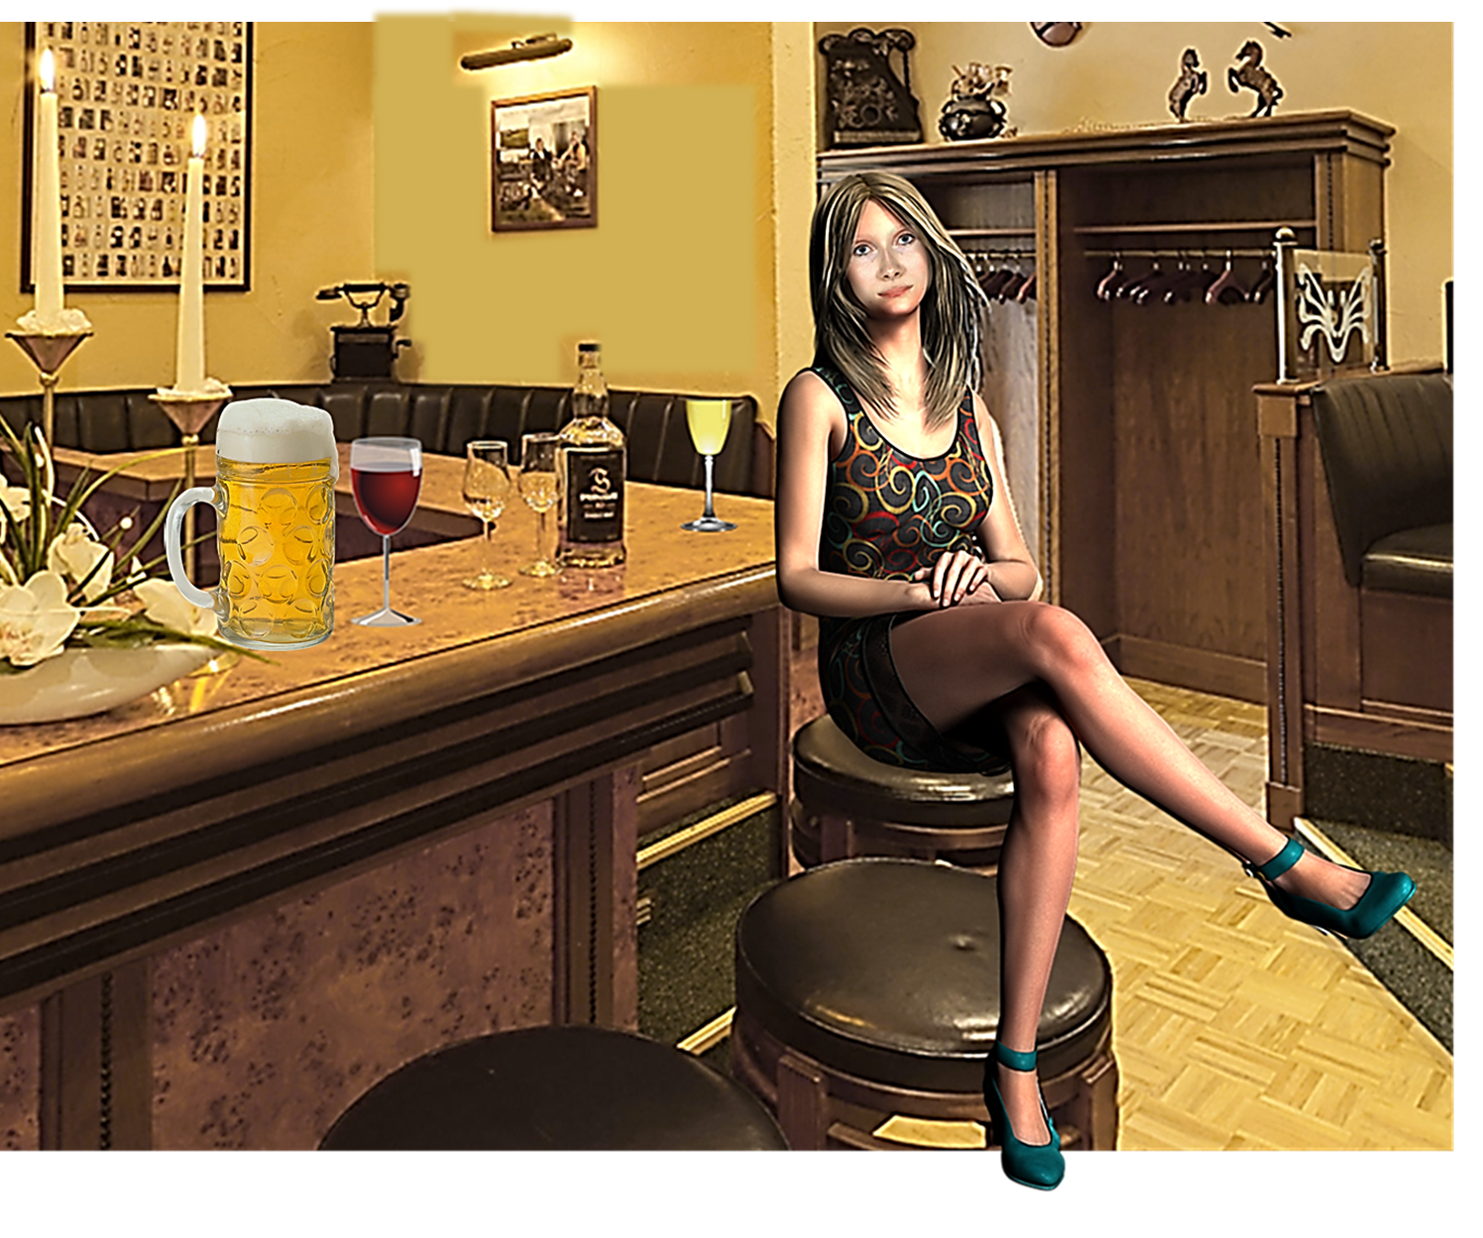

Slide 40
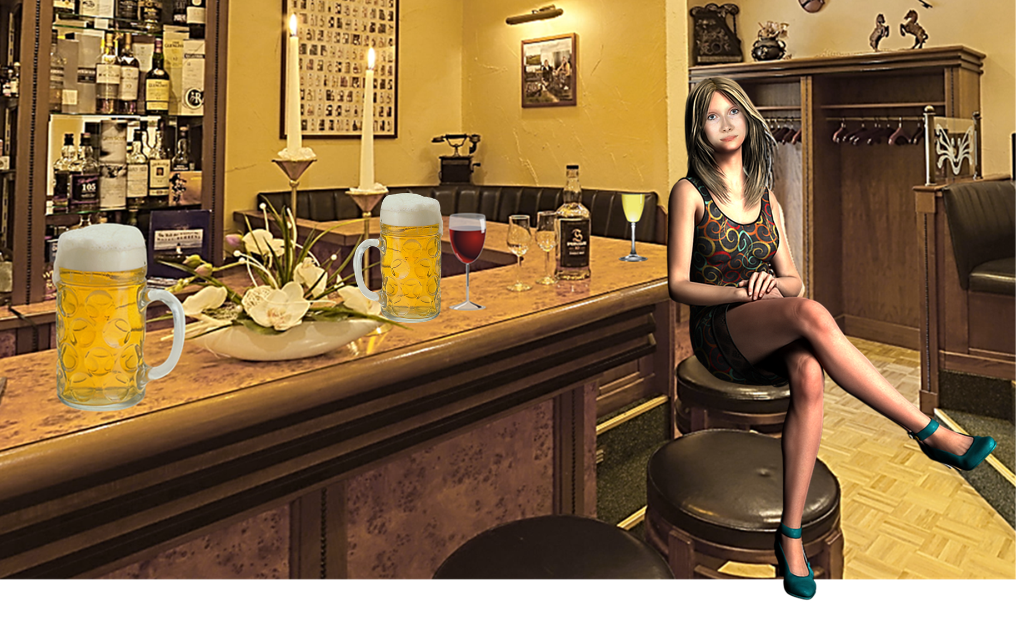

Slide 41


Slide 45

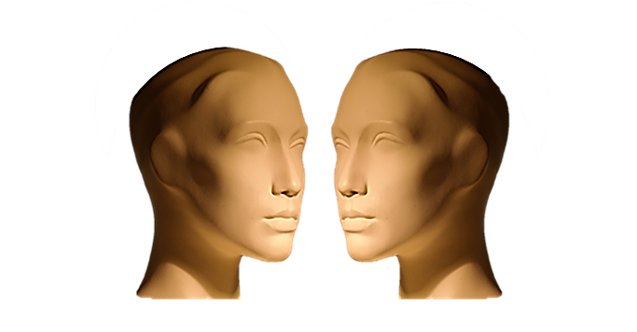


TYPICAL DIALOGUE
JUST LISTEN...

Slide 46


Slide 47
AFTER DINNER IN THE BAR

Slide 48
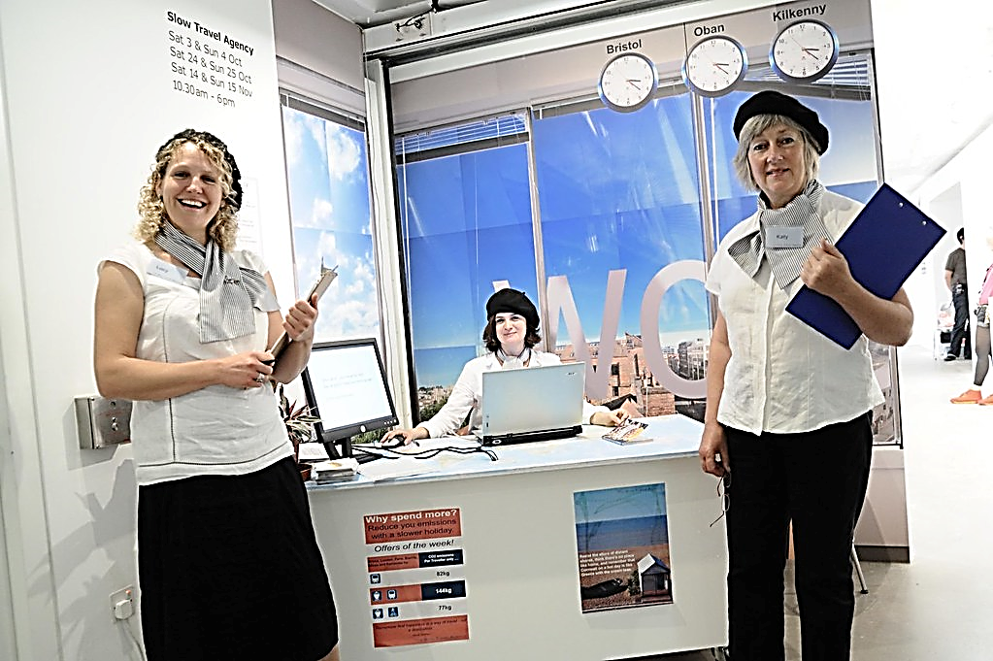
NEXT DAY AT THE TRAVEL AGENCY

Slide 49
WHERE WOULD YOU LIKE TO TRAVEL?

Slide 50
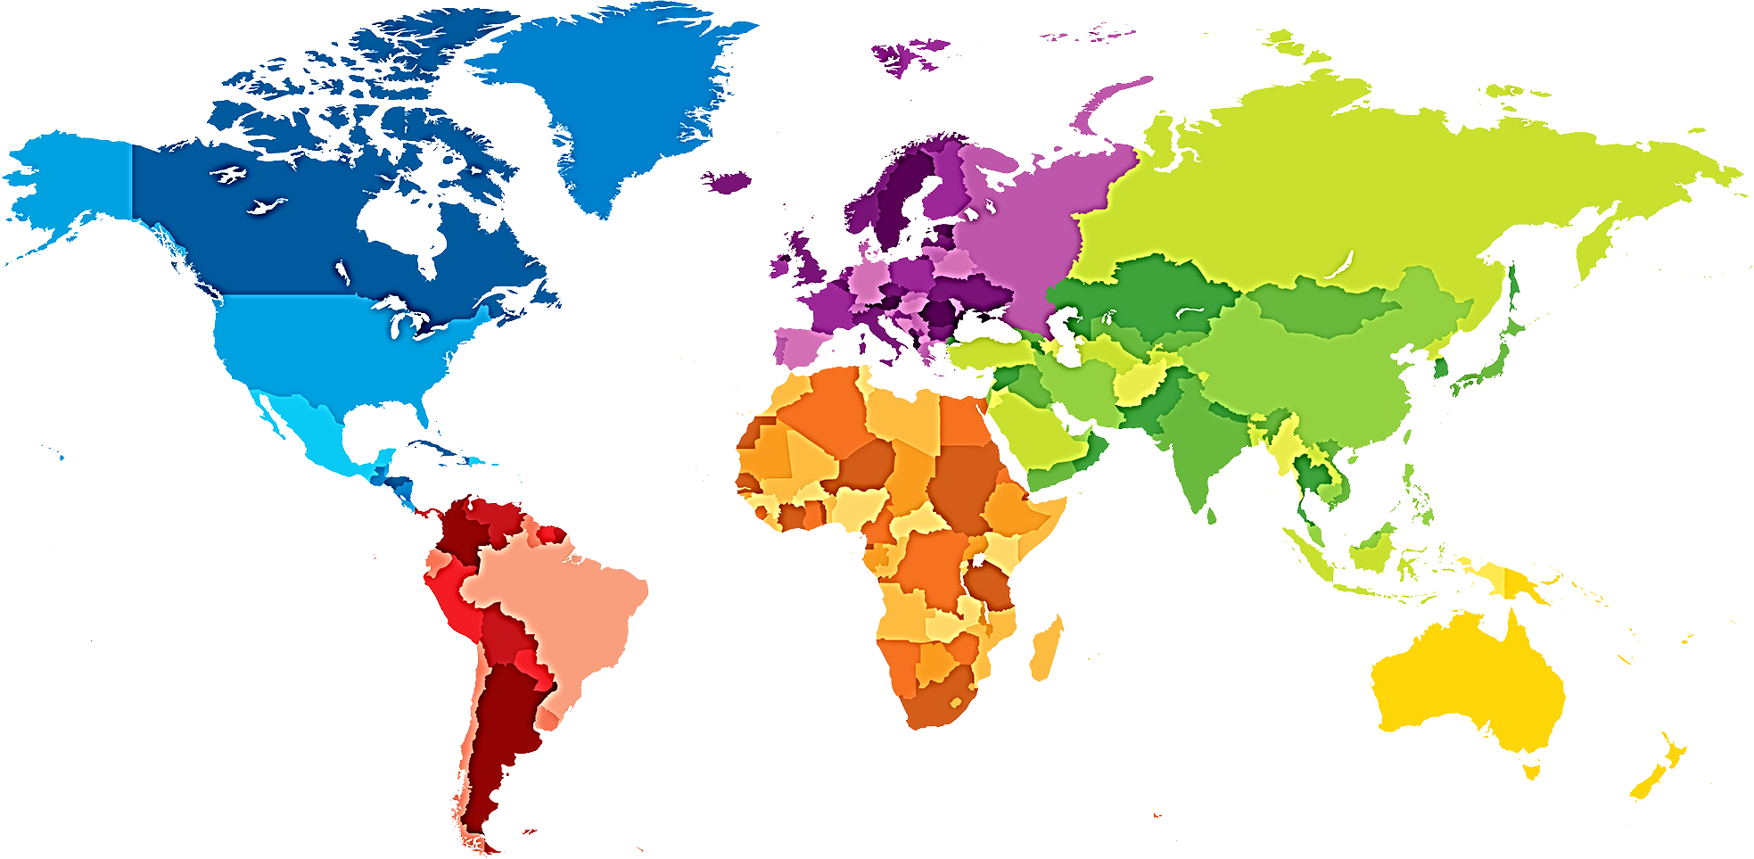
WOULD YOU LIKE TO GO TO EUROPE?
WOULD YOU LIKE TO GO TO NORTH AMERICA?
WOULD YOU LIKE TO GO TO CHINA?
WOULD YOU LIKE TO GO TO INDIA?
WOULD YOU LIKE TO GO TO SOUTH AMERICA?
WOULD YOU LIKE TO GO TO AUSTRALIA?
WOULD YOU LIKE TO GO TO AFRICA?

Slide 53
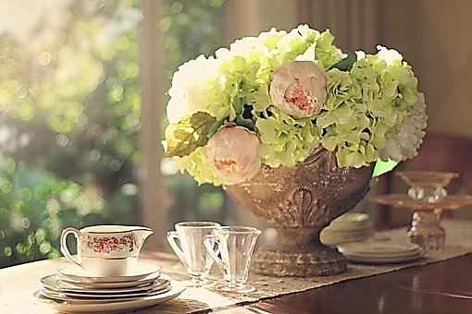

Slide 54
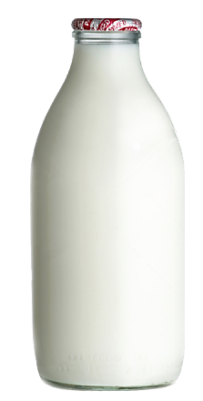
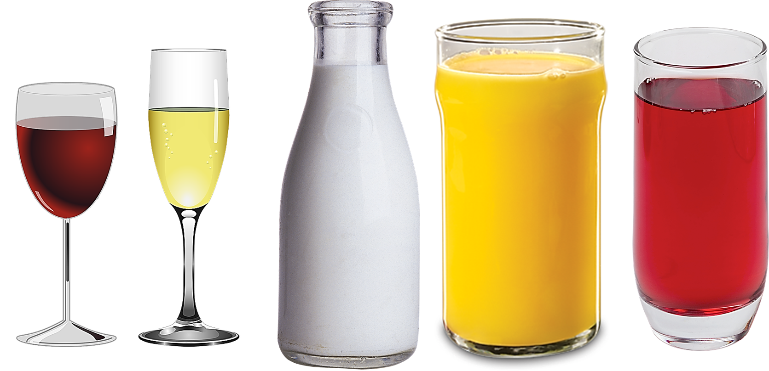

Slide 55



PREFERENCES!

Slide 56
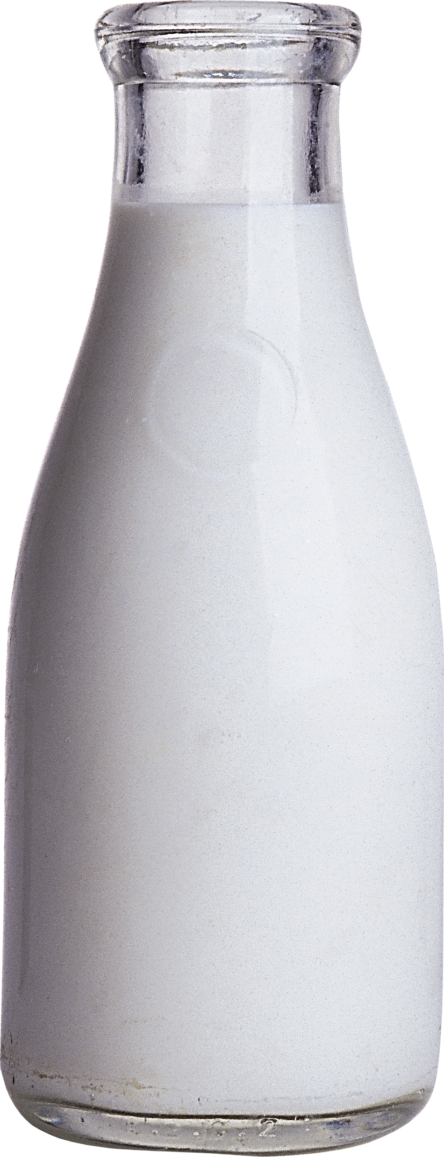

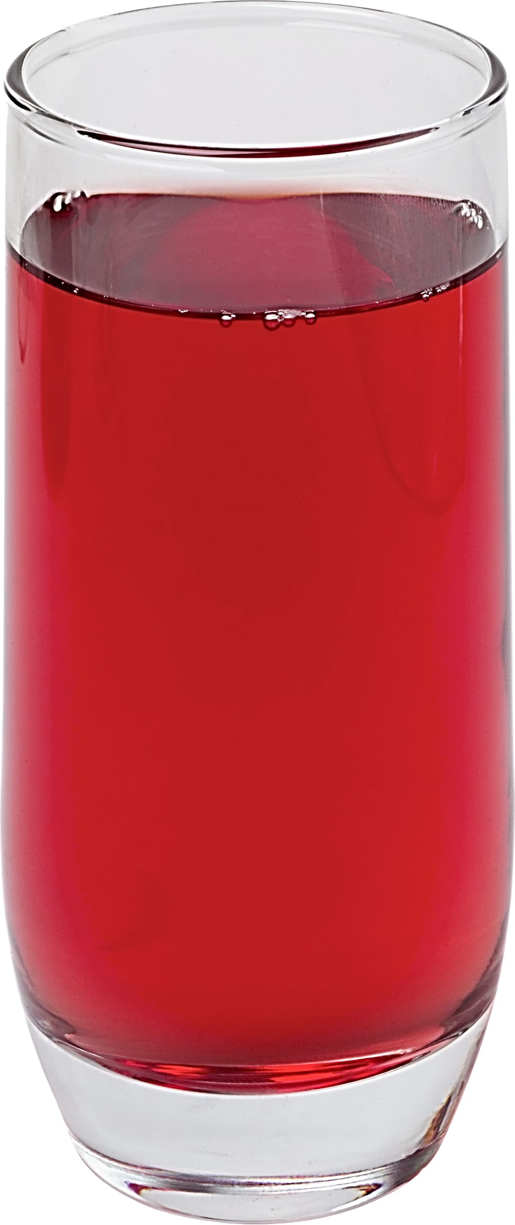

Slide 57
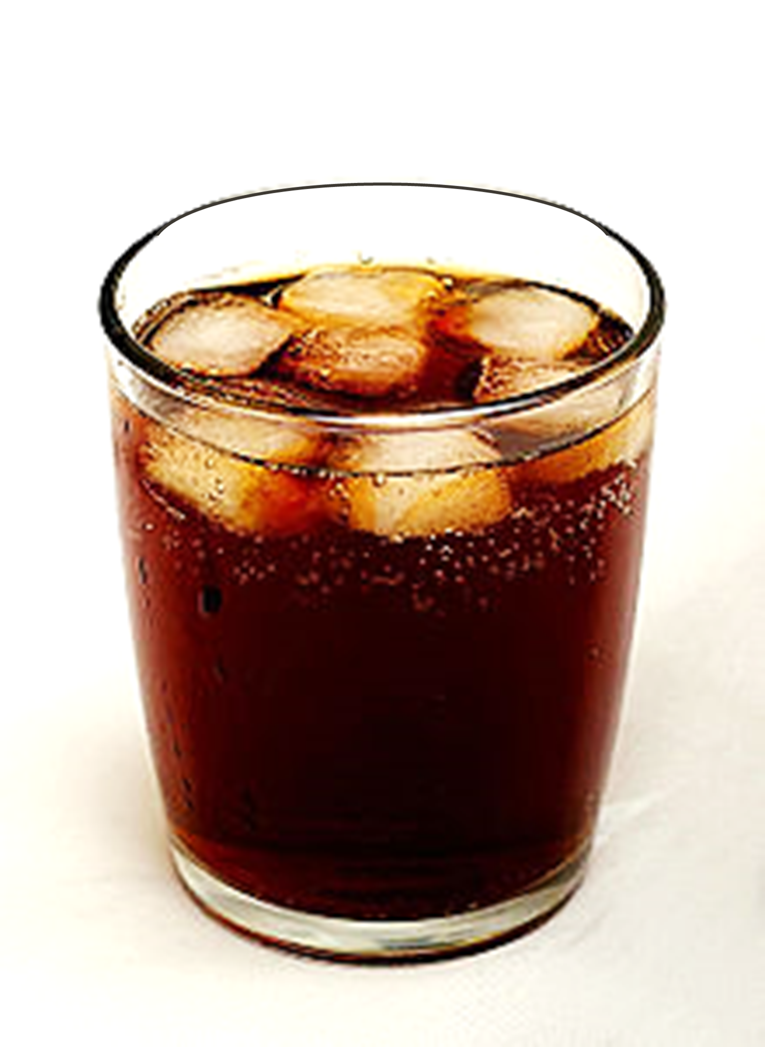

Slide 58
CONCEPTS

Slide 59
CONCEPTS

Slide 60



Slide 61



PREFERENCES!
CONTEXTS

