Slide 1
PREFERENCES
IN LIFE!

Slide 2
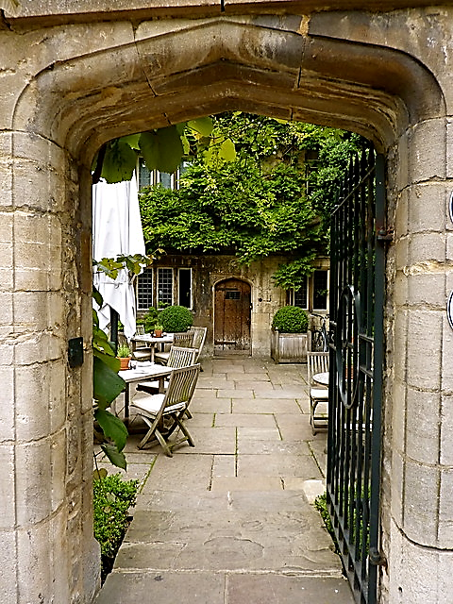
TEATIME IN OXFORD
WHAT
WOULD YOU LIKE?

Slide 3
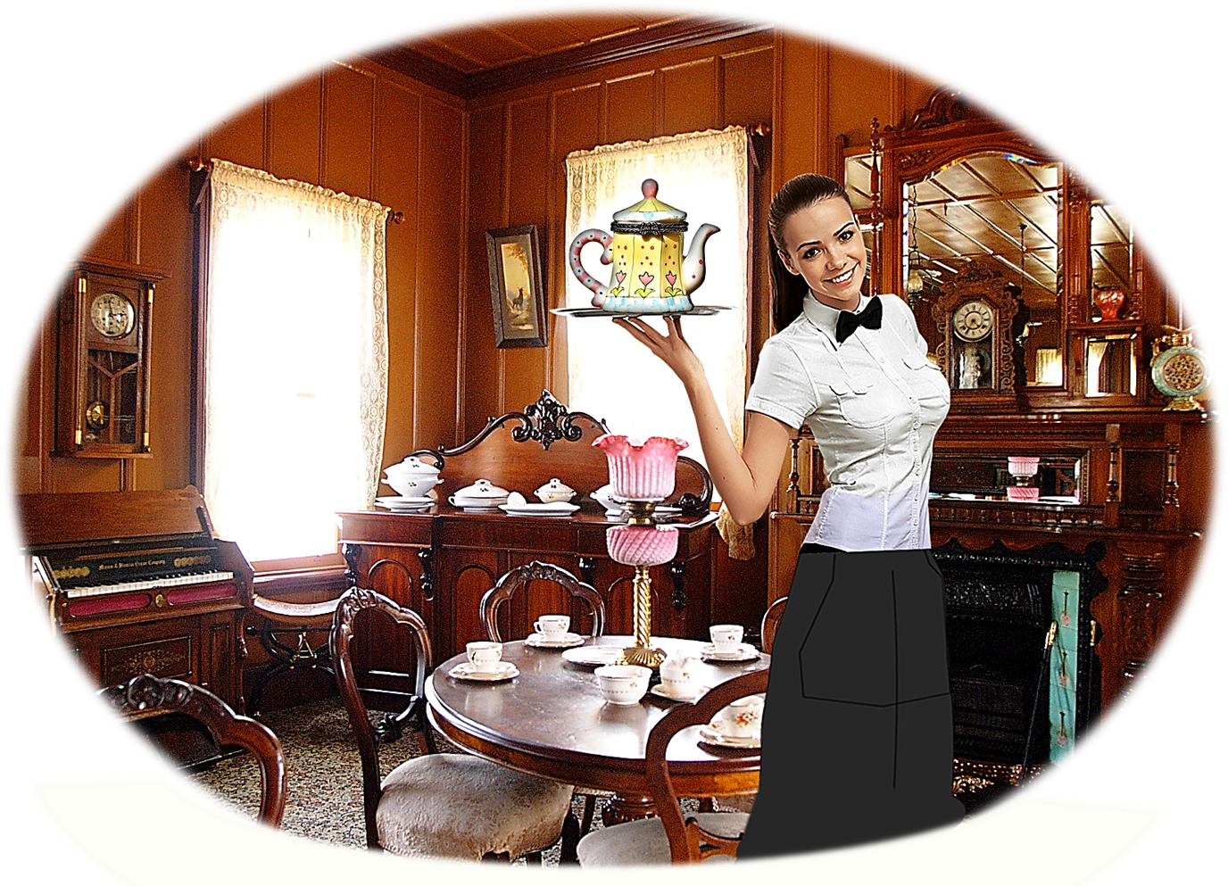
TEATIME IN OXFORD
WELCOME
TO
THE OLD TEA SHOP!

Slide 4

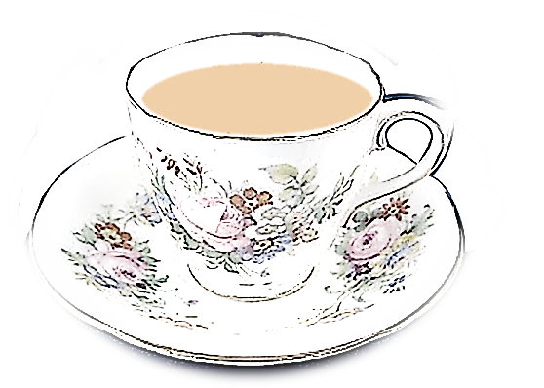
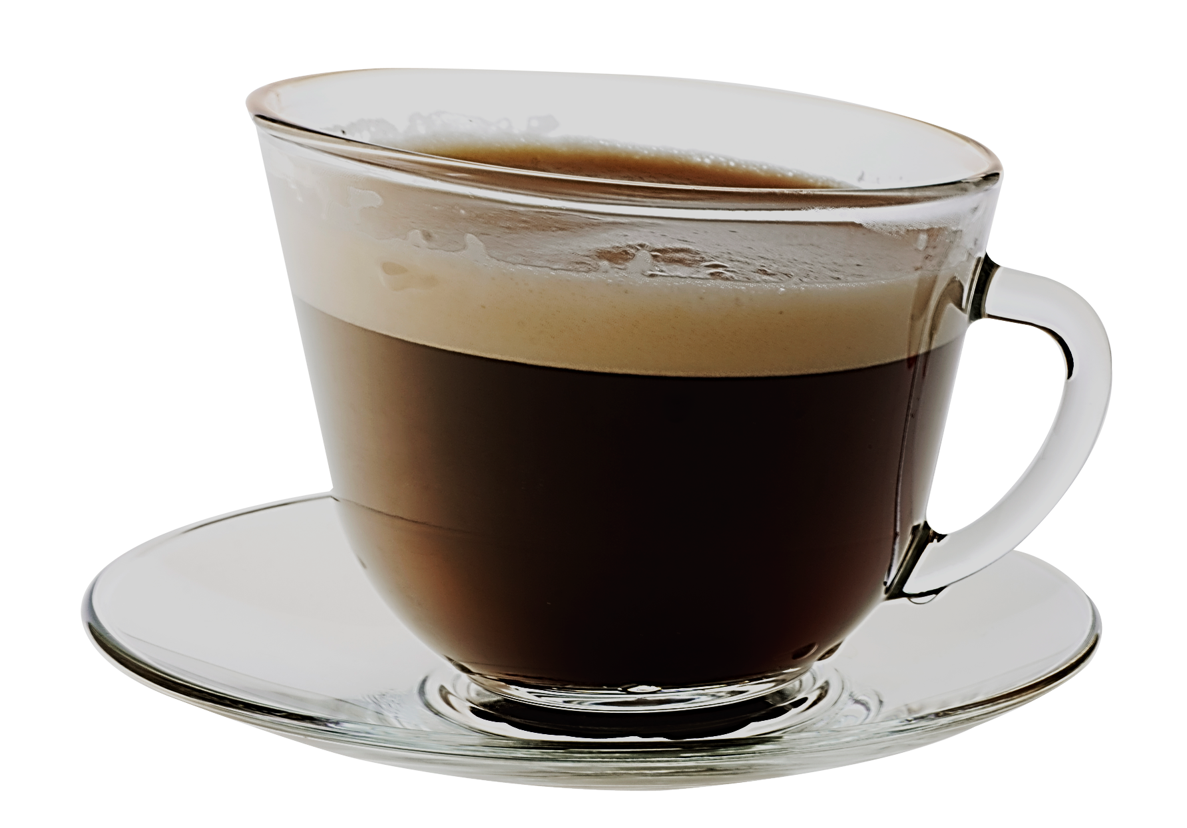
WOULD YOU LIKE
WOULD YOU PREFER
OR
TEA ?
COFFEE ?

Slide 5
WHAT DO
YOU LIKE?
CHOCOLATE CAKE ?
BISCUITS ?
SANDWICHES ?
HAMBURGERS ?

Slide 6
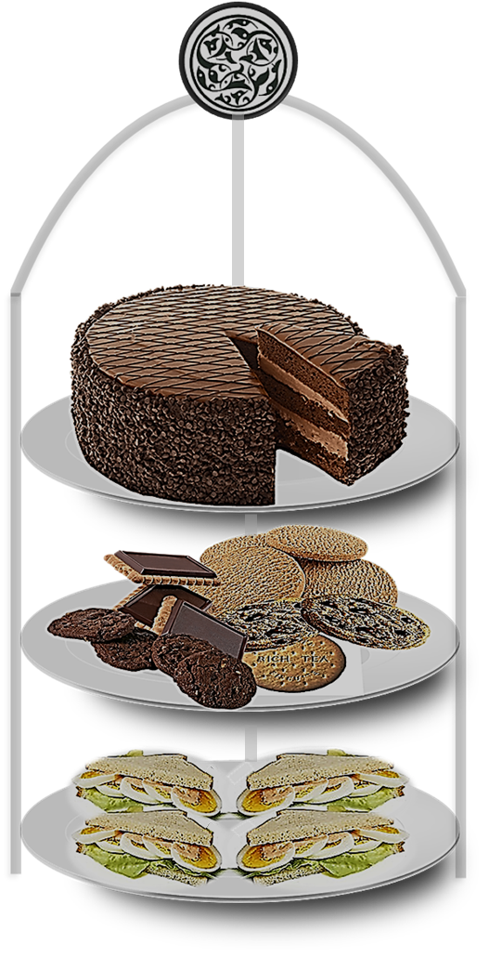


WHICH WOULD YOU LIKE?
CHOCOLATE CAKE
BISCUITS
SANDWICHES

Slide 7
WHICH WOULD YOU LIKE?
CHOCOLATE CAKE
BISCUITS
SANDWICHES

Slide 8
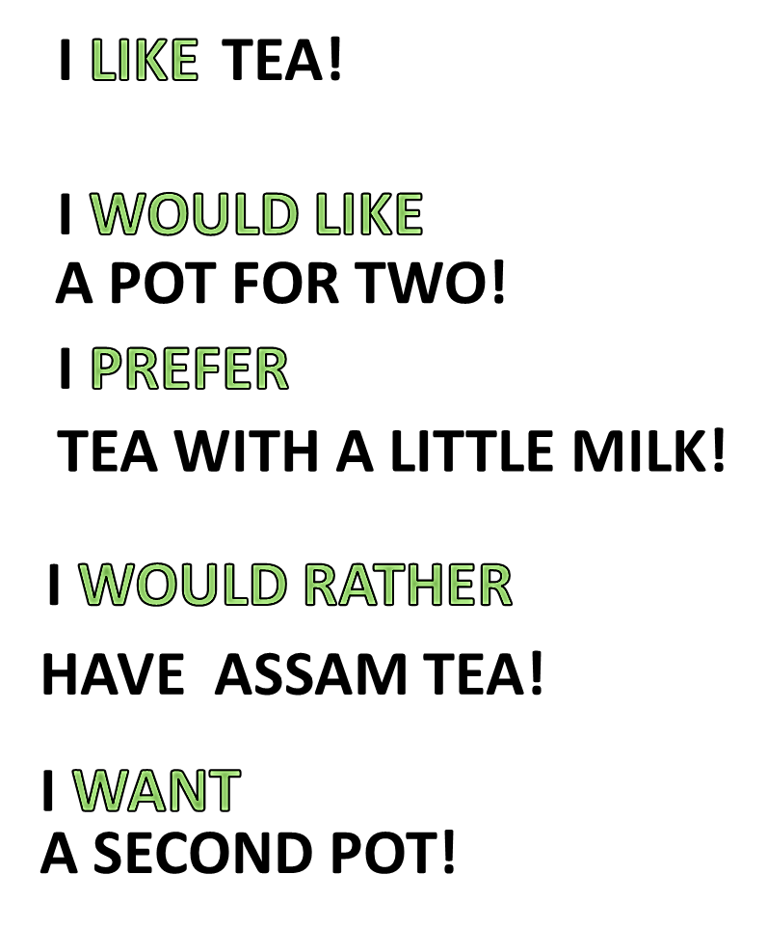
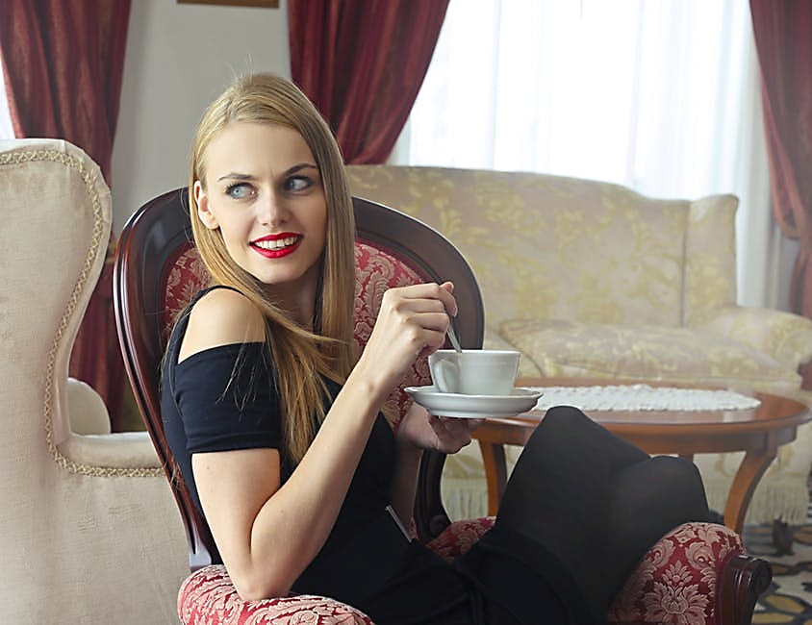
JENNY’S PREFERENCES

Slide 9
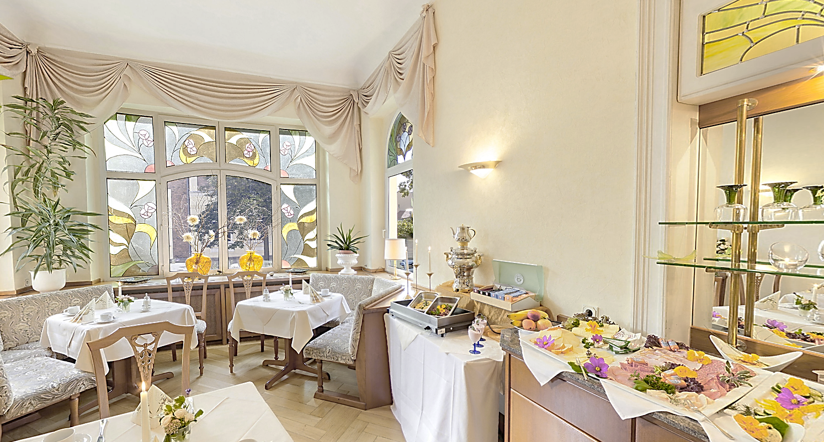
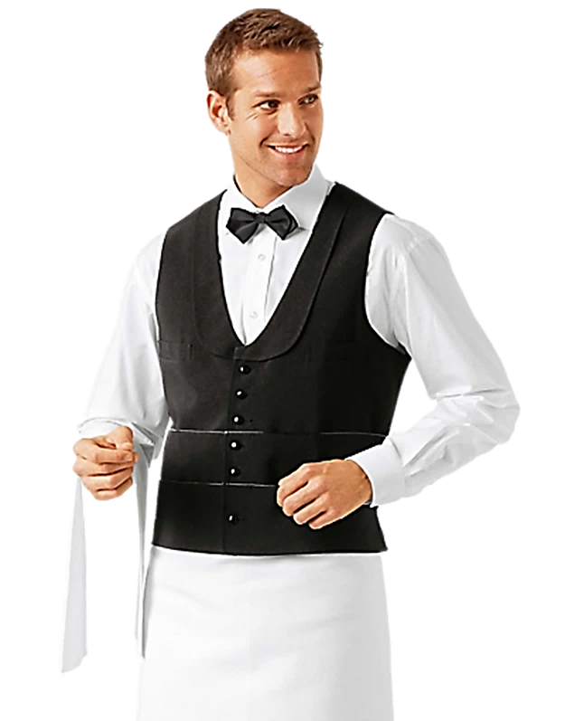
LATER IN THE RESTAURANT

Slide 10
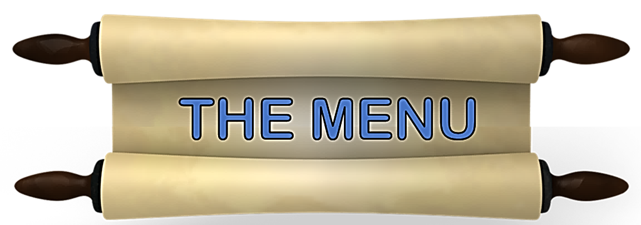
WHAT WOULD YOU LIKE?
HERE’S

Slide 11
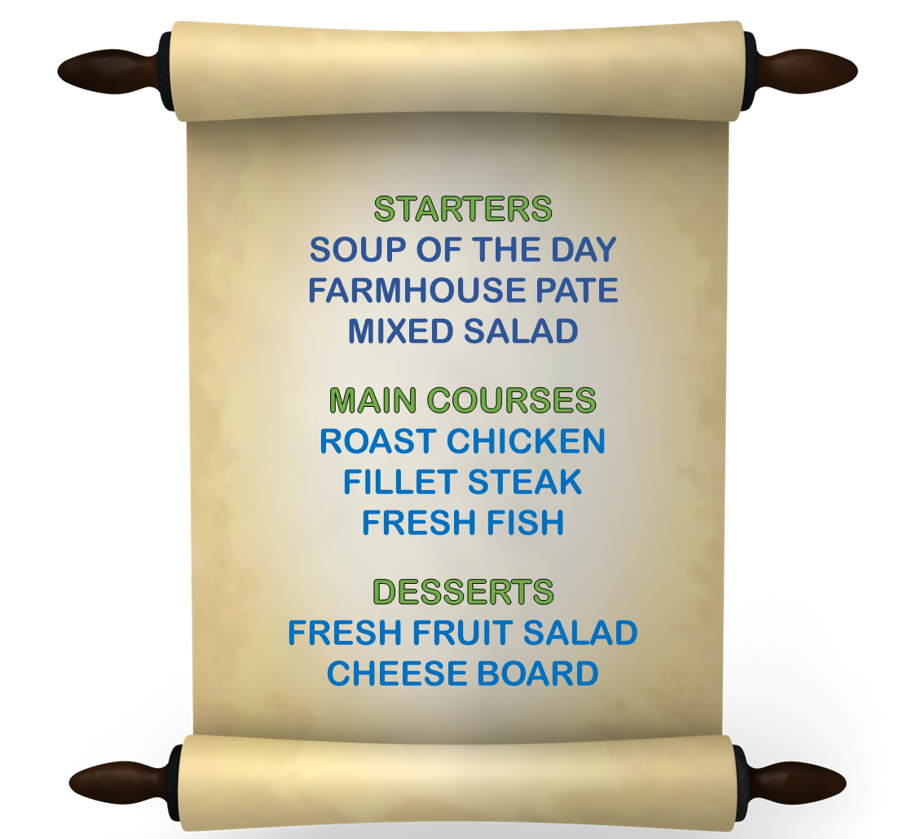
THE MENU
WOULD YOU LIKE A STARTER?
WHICH WOULD YOU LIKE
THE SOUP OR THE PATE?
THE SOUP PLEASE
FOR THE MAIN COURSE
WOULD YOU PREFER
STEAK OR FISH?
THE FISH CERTAINLY
FOR DESSERT
WOULD YOU LIKE
FRUIT SALAD?
I WOULD RATHER HAVE
THE CHEESE, PLEASE

Slide 12
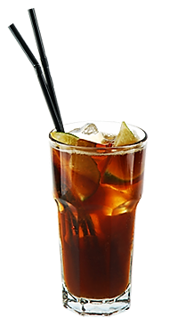
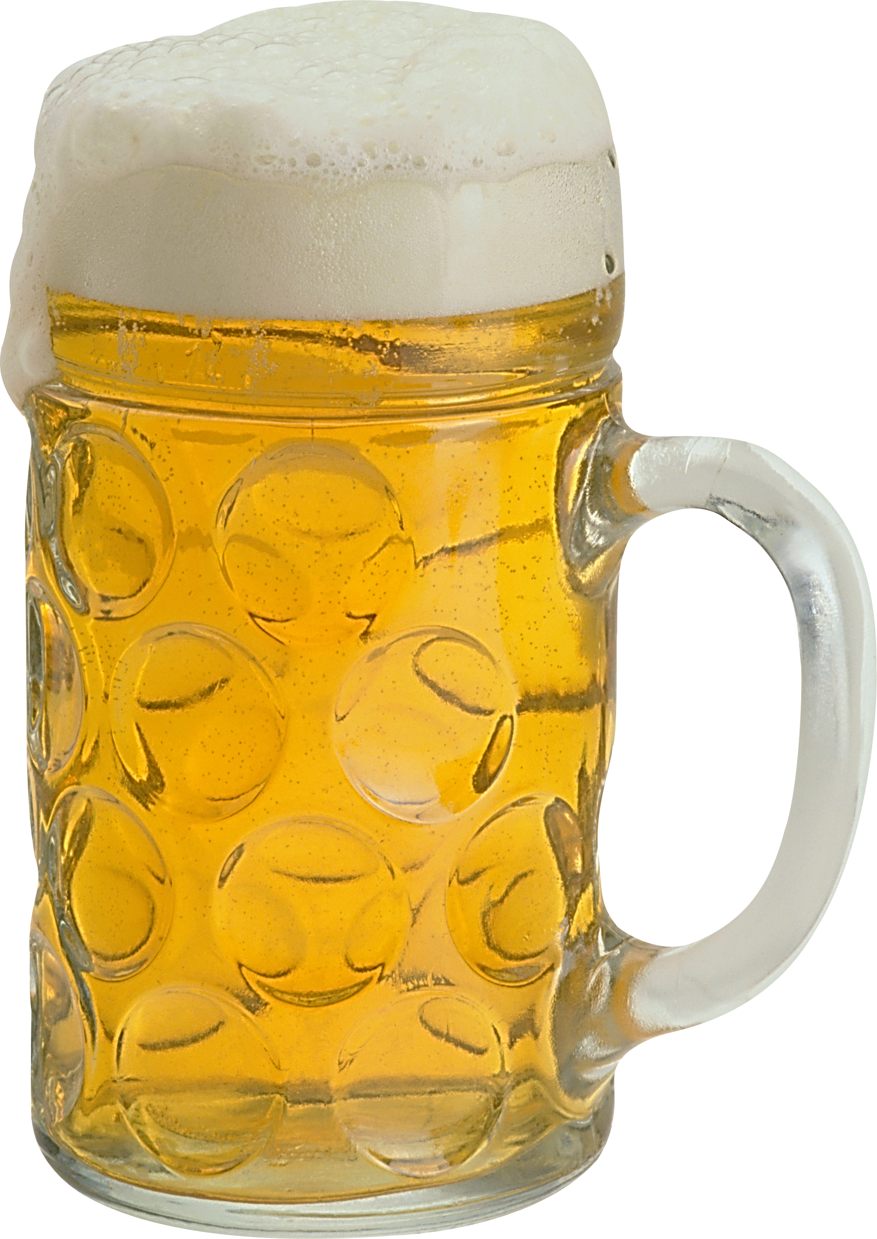
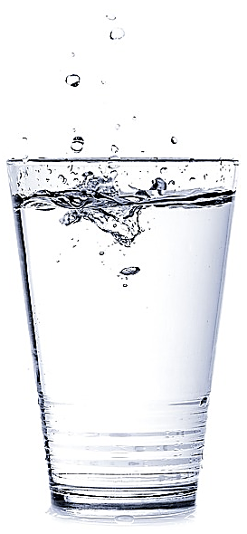

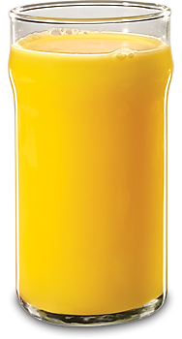
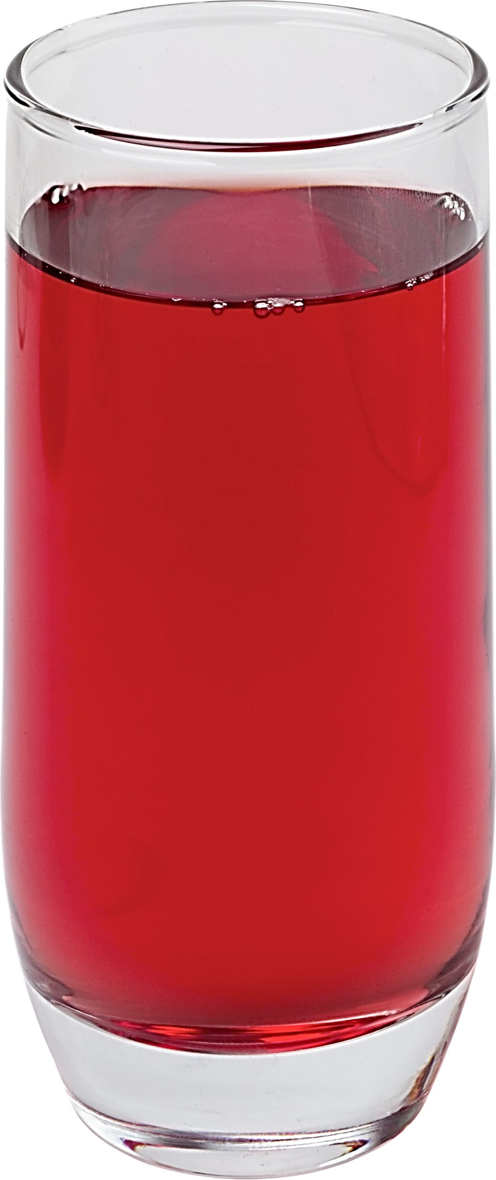
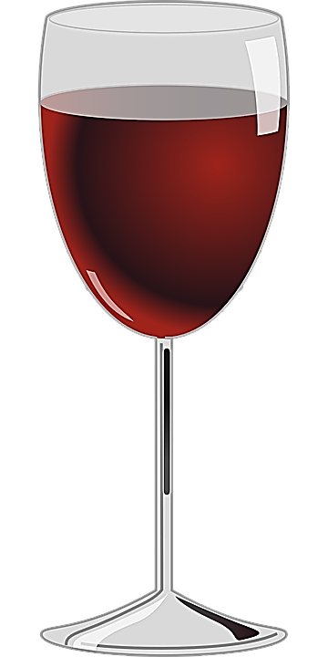
AFTER DINNER IN THE BAR
WHAT WOULD YOU LIKE?

Slide 13

WOULD YOU LIKE
COLA
RED
WINE
WHITE
WINE
MINERAL
WATER
BEER
ORANGE
JUICE
FRUIT
JUICE

Slide 14
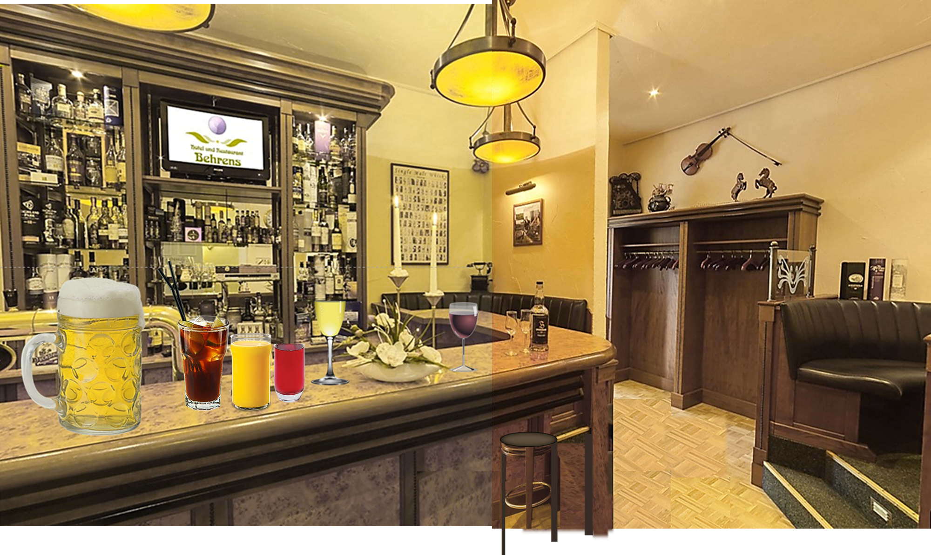
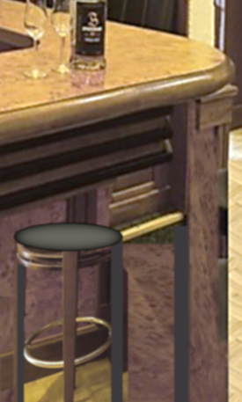
WHO WOULD LIKE WHAT ?
?
?
?
?
?
?

Slide 15
WHO WOULD LIKE WHAT ?
?
?
?
?
?
?

Slide 16
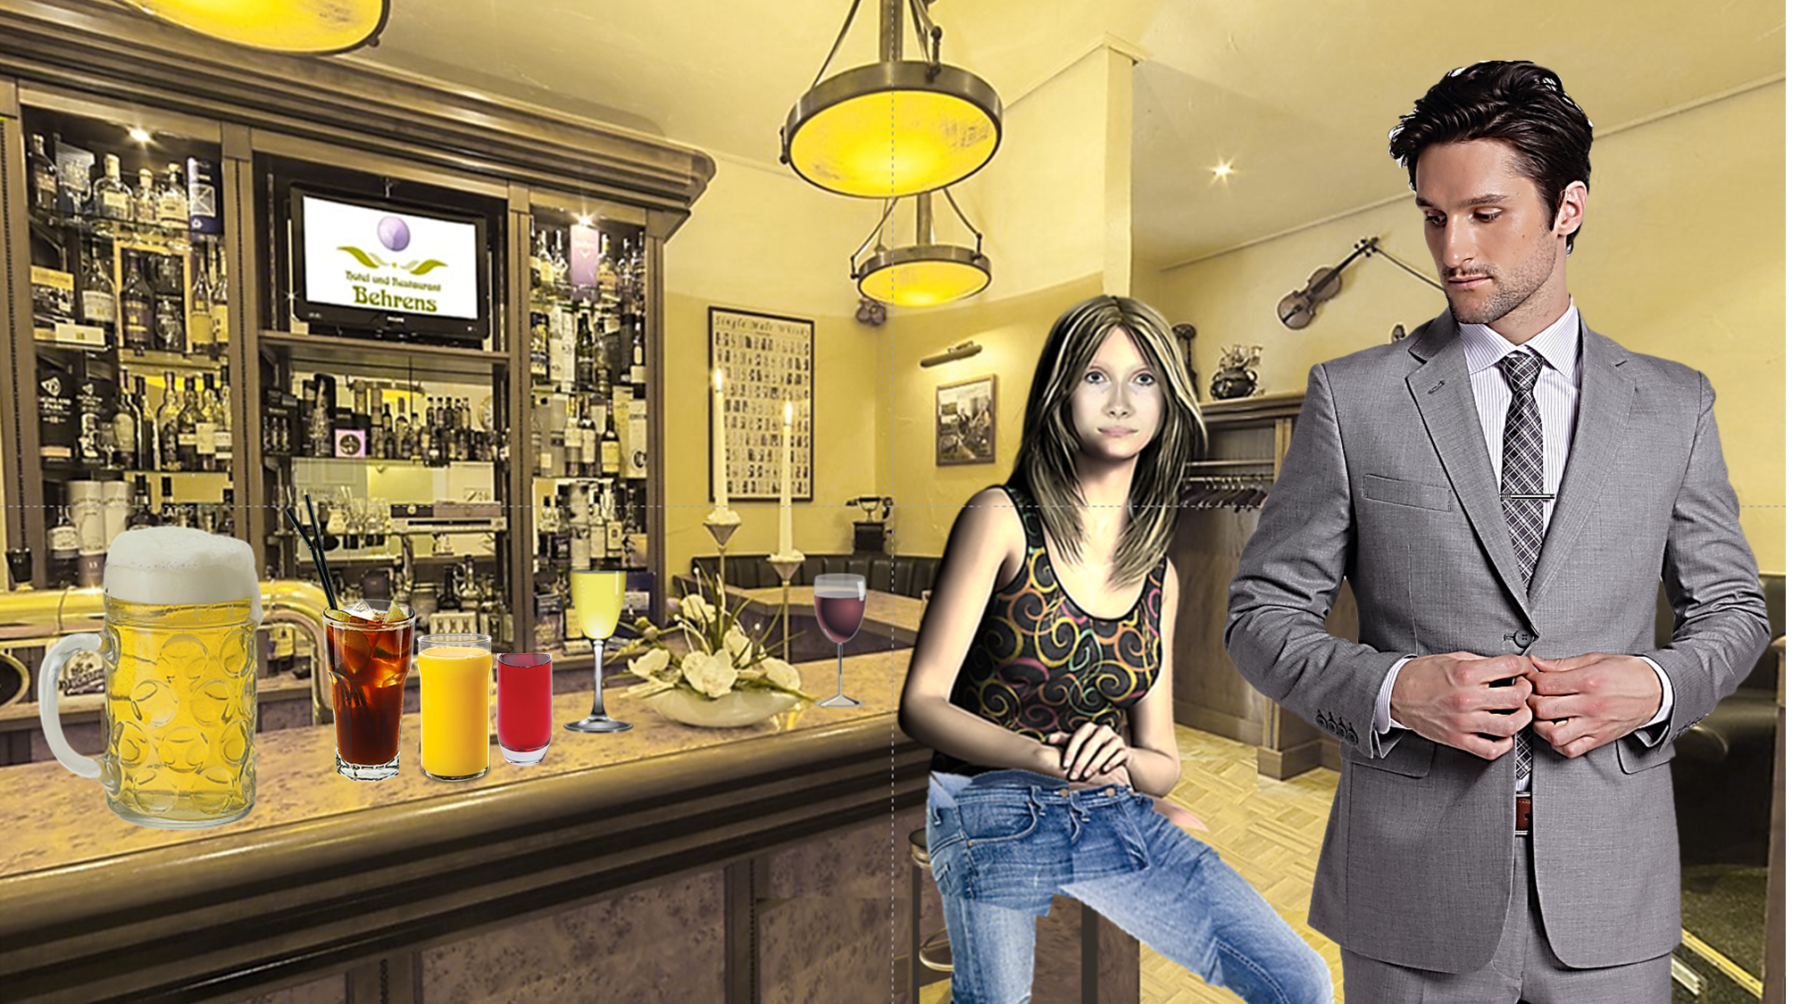

A GOOD QUESTION!

Slide 17

FIONA: IT’S A DRINKS PARTY-WHAT WOULD YOU LIKE TONY?
TONY: I WOULD LIKE A BEER THANKS!
FIONA: I PREFER THE RED WINE I WONDER WHAT
THE OTHERS WOULD LIKE ?
TONY: I THINK MARY WOULD PREFER THE WHITE WINE
BUT I’M SURE THE THREE GUYS WITH CARS
WOULD RATHER HAVE THE SOFT DRINKS

Slide 18


Slide 19
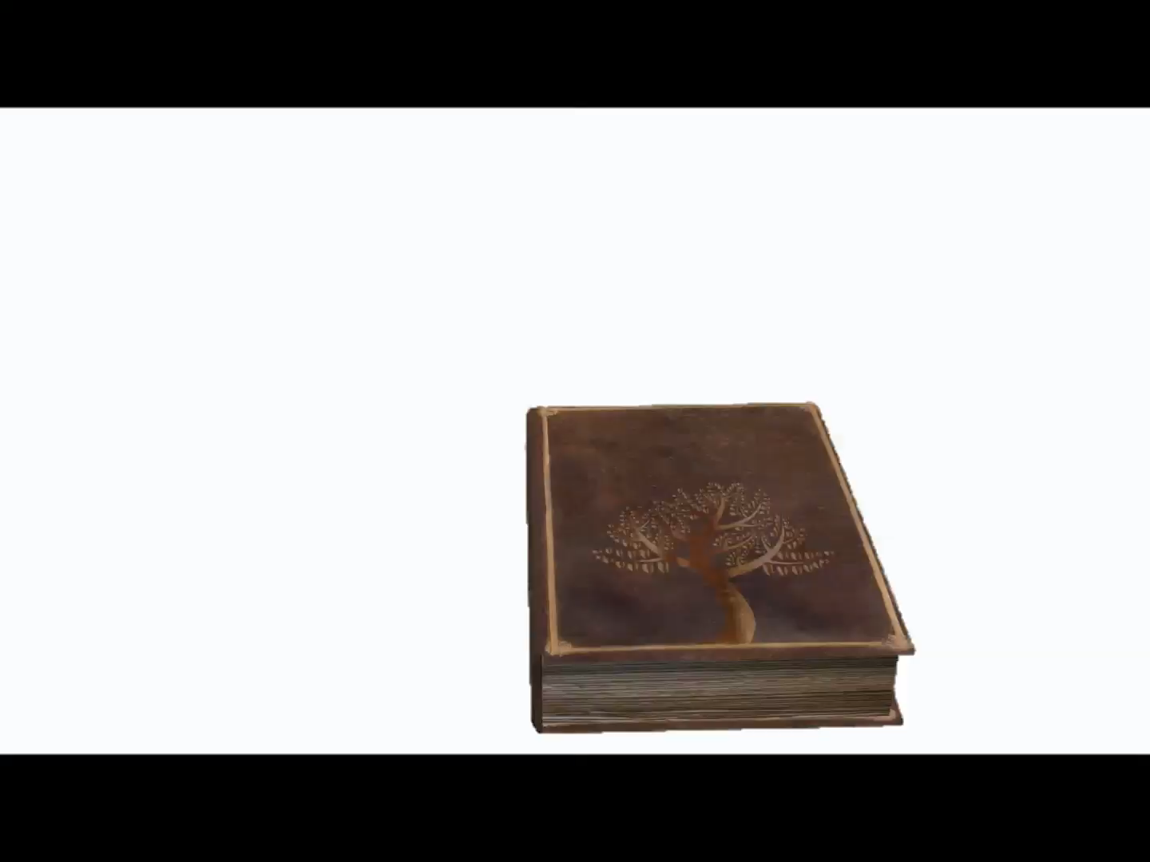
LANGUAGE IN CONTEXT

Slide 20
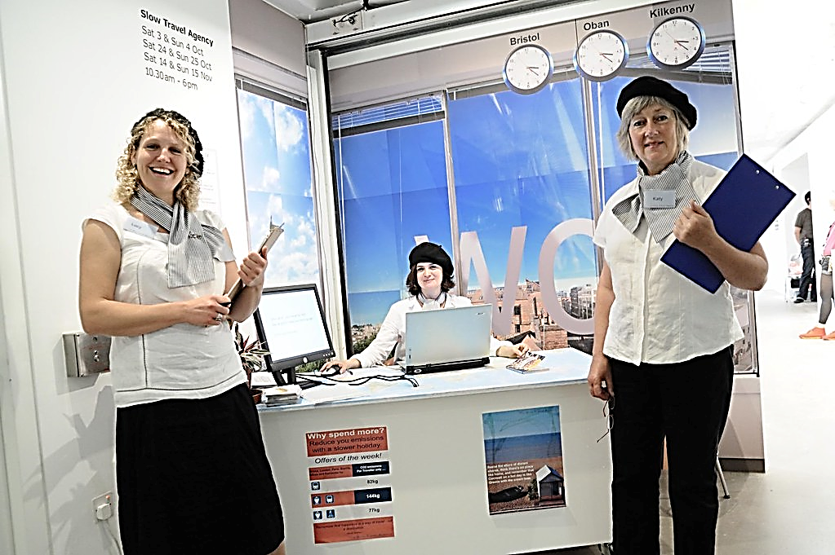
NEXT DAY AT THE TRAVEL AGENCY

Slide 21
WHERE WOULD YOU LIKE TO TRAVEL?

Slide 22
WHERE WOULD YOU LIKE TO GO?
WHAT KIND OF ACTIVITIES DO YOU LIKE?
HOW WOULD YOU PREFER TO TRAVEL?
WHAT SORT OF ACCOMMODATION WOULD YOU RATHER HAVE?
DO YOU HAVE ANY PREFERENCES FOR TIME OF YEAR?

Slide 23
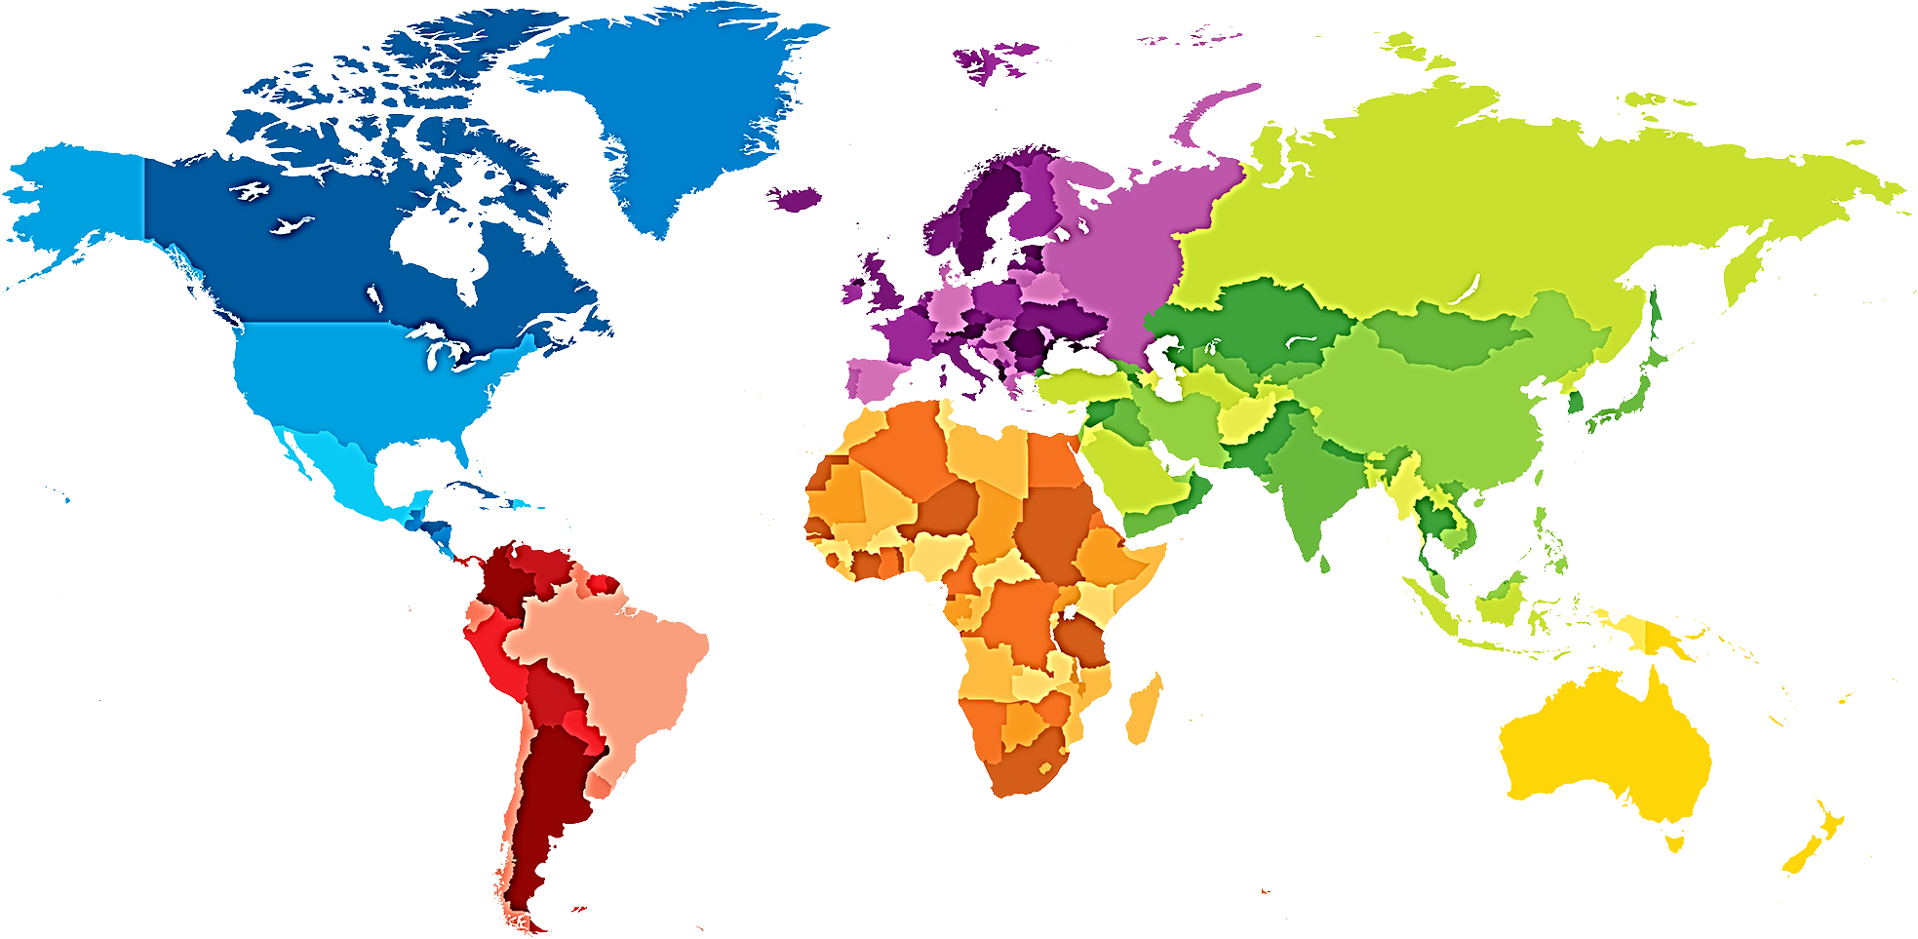
WHERE WOULD YOU LIKE TO TRAVEL?
WOULD YOU LIKE TO DISCOVERCHINA?
WOULD YOU LIKE TO GO TO EUROPE?
WOULD YOU LIKE TO VISIT NORTH AMERICA?
WOULD YOU LIKE TO SEE INDIA?
WOULD YOU LIKE TO TRAVEL TO AUSTRALIA?
WOULD YOU LIKE TO EXPLORE
SOUTH AMERICA?
WOULD YOU LIKE A TRIP TO AFRICA?

Slide 24
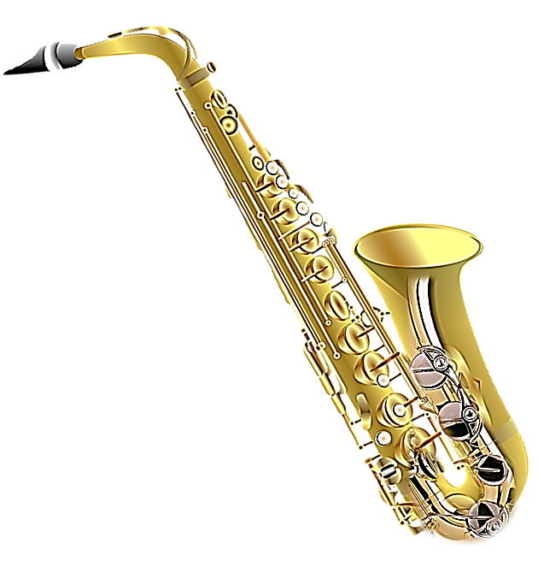
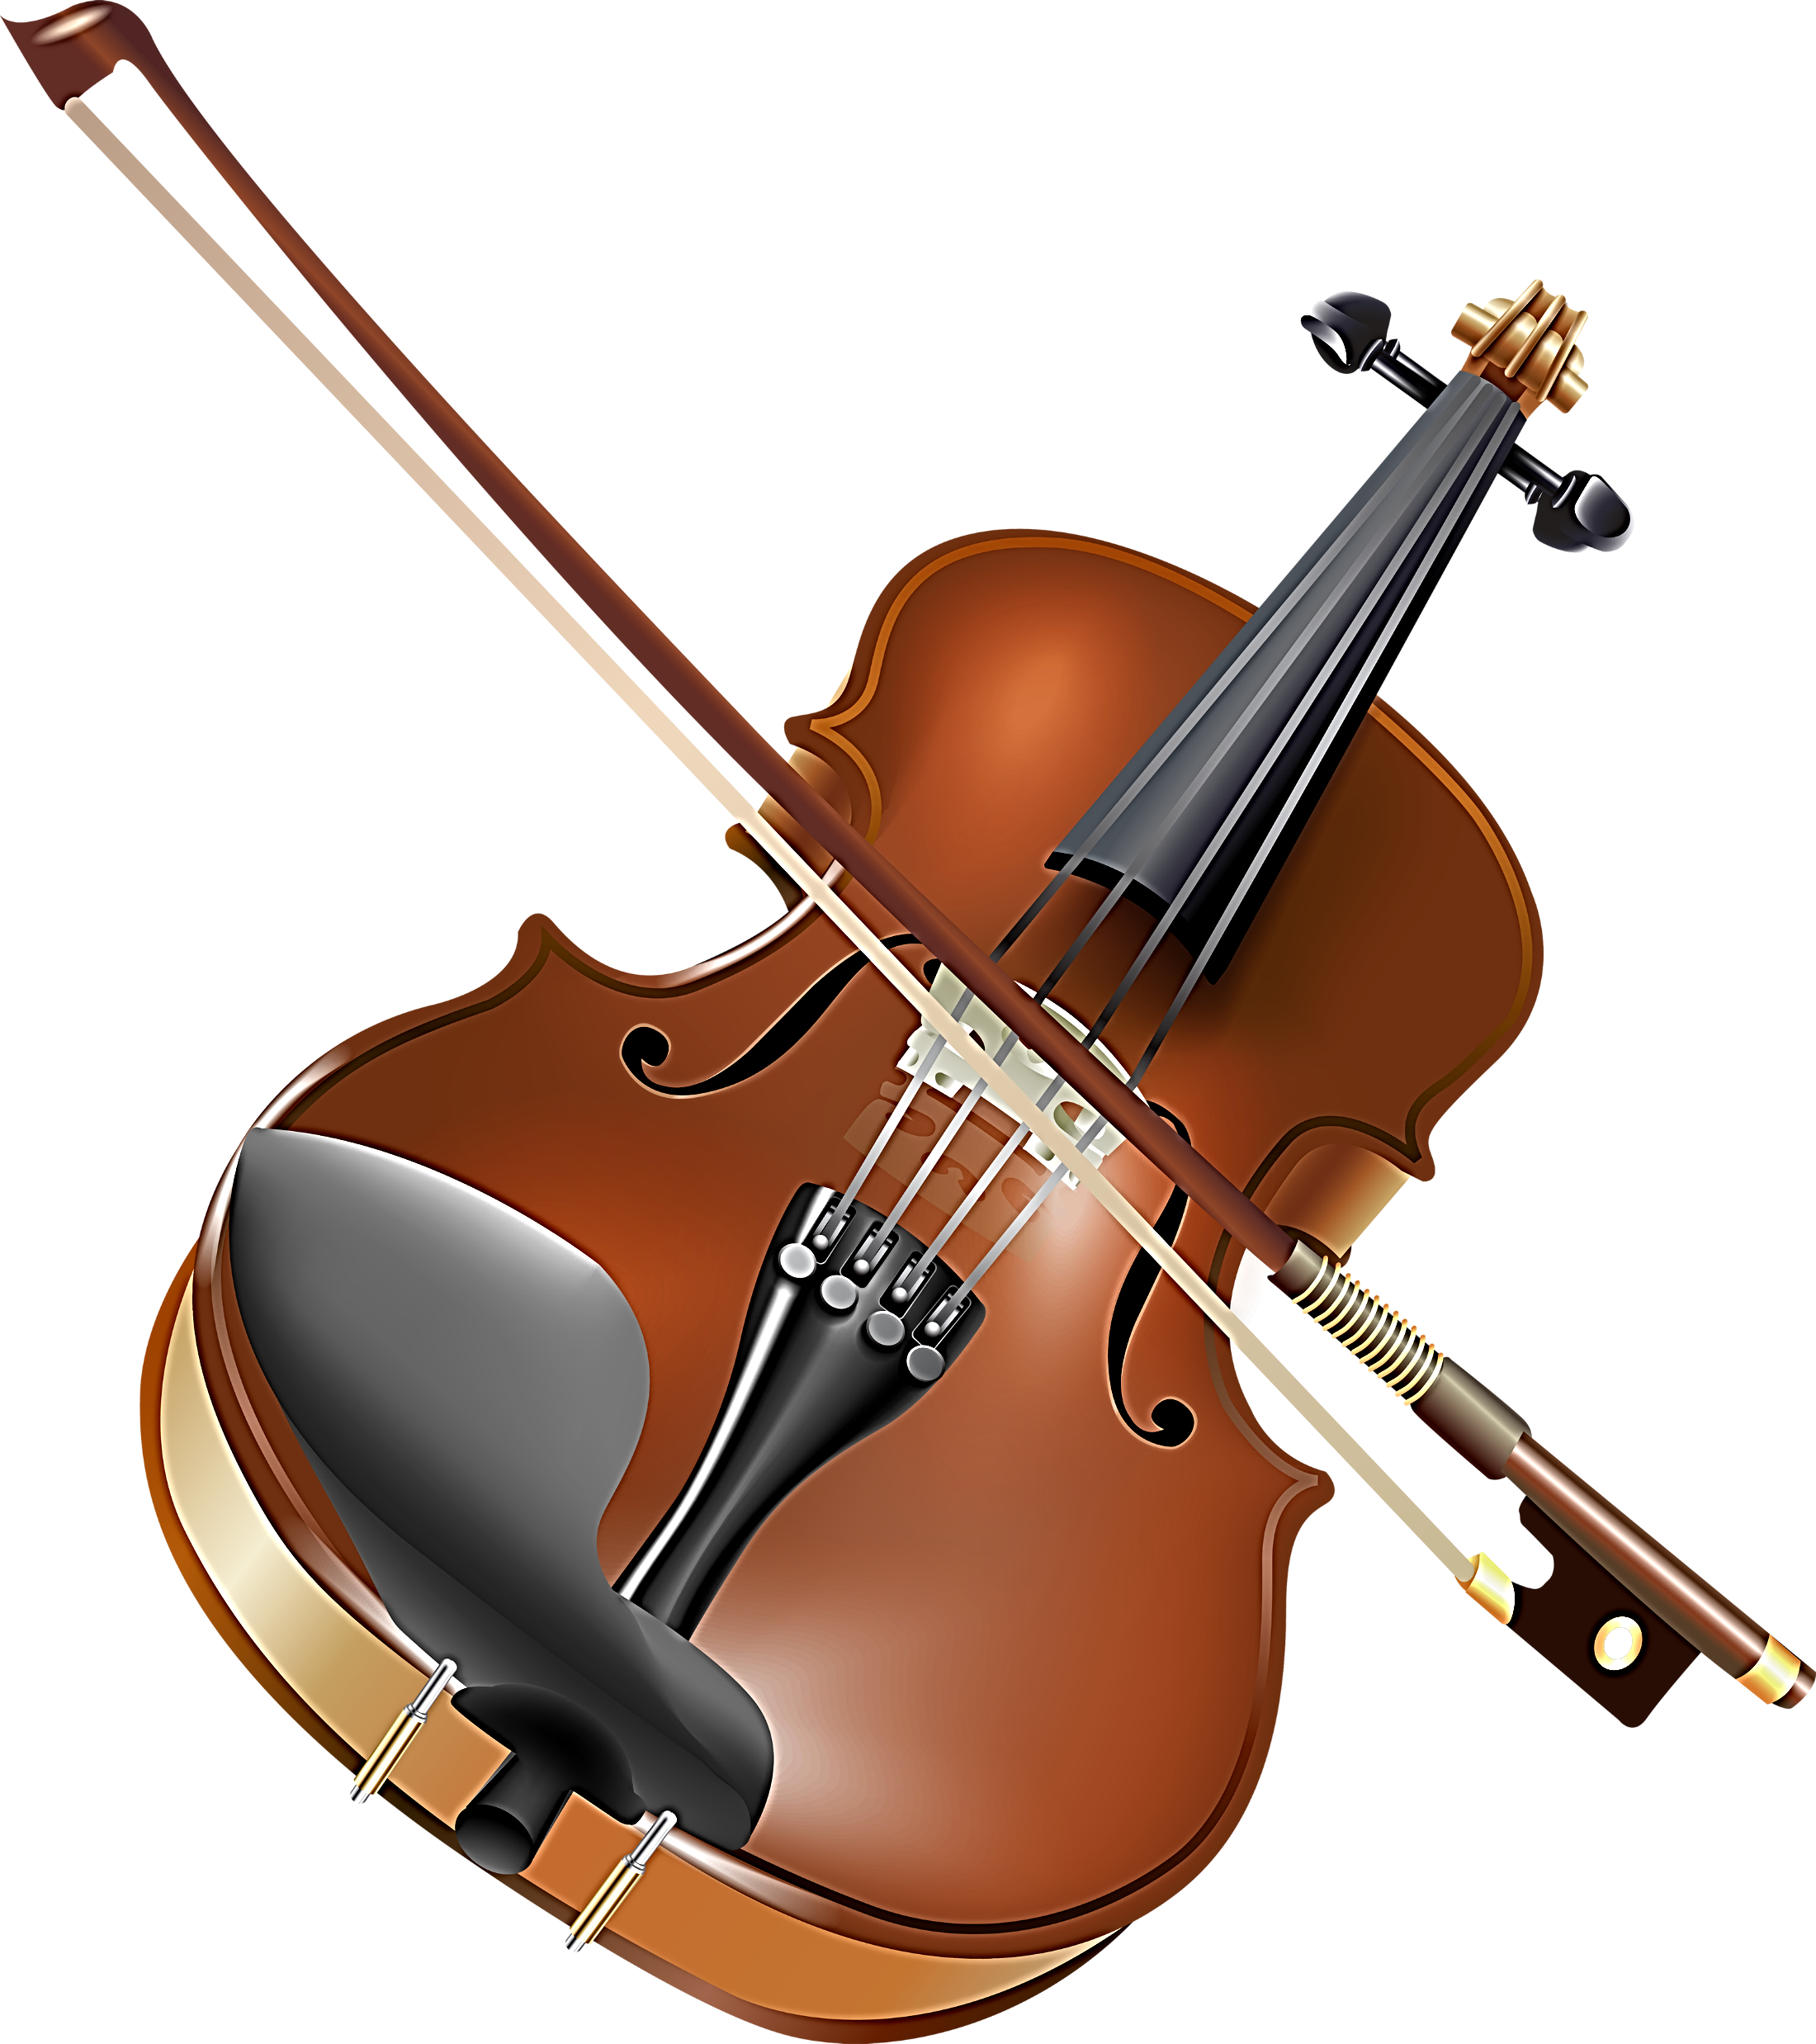
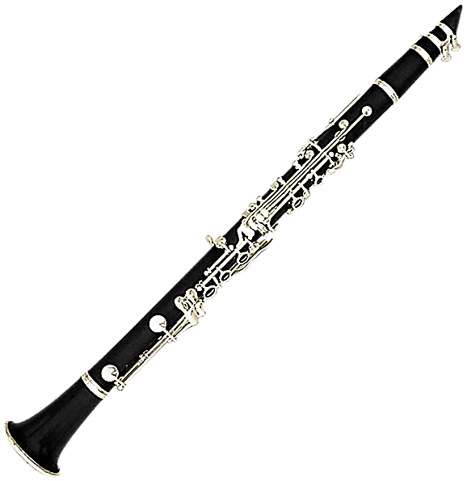
WHAT MUSICAL INSTRUMENTS
DO YOU LIKE?
WE BOTH LIKE
THE CLARINET
I WOULD RATHER
LISTEN TO THE SAXOPHONE
I LIKE
THE VIOLIN

Slide 25

PREFERENCES!
I LIKE
I WOULD LIKE
I PREFER
I WOULD PREFER
I WOULD RATHER
I WANT
GENERAL
SPECIFIC
GENERALLY BEST FOR ME
SPECIFICALLY
BEST FOR ME
BETTER ALTERNATIVE FOR ME
DIRECT

Slide 26
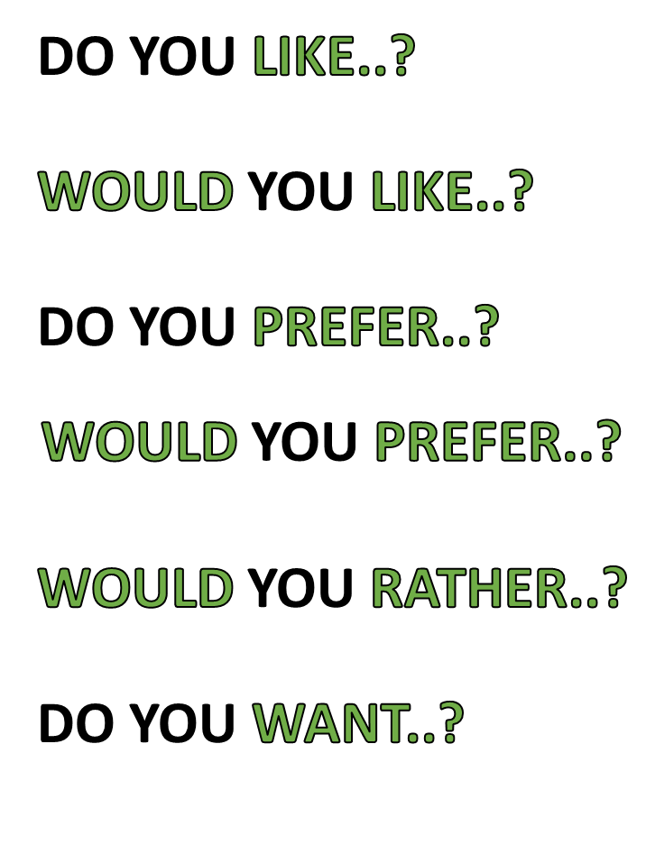
PREFERENCES!
GENERAL
SPECIFIC
GENERALLY BEST FOR YOU
SPECIFICALLY
BEST FOR YOU
BETTER ALTERNATIVE FOR YOU
DIRECT

Slide 27
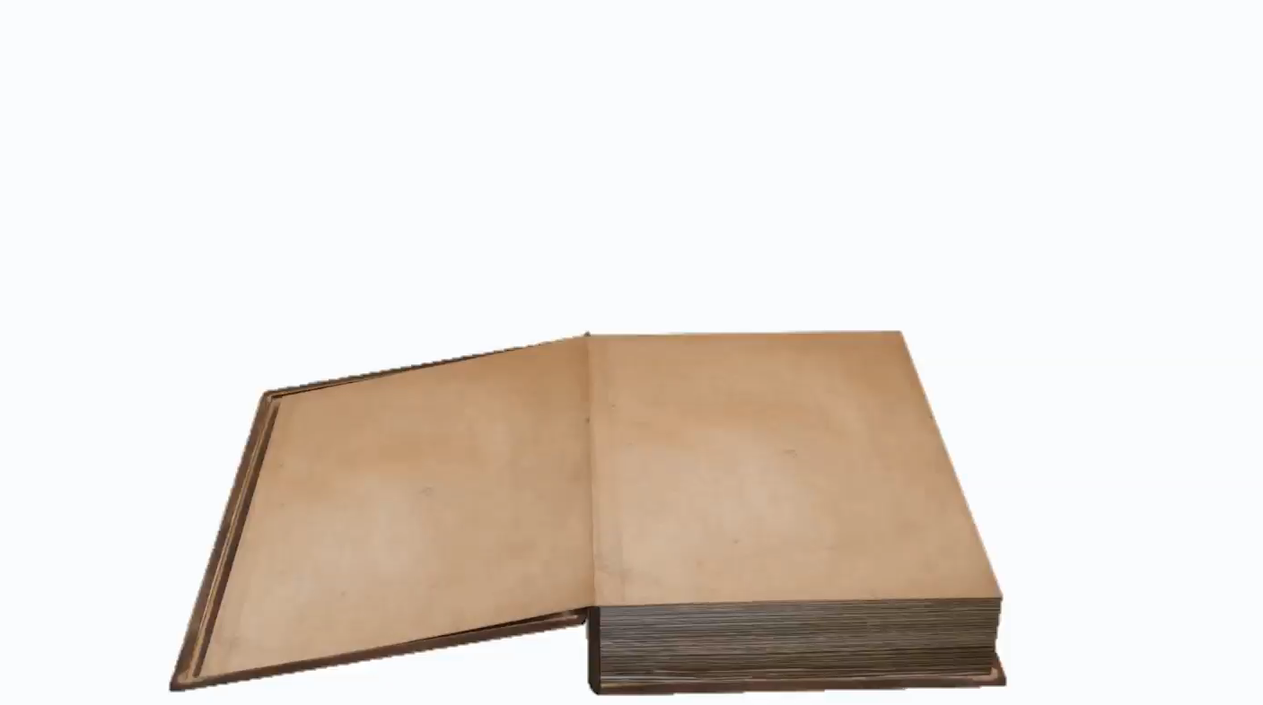
NOW MAKE YOUR OWN EXAMPLES !

Slide 28

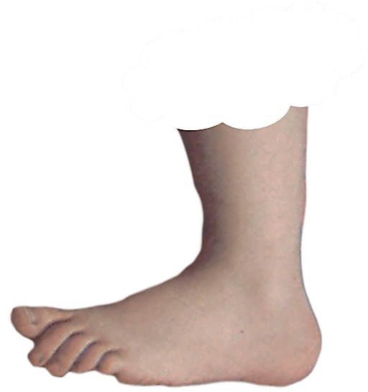
REMEMBER PREFERENCES ARE ABOUT
FAVORITE ACTIVITIES OR THINGS
THAT YOU WANT MORE THAN OTHERS
ALSO PLACES YOU ENJOY
AND PEOPLE THAT MAKE YOU HAPPY
FOOTNOTE
FOOTNOTE

Slide 30
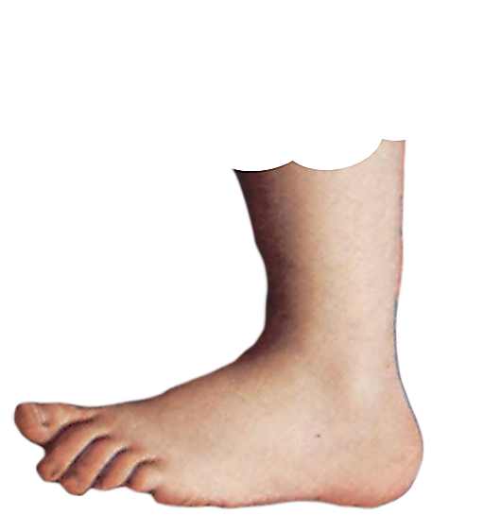
OTHER CONTEXTS OF
LIKE
MEANING: A PERSONAL WISH.
We can go swimming if you like
SIMILAR WORD: PREFER OPPOSITE WORD: UNLIKE
MEANING: TO ENJOY.
Joe likes going to the movies
SIMILAR WORDS: prefer enjoy, love, appreciate, fancy,
OPPOSITE WORDS: dislike, hate
MEANING: HAVING POSITIVE FEELINGS FOR SOMEBODY.
I really like her a lot
SIMILAR WORDS: ADORE, FANCY, FAVOUR, ADMIRE
OPPOSITE WORDS: DISLIKE, HATE
MEANING: SIMILAR
He is like his mother
LIKE
CAN HAVE OTHER CONTEXTS
FOOTNOTE
FOOTNOTE

Slide 31
NOTICE THIS!
MEANING: HAVING POSITIVE FEELINGS FOR SOMEBODY.
I REALLY LIKE HER A LOT.
OPPOSITE WORD DISLIKE
I REALLY DISLIKE HER A LOT.
MEANING: SIMILAR
HE IS LIKE HIS MOTHER
OPPOSITE WORD UNLIKE
HE IS UNLIKE HIS MOTHER

Slide 32


Slide 35

WHICH DRINK WOULD YOU LIKE
COLA
RED
WINE
WHITE
WINE
MINERAL
WATER
BEER
ORANGE
JUICE
FRUIT
JUICE

Slide 36
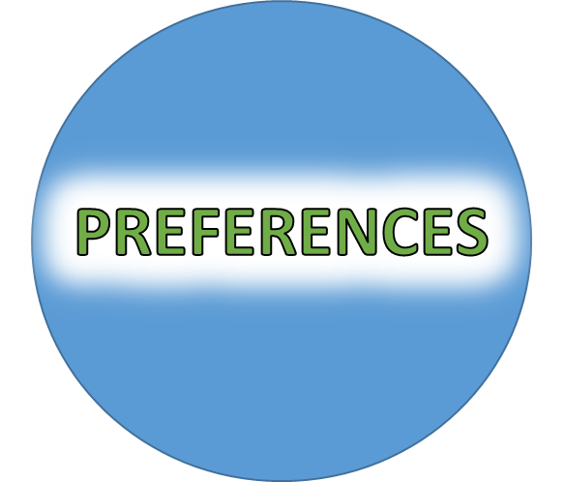
REMEMBER PREFERENCE CONTEXTS
WOULD LIKE
LIKE
GENERAL
SPECIFIC
WOULD PREFER
PREFER
GENERAL
SPECIFIC
DIRECT
WOULD RATHER
INSTEAD
WANT

Slide 37


Slide 38

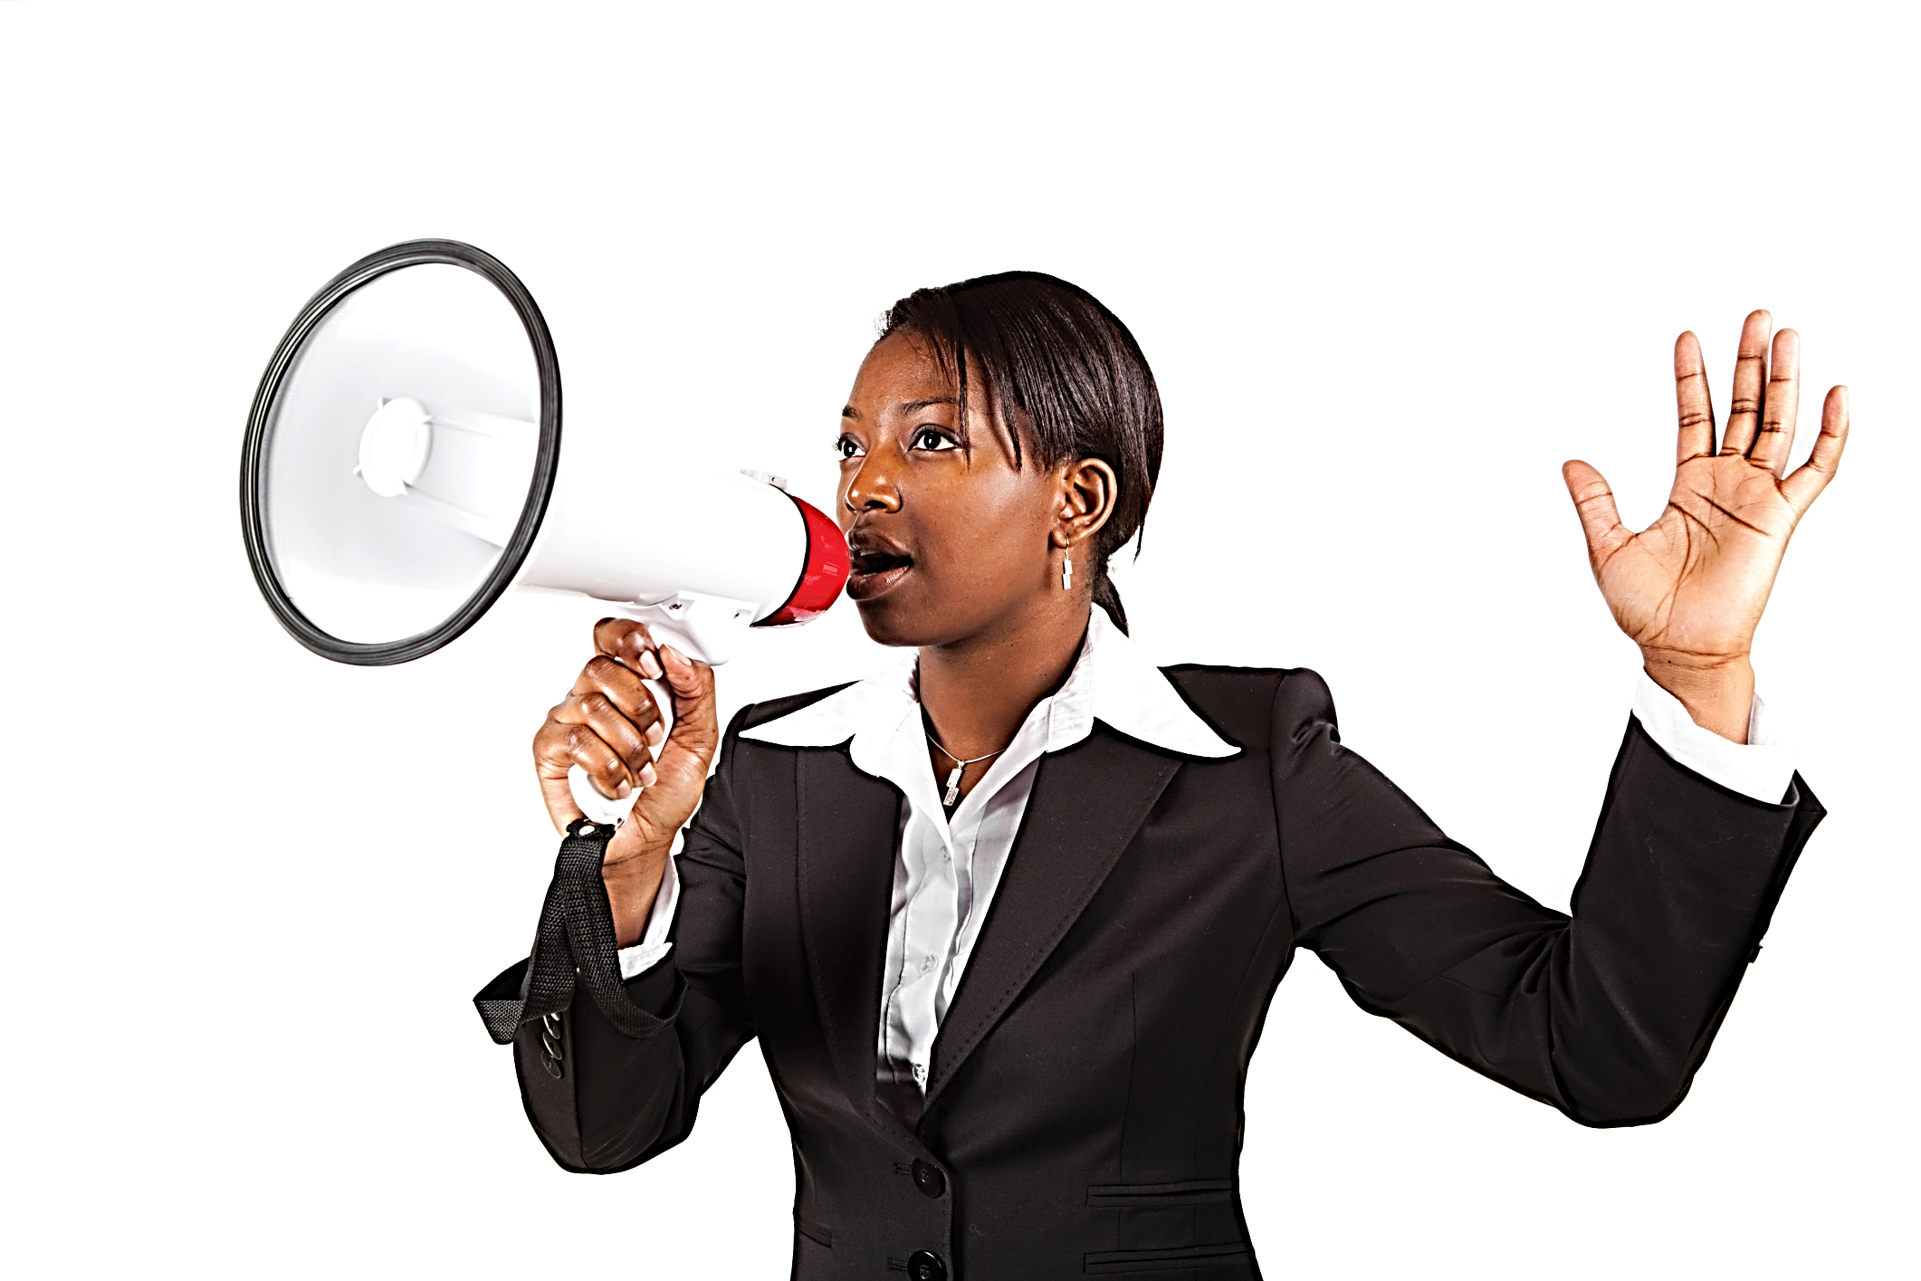
This Photo by Unknown Author is licensed under CC BY-SA-NC

Slide 41
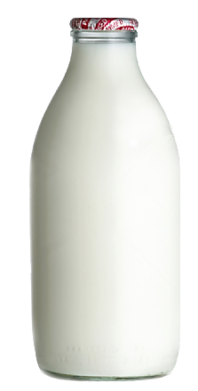
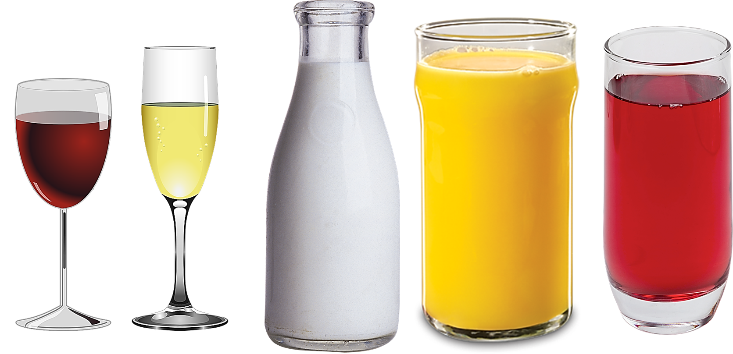

Slide 42
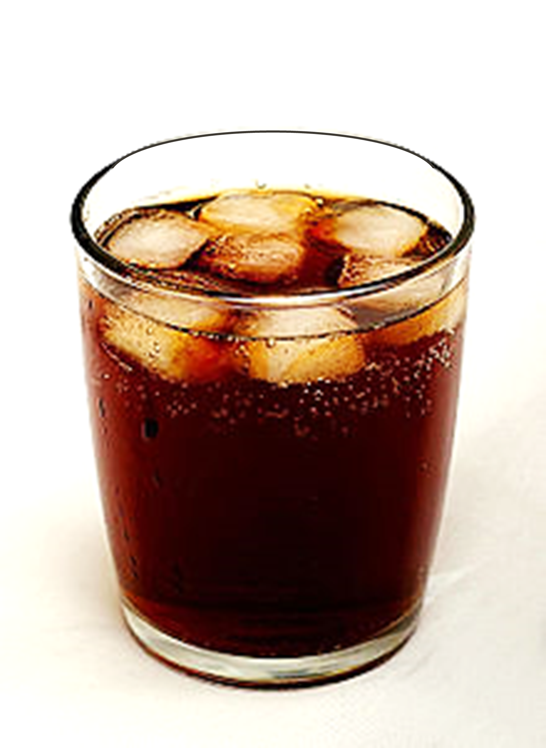

Slide 43


Slide 44


CONCEPTS

Slide 45



Slide 46



PREFERENCES!
CONTEXTS

Slide 47
LIKE
WOULD LIKE
PREFER
WOULD PREFER
WOULD RATHER
WANT

Slide 48
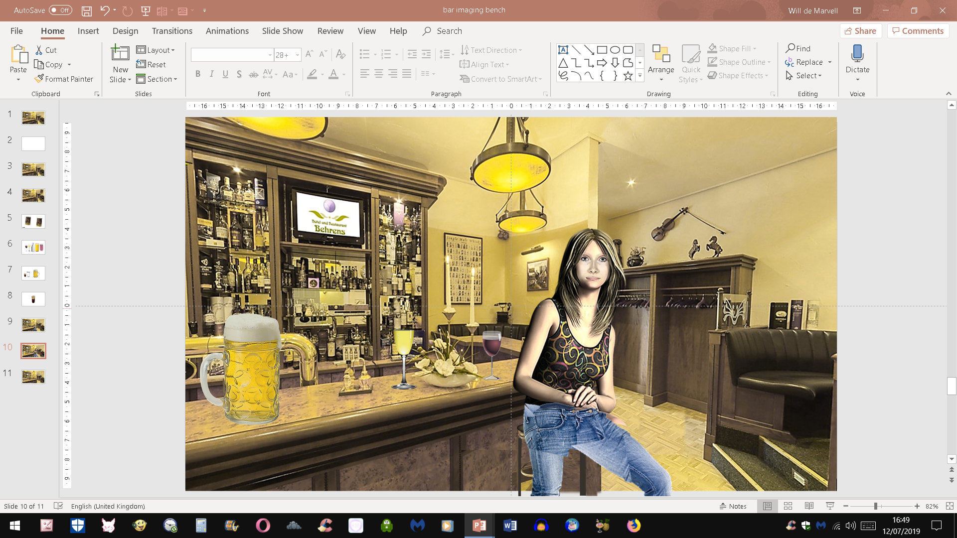

Slide 49
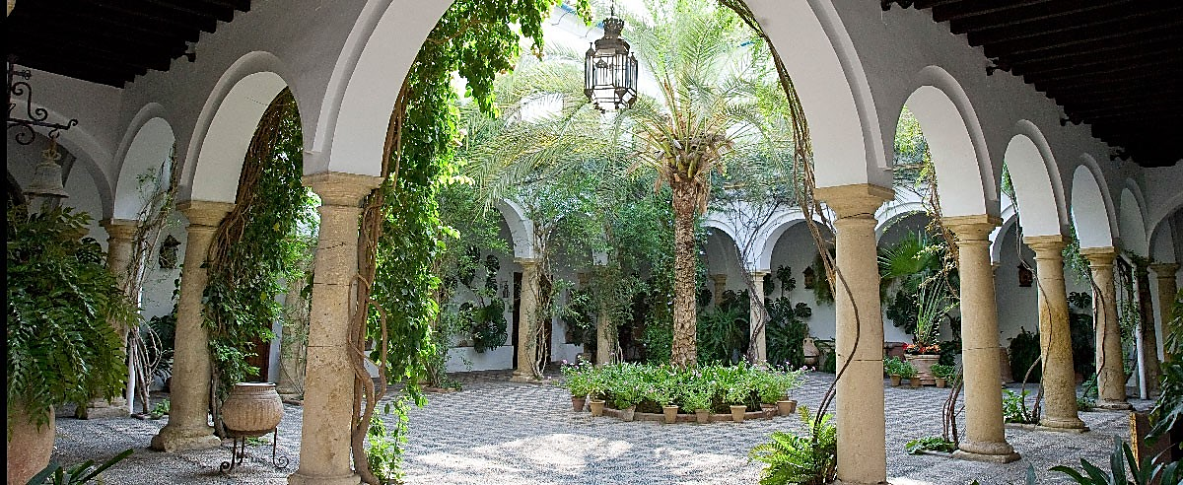

Slide 50
MEANING: to feel a desire or want.
We can go swimming if you like.
SIMILAR WORDS: prefer,care, please, wish
MEANING: to find pleasure in; enjoy.
Joe likes going to the movies.
SIMILAR WORDS: prefer enjoy, love, appreciate, fancy,
OPPOSITE WORDS: dislike, hate
MEANING: to have positive feelings for.
I really like her a lot.
SIMILAR WORDS adore, fancy, favour, admire
OPPOSITE WORDS: dislike, hate
MEANING: similar to
He is like his mother
SIMILAR WORDS the same as or similar to
OPPOSITE WORD unlike

Slide 52
CONCEPTS

Slide 53
WOULD
RATHER
WANT

Slide 54
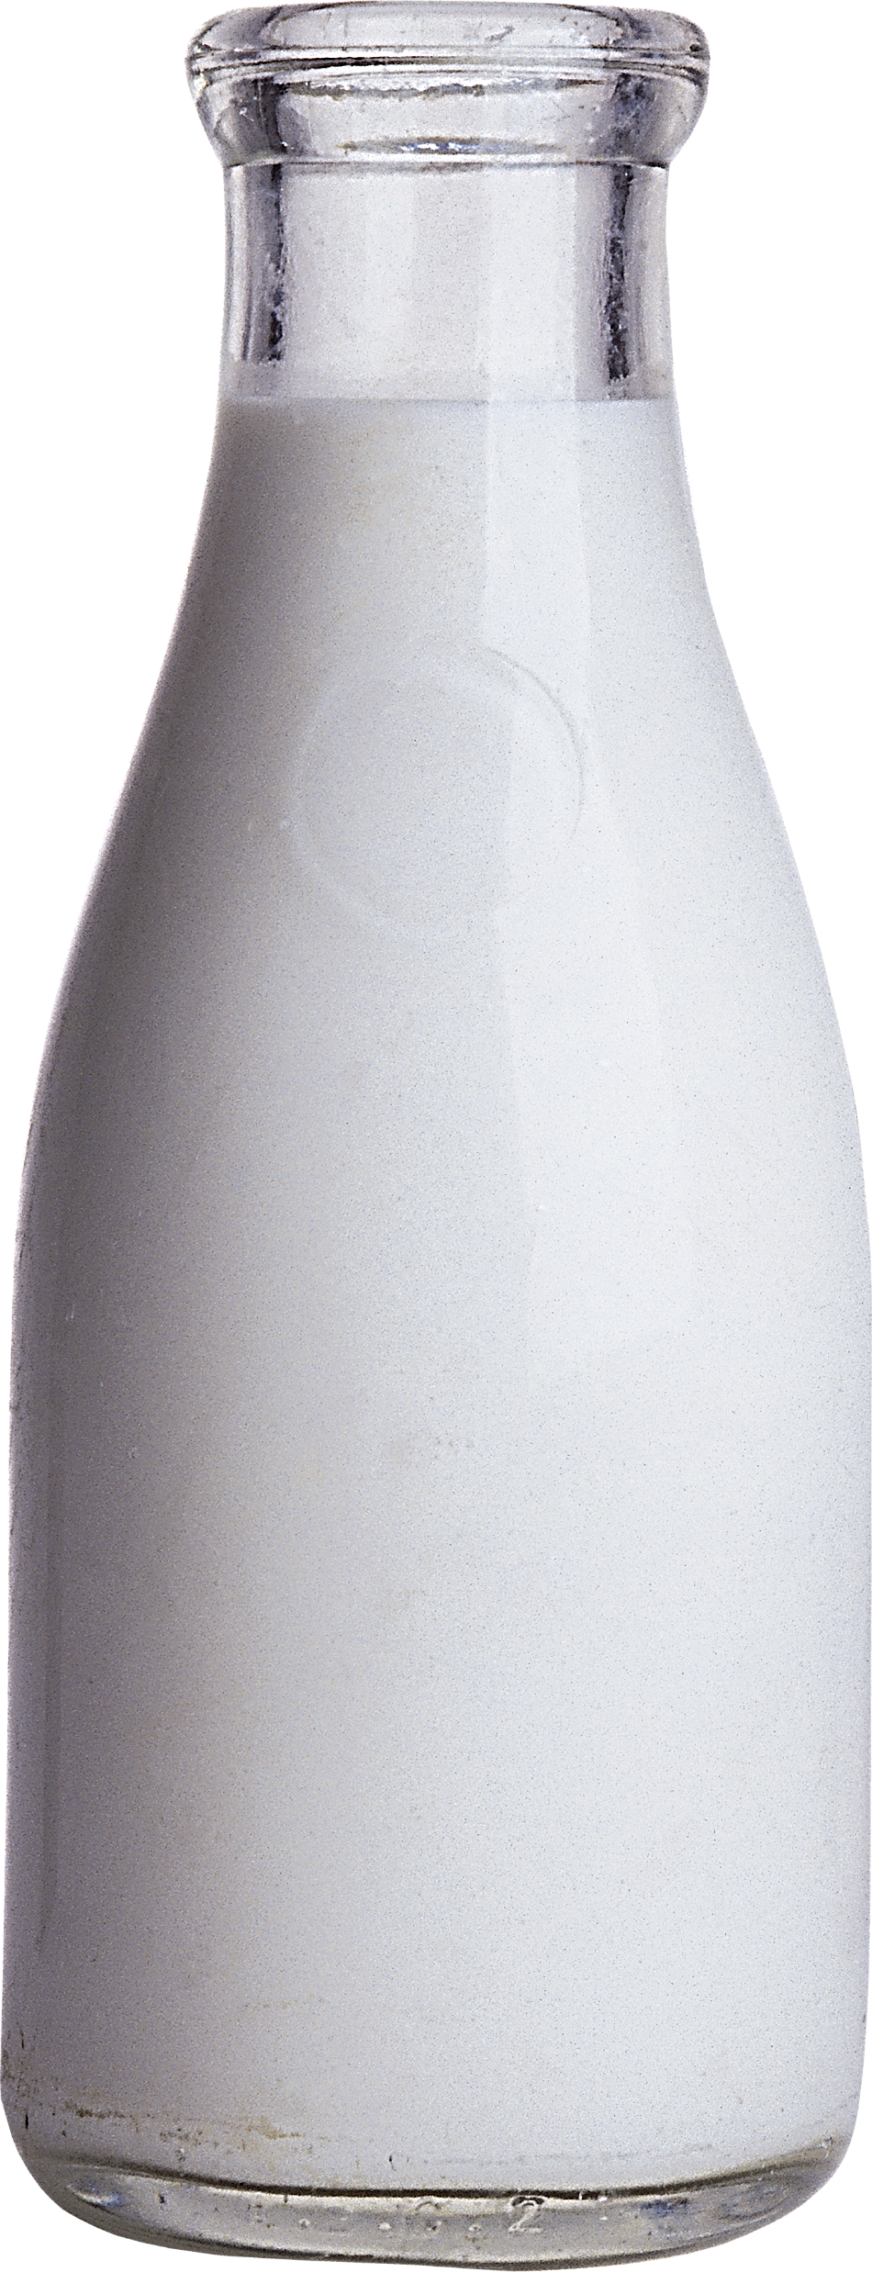

Slide 56
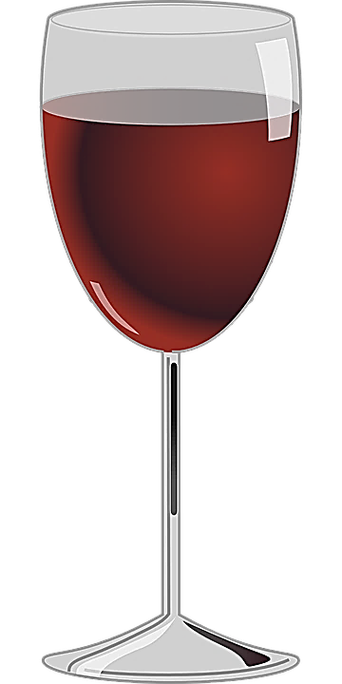
AFTER DINNER IN THE BAR

Slide 57
LATER IN THE RESTAURANT

Slide 58

JUST LISTEN...

Slide 59
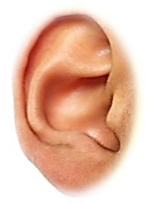
NOW LISTEN...

Slide 60
JUST LISTEN...

Slide 61
LATER IN THE RESTAURANT

Slide 62
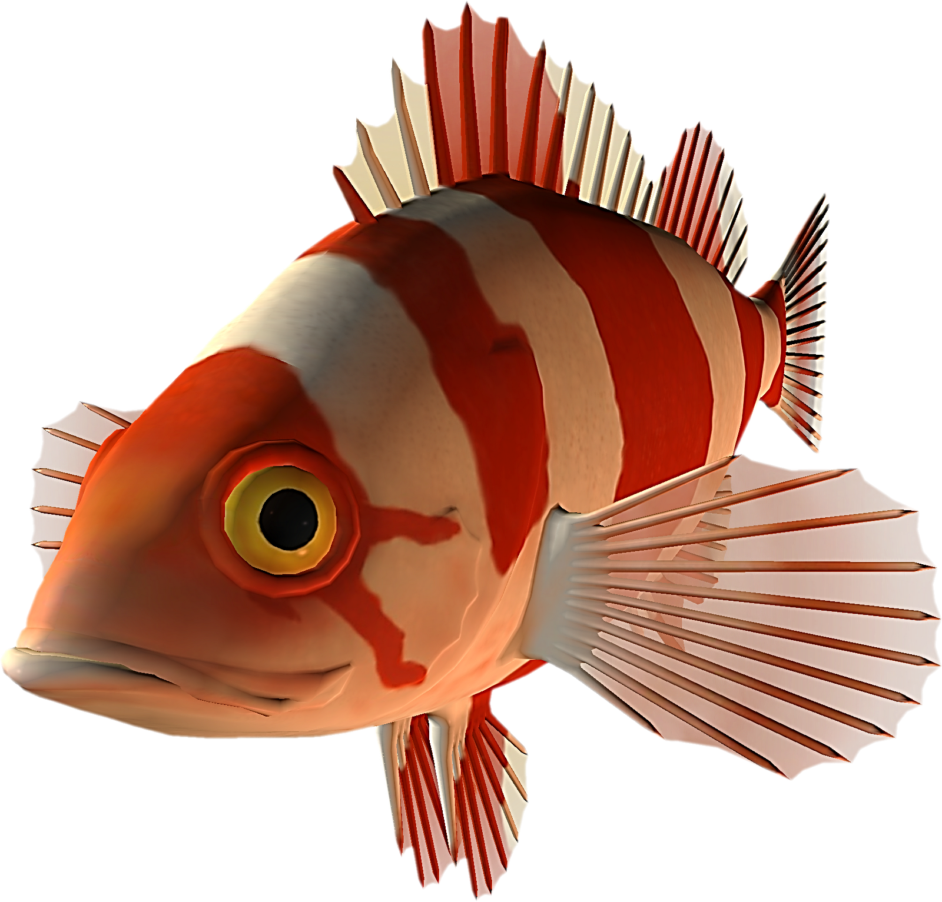

Slide 63
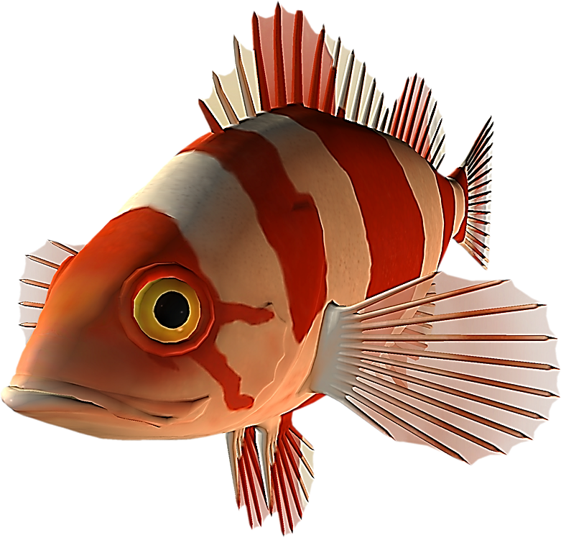

Slide 64
LIKE
CAN HAVE OTHER MEANINGS
FOOTNOTE
FOOTNOTE

Slide 65
MEANING: to feel a desire or want.
We can go swimming if you like.
SIMILAR WORDS: prefer, care, please, wish
MEANING: to find pleasure in, enjoy.
Joe likes going to the movies.
SIMILAR WORDS: prefer enjoy, love, appreciate, fancy,
OPPOSITE WORDS: dislike, hate
MEANING: to have positive feelings for.
I really like her a lot.
SIMILAR WORDS adore, fancy, favour, admire
OPPOSITE WORDS: dislike, hate
MEANING: similar to
He is like his mother
SIMILAR WORDS the same as or similar to
OPPOSITE WORD unlike
OTHER MEANINGS OF
LIKE
LIKE
CAN HAVE OTHER MEANINGS
FOOTNOTE
FOOTNOTE

Slide 66
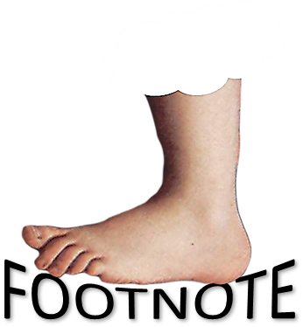
MEANING: to feel a desire or want.
We can go swimming if you like.
SIMILAR WORDS: prefer, care, please, wish
MEANING: to find pleasure in, enjoy.
Joe likes going to the movies.
SIMILAR WORDS: prefer enjoy, love, appreciate, fancy,
OPPOSITE WORDS: dislike, hate
MEANING: to have positive feelings for.
I really like her a lot.
SIMILAR WORDS adore, fancy, favour, admire
OPPOSITE WORDS: dislike, hate
MEANING: similar to
He is like his mother
SIMILAR WORDS the same as or similar to
OPPOSITE WORD unlike

Slide 67
LIKE
CAN HAVE OTHER MEANINGS
FOOTNOTE
FOOTNOTE

Slide 68
A GOOD QUESTION!

Slide 69
xxxxxxxxx

Slide 70
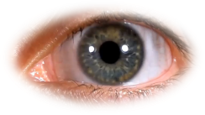
xxxxxxxxx

Slide 71
xxxxxxxxx

Slide 72

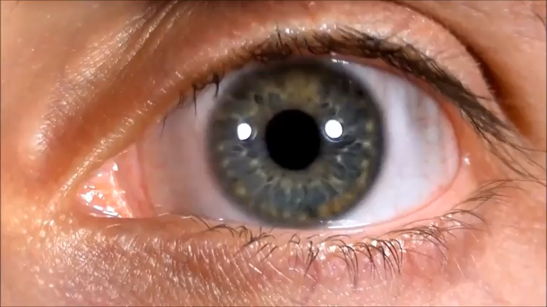
CHECK THIS
WORD
CONTEXTS

Slide 73
CHECK THIS
WORD
CONTEXTS

Slide 74
FOOTNOTE
FOOTNOTE

Slide 75
CHECK THIS WORD
CONTEXT
CONTEXT
CONTEXT

Slide 76
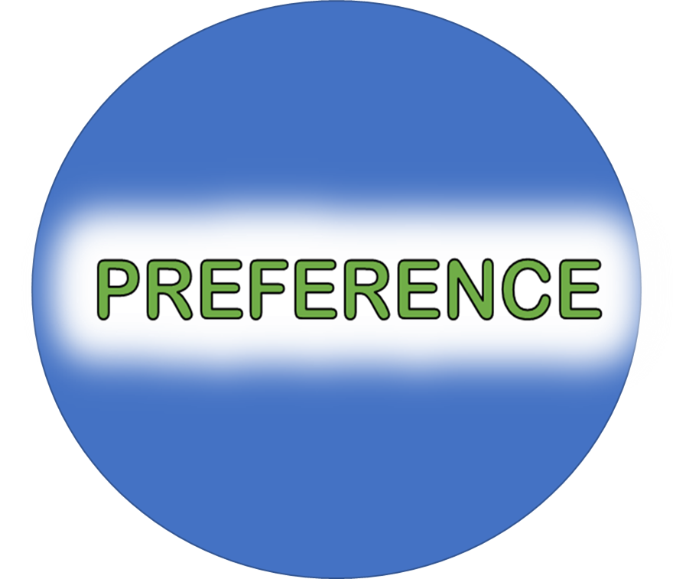
CONTEXTS
CHECK THIS WORD

Slide 77
WHAT IS A CONTEXT ?
A CONTEXT IS THE CIRCUMSTANCES IN WHICH AN EVENT OCCURS; A SETTING. FACTS THAT SURROUND AN EVENT OR SITUATION. BACKGROUND, ENVIRONMENT, FRAMEWORK, SETTING, OR SITUATION SURROUNDING AN EVENT
THE CIRCUMSTANCES THAT FORM THE SETTING FOR AN EVENT, STATEMENT, OR IDEA, AND IN TERMS OF WHICH IT CAN BE FULLY UNDERSTOOD.
THE ASPECTS OF AN EVENT WHICH GIVE IT DENTITY AND MEANING

Slide 78
CHECK THIS IN YOUR LANGUAGE

Slide 79


Slide 80

WHERE WOULD YOU LIKE TO GO?
WHAT KIND OF ACTIVITIES DO YOU LIKE?
HOW WOULD YOU PREFER TO TRAVEL?
WHAT SORT OF ACCOMMODATION WOULD YOU RATHER HAVE?
DO YOU HAVE ANY PREFERENCES FOR TIME OF YEAR?

Slide 81

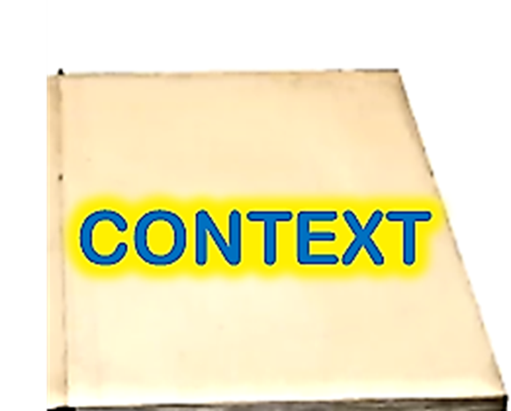


Slide 82
A GOOD QUESTION!

Slide 83
LANGUAGE IN CONTEXT

Slide 84
MORE EXAMPLES

Slide 85
ETC

