Slide 1

A CONTEXT IS THE SITUATION AND FACTS OF AN EVENT WHICH GIVE IT IDENTITY AND MEANING
WHAT IS A CONTEXT ?

Slide 2

CHECK THIS WORD
CONTEXT
CONTEXT
CONTEXT

Slide 3


WORK
HOME
FRIENDS AND FAMILY
PLAY

Slide 4

COULD BE AT A DESK
WORK
HOME
SIT
FRIENDS AND FAMILY
PLAY

Slide 5
WORK
HOME
CONTEXTS
CAN CHANGE
MEANINGS
FRIENDS AND FAMILY
PLAY

Slide 6

SO…
WHAT IS A CONTEXT ?
IT IS THE ASPECTS OF AN EVENT WHICH GIVE IT IDENTITY AND MEANING

Slide 7
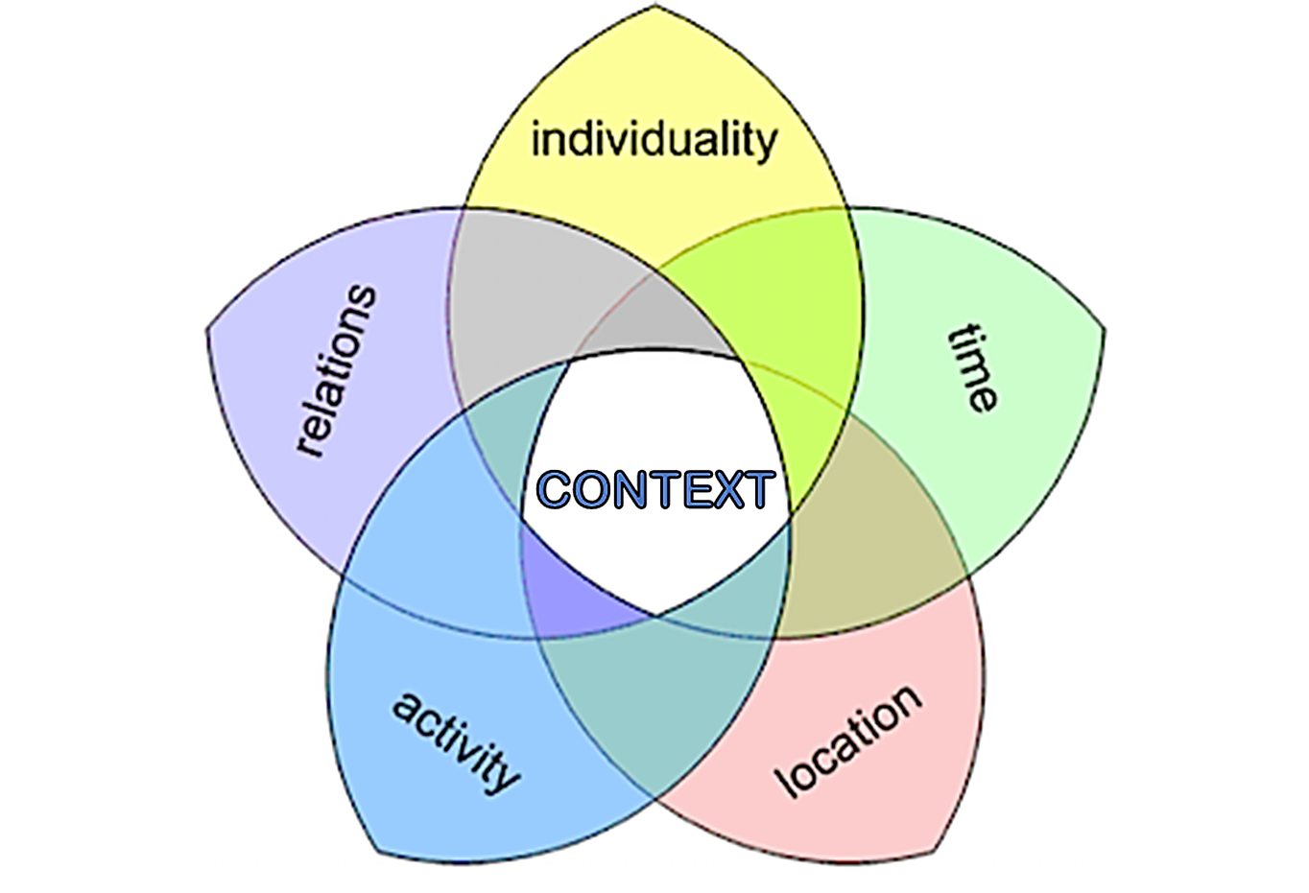
HERE ARE SOME OF THE ASPECTS WHICH CAN DEFINE A CONTEXT

Slide 8

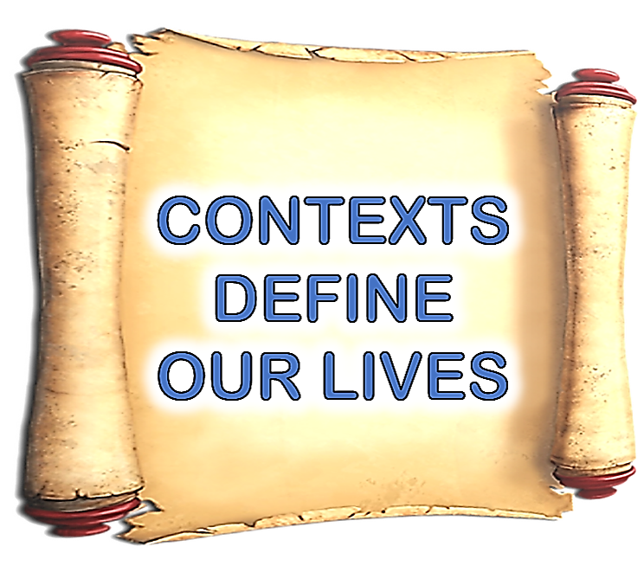
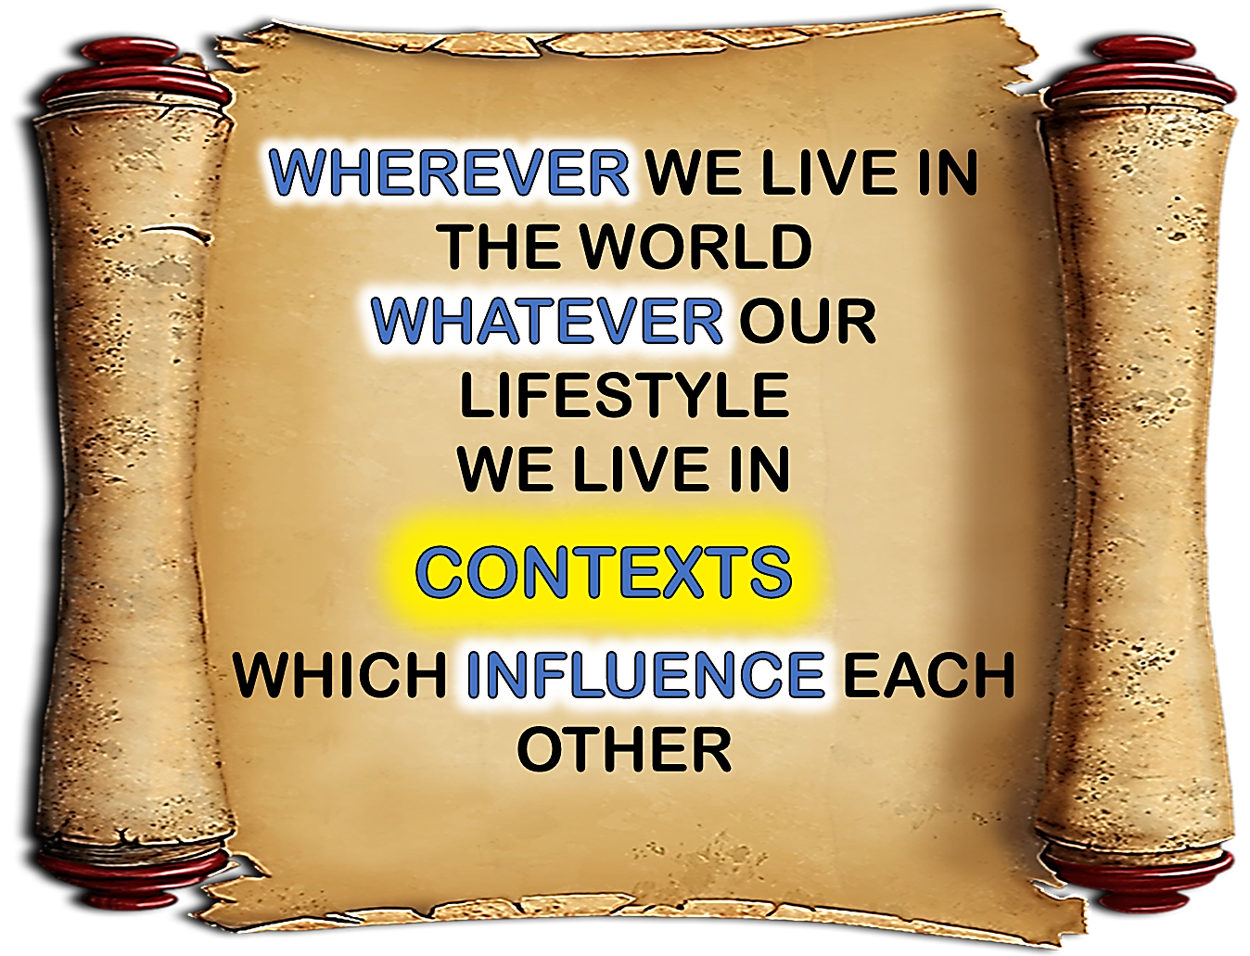

Slide 9

CHECK THE
BLUE
WORDS!

Slide 14


Slide 15



Slide 17



Slide 18



Slide 20


Slide 23



Slide 24


Slide 25



Slide 26
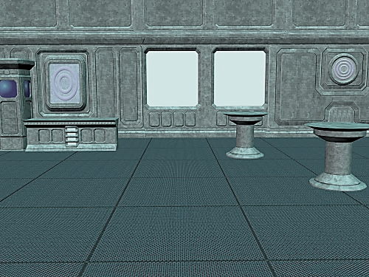


Slide 27



Slide 30


Slide 33


Slide 35



Slide 37
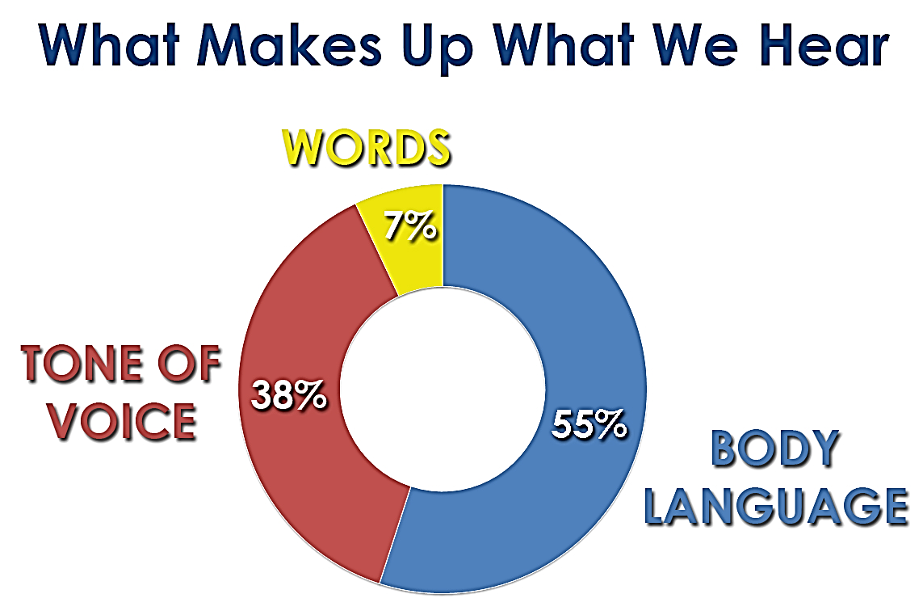

Slide 38


Slide 41


Slide 44

IDEA TO REMEMBER
CONTEXTS
CAN CHANGE
MEANINGS

Slide 45
WHAT IS A CONTEXT ?
A CONTEXT IS THE SITUATION AND FACTS OF AN EVENT WHICH GIVE IT IDENTITY AND MEANING

Slide 47



