Slide 1

CHECK THESE WORDS!
HABITS
AND
ROUTINES

Slide 2
CHECK THESE WORDS!
HABITS
AND
ROUTINES

Slide 3
A NORMAL HABIT
Stroking the chin is often a signal
that the person is thinking hard.
Maybe they are judging or evaluating something, particularly if there is a choice or decision to make.
One hand will move to the chin
and begin a chin-stroking gesture.
This chin-stroking gesture is the signal
that the listener is making a decision.

Slide 4
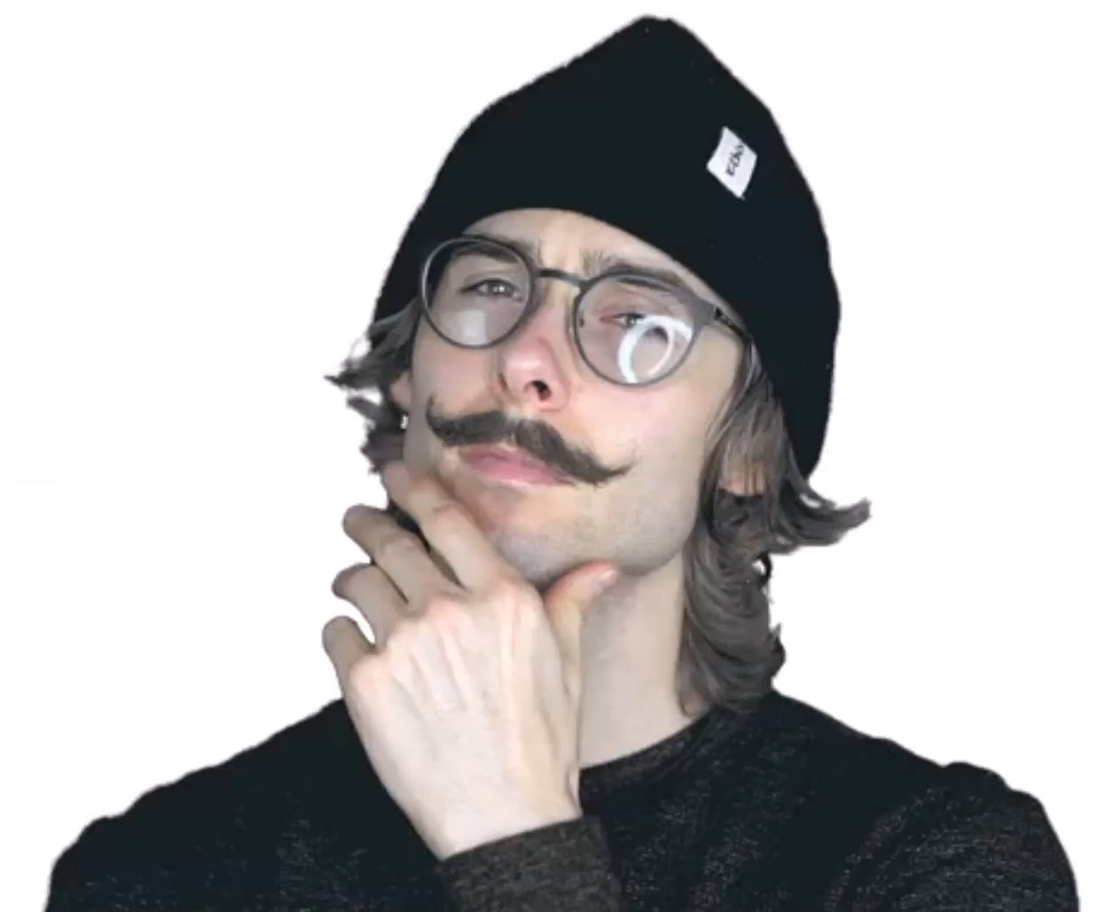
A NORMAL HABIT

Slide 5
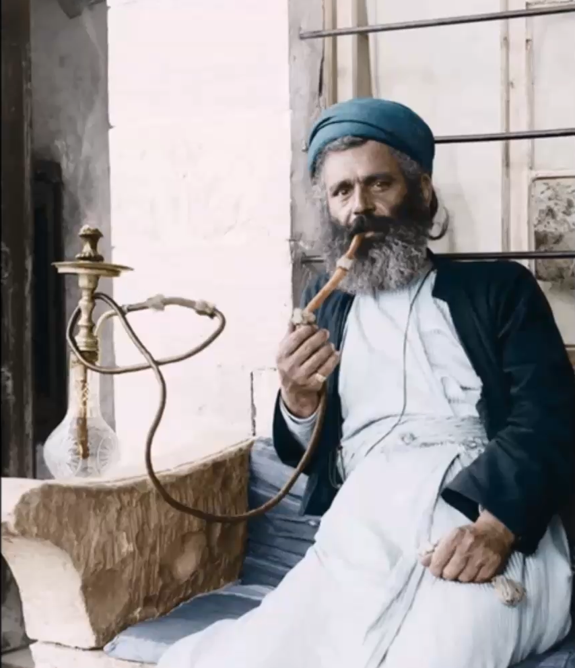
A BAD HABIT
Smoking is bad for you!.

Slide 9
HABITS
AND
ROUTINES

Slide 10
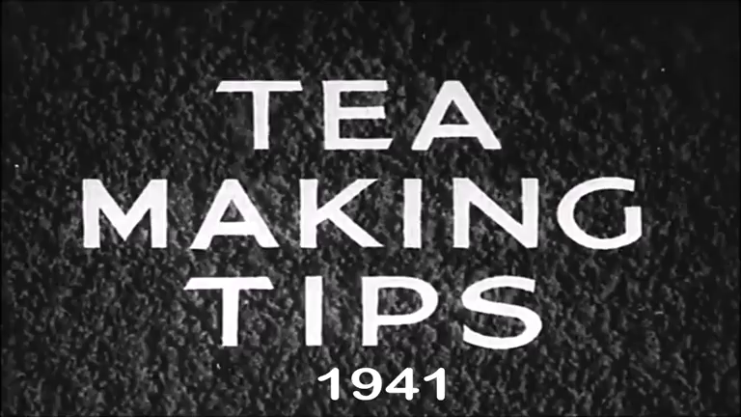
THE SIX GOLDEN RULES

Slide 11
THE SIX GOLDEN RULES
1 ALWAYS USE A GOOD QUALITY TEA
2 ALWAYS USE FRESHLY DRAWN WATER
3 REMEMBER TO WARM THE TEAPOT
4 MEASURE THE RIGHT QUANTITY OF TEA
5 TAKE TEAPOT TO BOILING KETTLE
6 LET THE TEA BREW FOR 5-7 MINUTES

Slide 12
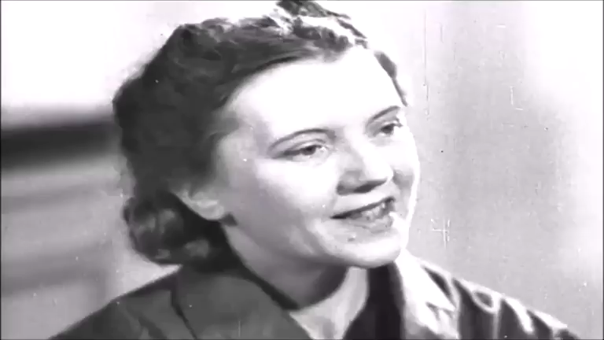
THE SIX GOLDEN RULES

Slide 13
THE SIX GOLDEN RULES
1 ALWAYS USE A GOOD QUALITY TEA
2 ALWAYS USE FRESHLY DRAWN WATER
3 REMEMBER TO WARM THE TEAPOT
4 MEASURE THE RIGHT QUANTITY OF TEA
5 TAKE TEAPOT TO BOILING KETTLE
6 LET THE TEA BREW FOR 5-7 MINUTES

Slide 14
THE SIX GOLDEN RULES
SO LET EVERY CUP YOU MAKE BE A CUP THAT CHEERS!

Slide 15
THE SIX GOLDEN RULES

Slide 16
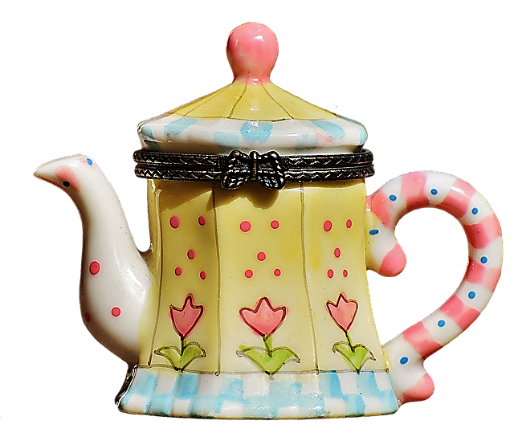
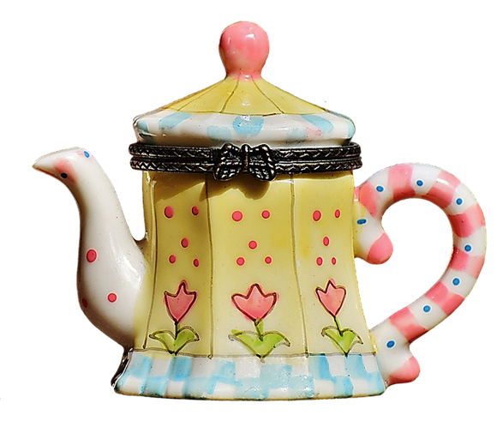

Slide 17
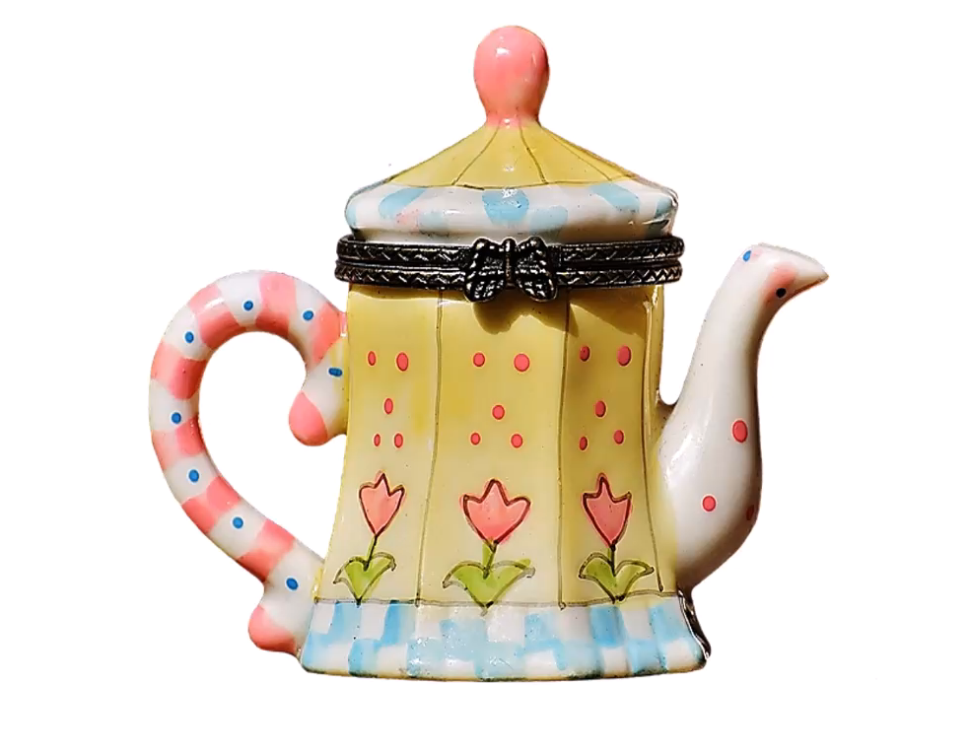
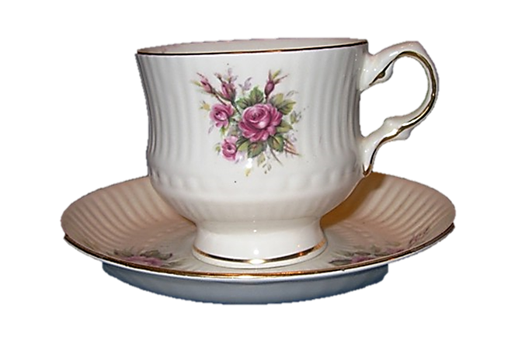

Slide 18
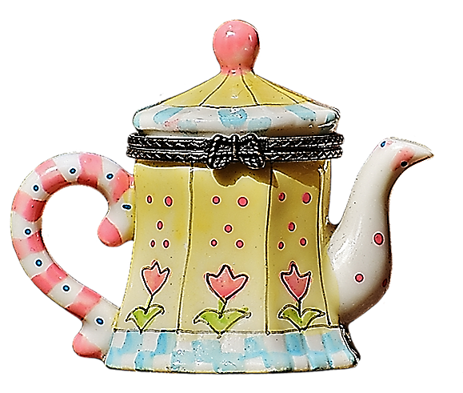

Slide 19
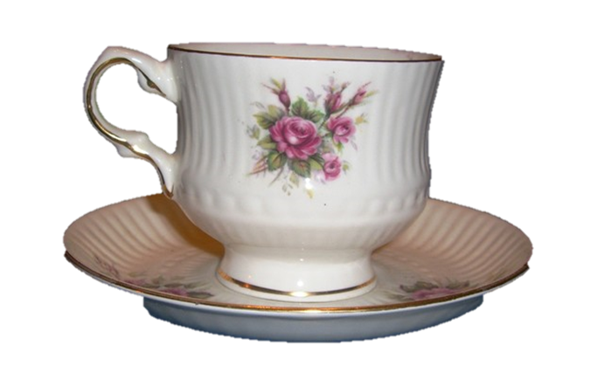

Slide 20
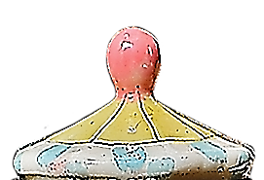

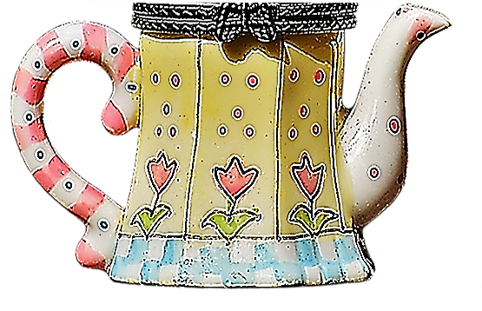

Slide 22
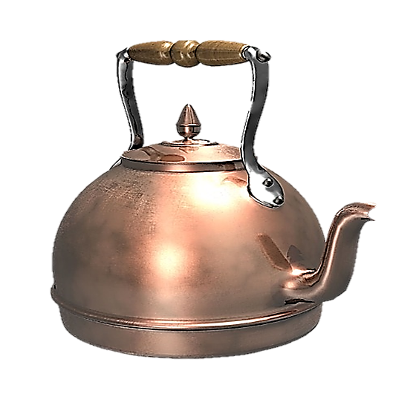

Slide 23


Slide 25
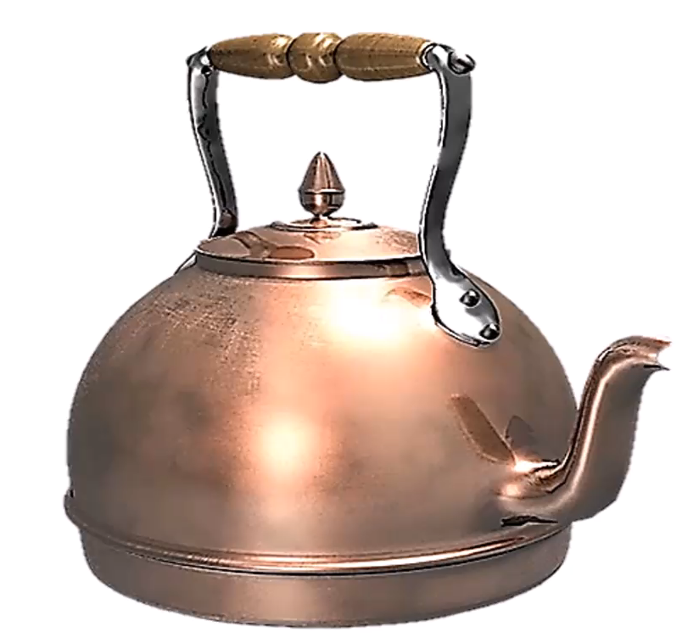
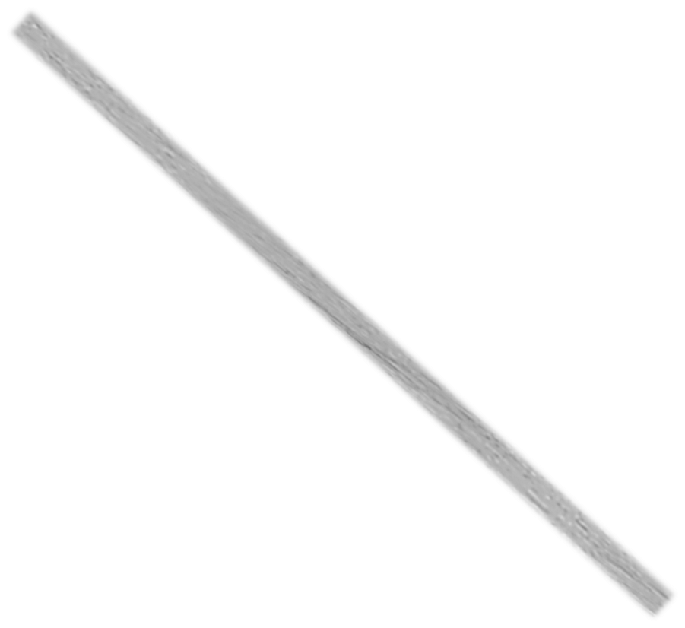

Slide 26
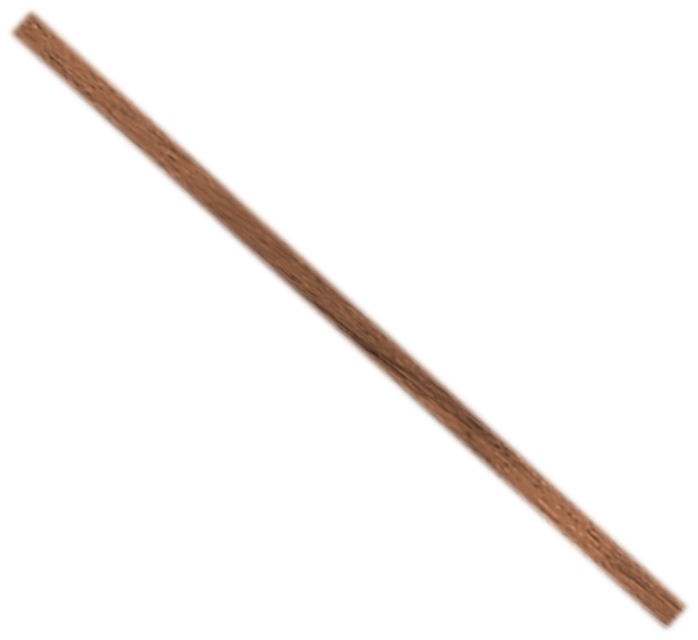


Slide 30
STORY TIME: HABITS
This is a story of living habits which often happened, but not routinely.
STORY TIME: ROUTINES
This is a story of a routine that always happened.
When I worked in Paris years ago, most weekends I used to relax by the river. I used to go to the same cafe on Saturday mornings and used to read the newspapers and talk to my friends. We used to drink coffee all morning and just enjoy the Parisian atmosphere.
When I worked in Paris years ago, every weekend I would relax by the river. I would go to the same cafe on Saturday mornings and would read the newspapers and talk to my friends. We would drink coffee all morning and just enjoy the Parisian atmosphere.

Slide 31
Except in negatives and questions, the correct form is used to.However, in negatives and questions using the auxiliary verb do, the correct form is use to, because the form of the verb required is the infinitive.
Oxford American Dictionary
1 The construction used to is standard, but difficulties arise with the formation of negatives and questions. Traditionally, used to behaves as a modal verb, so that questions and negatives are formed without the auxiliary verb do, as in it used not to be like that and used she to come here? In modern English, this question form is now regarded as very formal or awkwardly old-fashioned, and the use with do is broadly accepted as standard, as in did she use to come here? Negative constructions with do, on the other hand (as in it didn’t use to be like that), although common, are informal and are not generally accepted.
2 There is sometimes confusion over whether to use the form used to or use to, which has arisen largely because the pronunciation is the same in both cases. Except in negatives and questions, the correct form is used to: we used to go to the movies all the time (not we use to go to the movies). However, in negatives and questions using the auxiliary verb do, the correct form is use to, because the form of the verb required is the infinitive: I didn’t use to like mushrooms (not I didn’t used to like mushrooms)

Slide 32
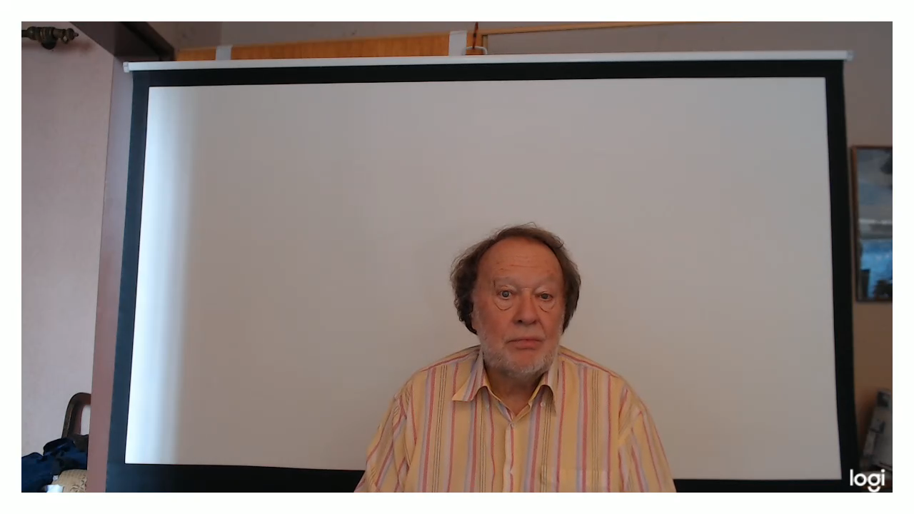

Slide 34
https://www.differencebetween.com/difference-between-habit-and-vs-routine/

Slide 35
MAKING TEA IS A ROUTINE
THE SIX GOLDEN RULES

Slide 36
TEA POT
TEA CUP
KETTLE
MILK JUG
TEASPOON
SUGAR BOWL
TEA COSY

Slide 37
HABITS
AND
ROUTINES

