Slide 1
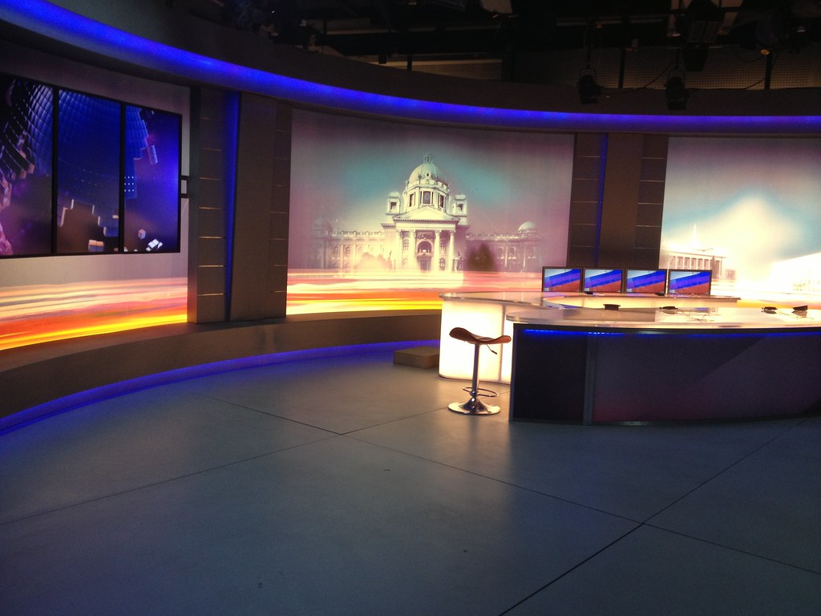
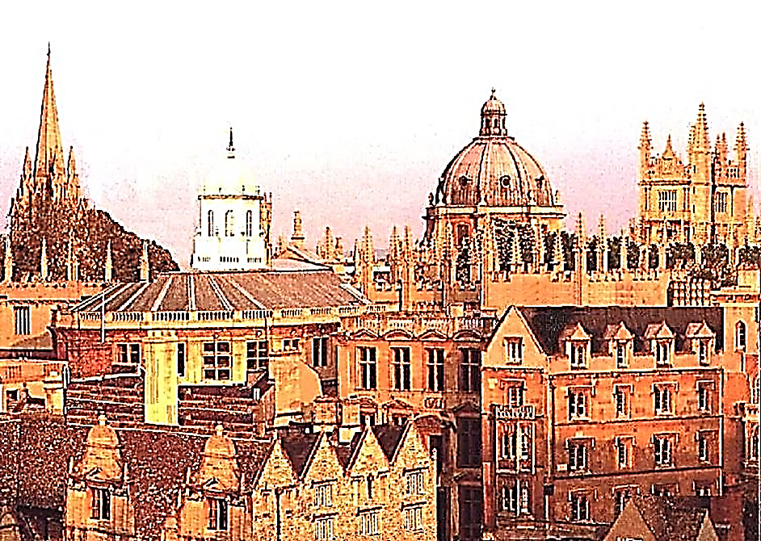




OETV

Slide 2
ENGLISH
LEARNING
PROJECT

Slide 3
ENGLISH
LEARNING
PROJECT

Slide 4

PROFESSORENGLISH

Slide 5
OETV

Slide 6
OETV

Slide 7
OETV

Slide 8
OETV

Slide 9
OETV

Slide 10
OETV

Slide 11
OETV

Slide 12

OETV

Slide 13


Slide 14
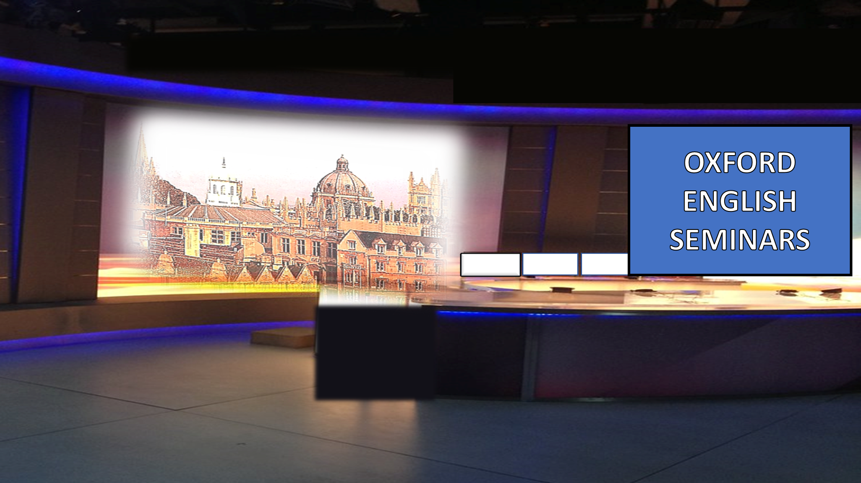

Slide 16


Slide 20
OETV

Slide 21


Slide 22
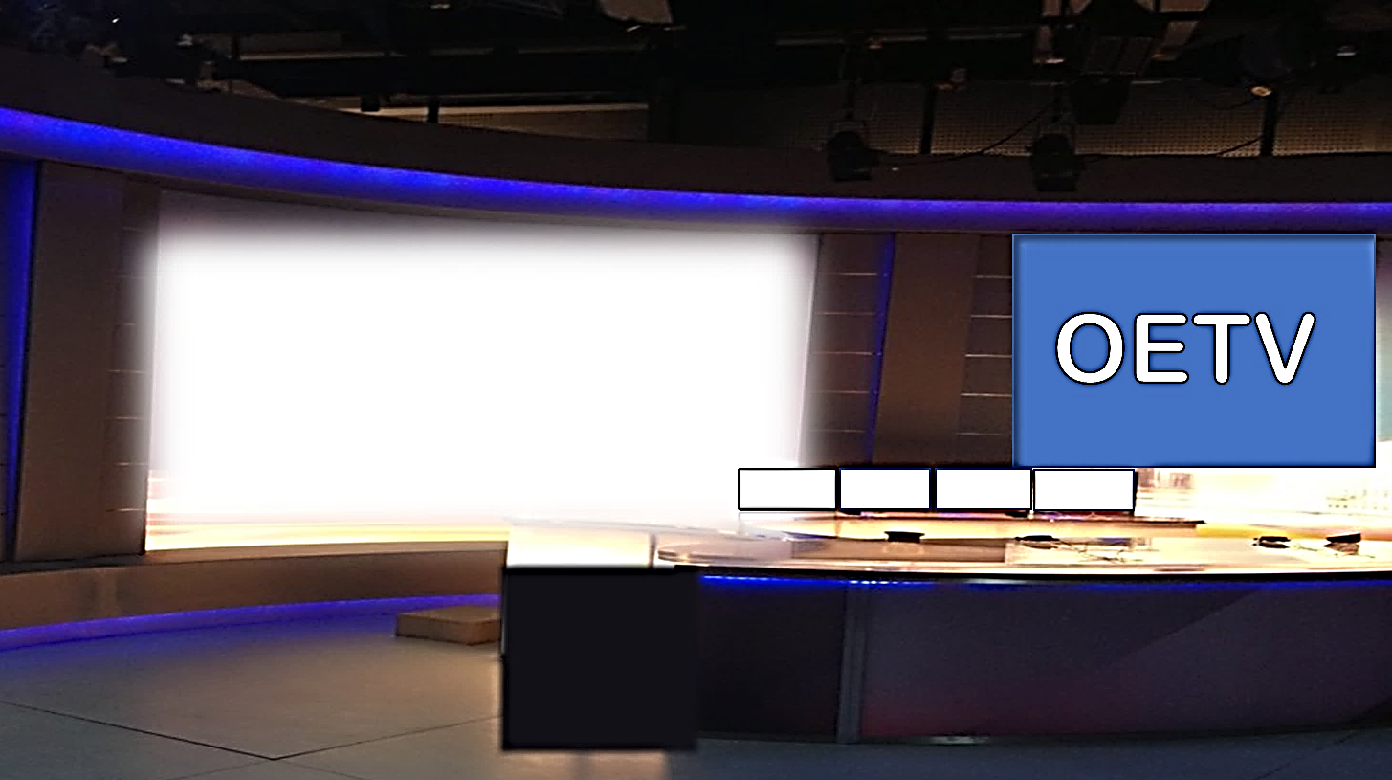

Slide 27


Slide 28


