Slide 1

THE SOUNDS OF SPEECH

Slide 2


Slide 3
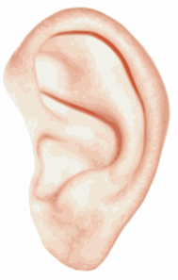
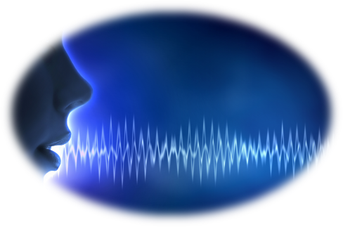
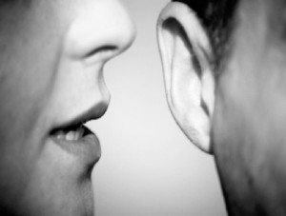
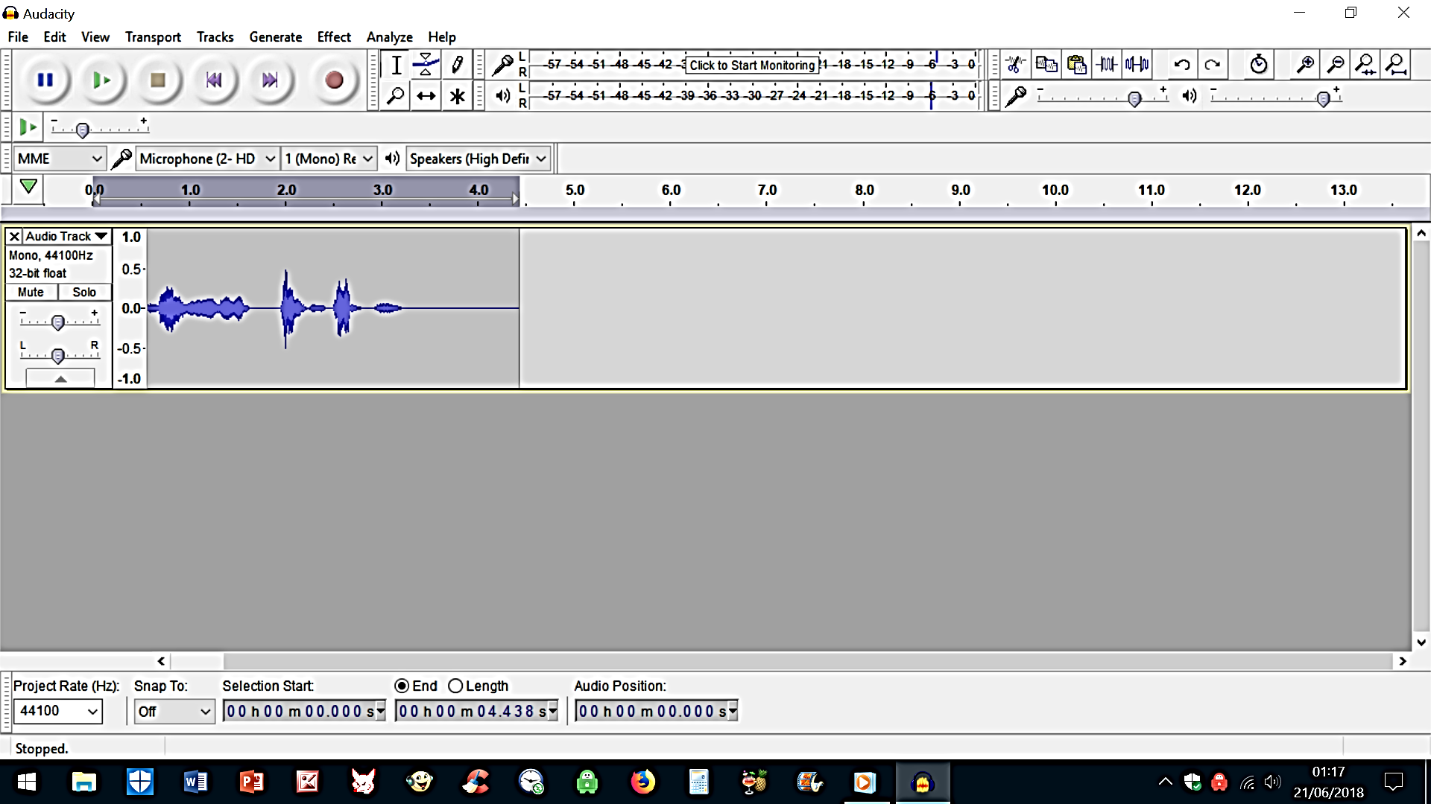
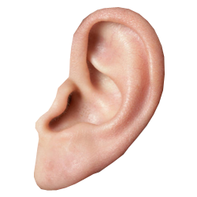
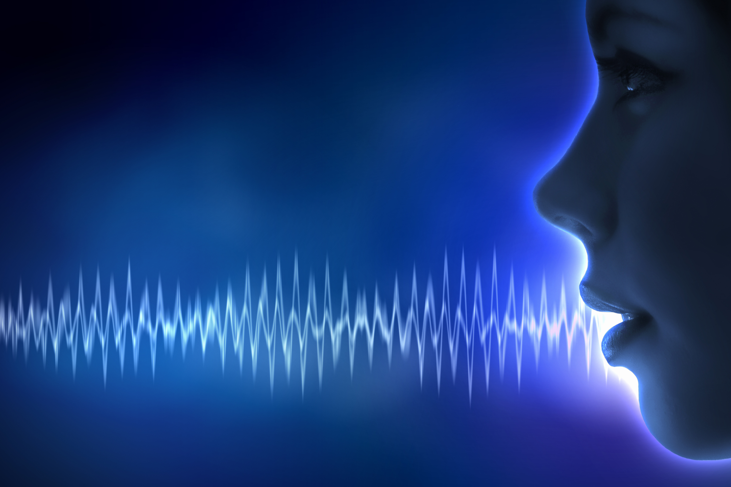
This Photo by Unknown Author is licensed under CC BY-NC
This Photo by Unknown Author is licensed under CC BY-NC-ND
THE SOUNDS OF SPEECH

Slide 4

THE SOUNDS OF SPEECH

Slide 5
THE SOUNDS OF SPEECH

Slide 6
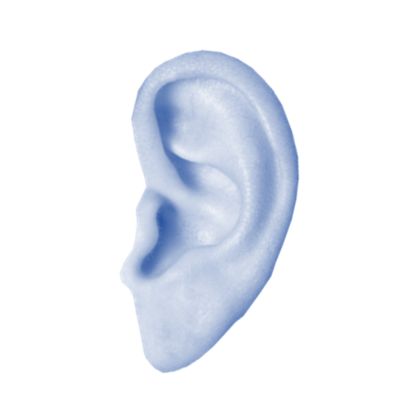


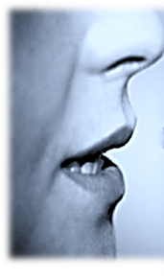
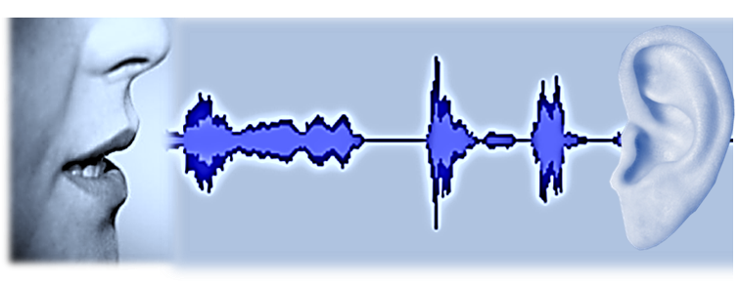
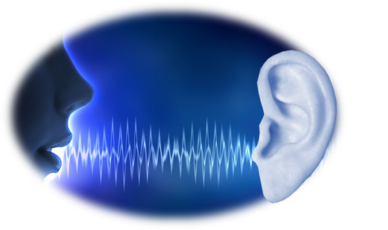
THE SOUNDS OF SPEECH

Slide 7
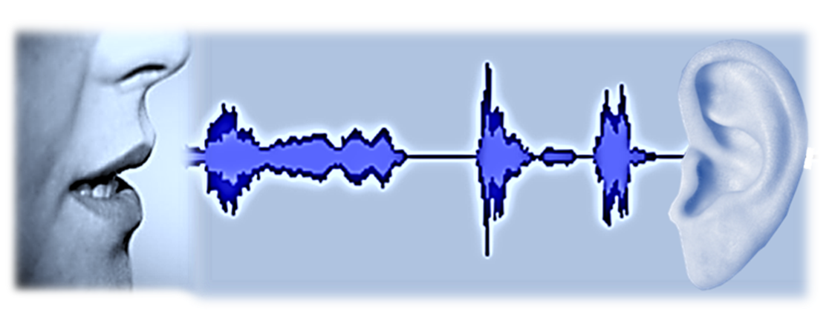
THE SOUNDS OF SPEECH

