Slide 1
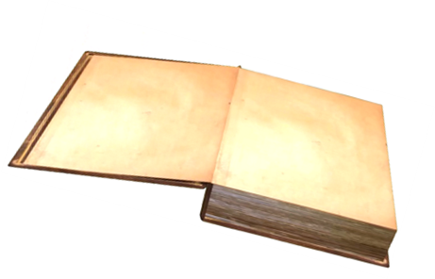
MANY PEOPLE USE
EITHER!
A LOT OF LOTS OF
LARGE
COUNTABLE OR UNCOUNTABLE QUANTITY

