Slide 2



Slide 3
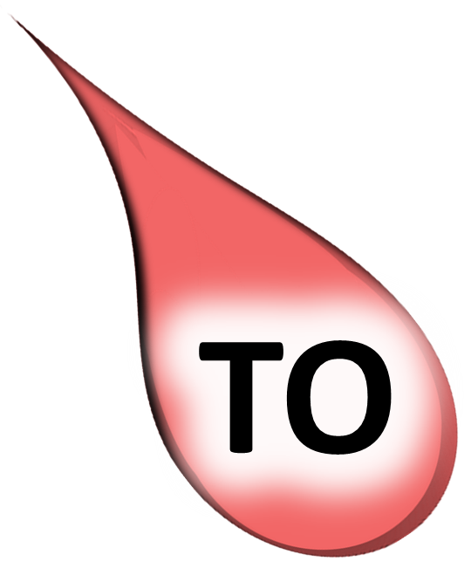

Slide 7
IN SO FAR AS
The prepositional phrase in so far as usually means because. Compare the two following examples:
Example I don't like working in central London in so far as it takes me over two hours to get to work.
Example I don't like working in central London because it takes me over two hours to get to work.
IN THAT
The prepositional phrase in that usually means because. Compare the two following examples:
Example It was a long meeting in that we had to finalise next year's budget.
Example It was a long meeting because we had to finalise next year's budget.

