Slide 1

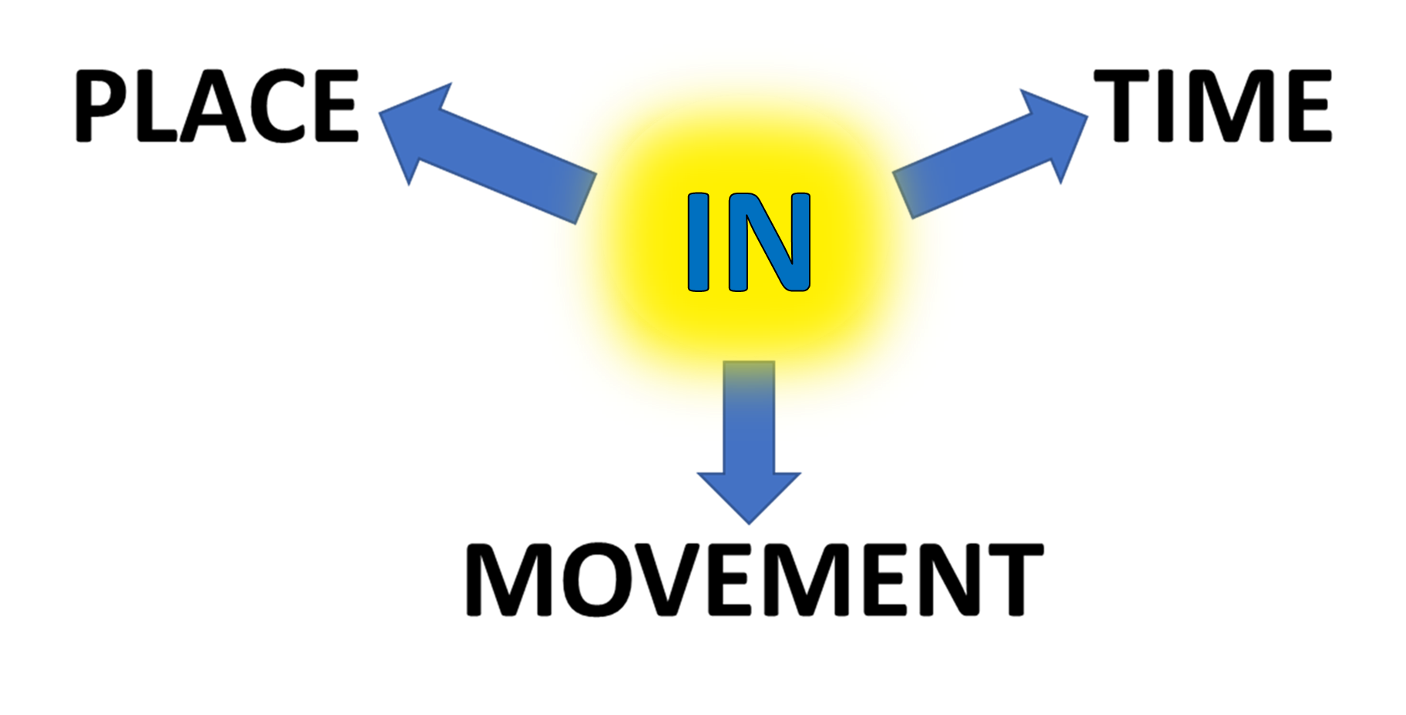
CONTAINED INSIDE LIMITS
PERIOD
DURATION
THROUGH AN AREA

