Slide 1
GET SUMMARY
RECEIVE
CHANGE
IS ABOUT
HAVING
THINGS
IS ABOUT DYNAMIC
DIFFERENCES

Slide 2
GET SUMMARY
RECEIVE
CHANGE
I OFTEN
GET
CALLS
I ALWAYS
GET
RELAXED!

Slide 3

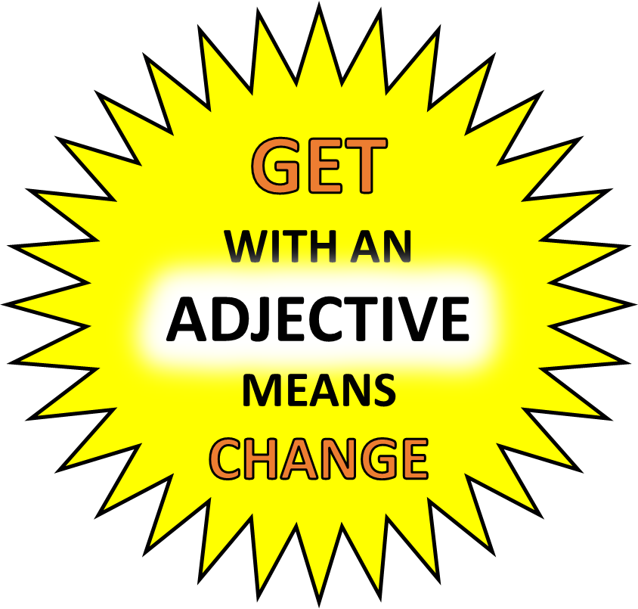
GET SUMMARY
RECEIVE
CHANGE
I OFTEN
GET
CALLS
I ALWAYS
GET
RELAXED!

