Slide 1
1.4.1 – 4 + 7 Ecology, Ecosystem, Biosphere, Habitat & Niche

Slide 2
Need to know
Define the term: ecosystem.
Name a range of ecosystems
Explain the term: biosphere.
Define the term: habitat.
Name examples of habitats.
Explain the term niche and give examples.

Slide 3
What is Ecology?
Ecology is the study of how living things relate to each other and to their environment
Their environment refers to all the conditions in which the organism lives, which affect the growth and development of the organism.

Slide 4
What is an Ecosystem?
An ecosystem is a community of living organisms interacting with one another and their non-living environment within a particular area.
The earth itself is a true ecosystem as no part of it is completely isolated from the rest.
Ecosystem = Communities + Environment

Slide 5
Learning check
What is ecology?
Ecology is the study of how living things relate to each other and to their environment

Slide 6
Diversity of ecosystems
Woodland, Hedgerow,
Seashore, Marine,
Grassland, Freshwater,
Tree, etc.
Can you name some more?
Ecosystems can be very large

Slide 7
To study an ecosystem
We divide the ecosystem into a number of smaller, more manageable areas (habitats).
Individual habitats are then studied.

Slide 8
Learning check
What is an ecosystem?
An ecosystem is a community of living organisms interacting with one another and their non-living environment within a particular area.

Slide 9

What is the Biosphere?
The biosphere is that part of the earth inhabited by living organisms, including land, ocean and the atmosphere in which life can exist.
It is the global ecosystem.

Slide 10
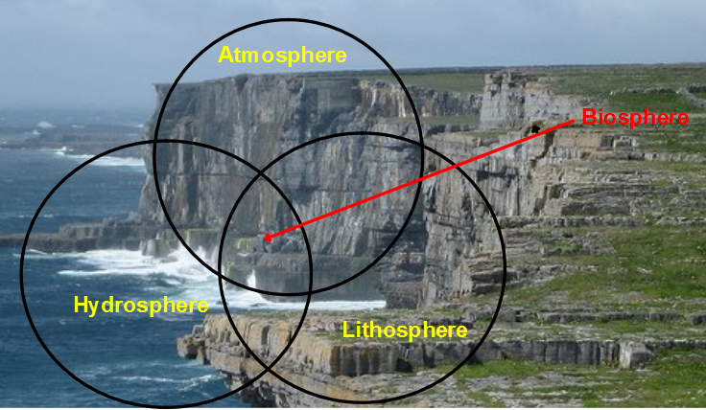
Biosphere

Slide 11
Relationships in the biosphere
Biosphere
The Biosphere is made up of ecosystems
Ecosystems
Ecosystems are made up of communities of organisms and the environment
Communities
Communities are made up of populations of different species of organisms

Slide 12
Learning check
What is the biosphere?
The biosphere is that part of the earth inhabited by living organisms, including land, ocean and the atmosphere in which life can exist.
It is the global ecosystem.

Slide 13
What is a Habitat?
A habitat is the particular place within the ecosystem where an organism lives and to which it is adapted
As a living organism (you) what is your Habitat, Ecosystem and Biosphere?

Slide 14
Summary
Biosphere = that part of the earth and its atmosphere in which life can exist composed of ecosystems
Ecosystems = composed of communities of organisms and their environment
Communities = populations of different species of organisms
Habitats = is the place where an organism lives and to which it is adapted

Slide 15
Learning check
What is a habitat?
A habitat is the particular place within the ecosystem where an organism lives and to which it is adapted.

Slide 16
Simple Definition
A niche is the functional role of an organism in an ecosystem.

Slide 17
Explanation of Niche
A niche is a term describing the relational position of a species or population in an ecosystem.

Slide 18
Learning Check
What is meant by a niche?
A niche is the functional role of an organism in an ecosystem.

Slide 19
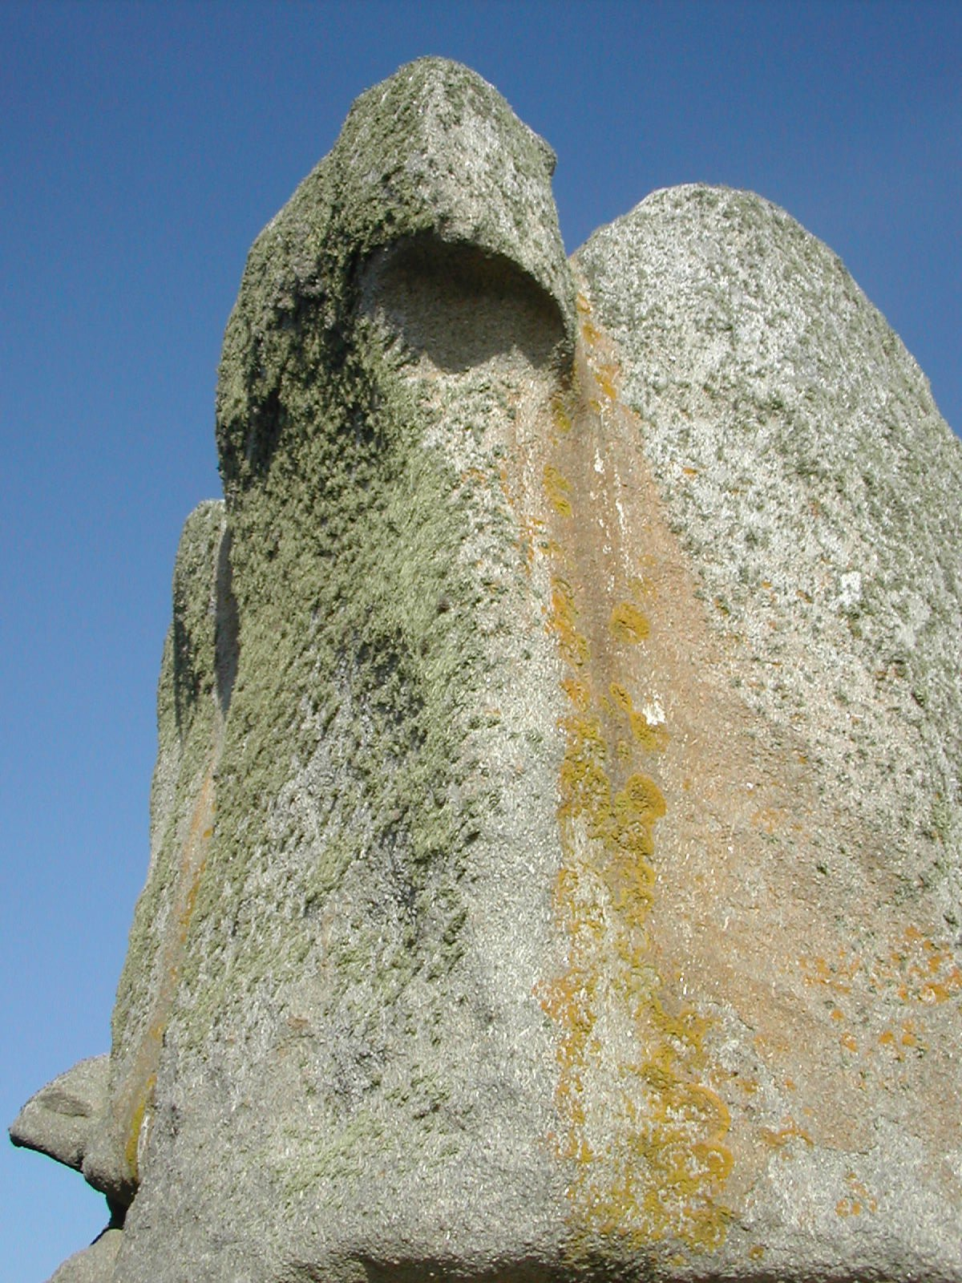
Lichens
Two lichens on a rock, in two different ecological niches.
Can you explain why they are different niches?
Lichenes on a rock
  Author: Johann Dréo
  Date: 2005, august, 10

Slide 20
Summary
For a species to maintain its population, its individuals must survive and reproduce.
Certain combinations of environmental conditions are necessary for individuals of each species to tolerate the physical environment, obtain energy and nutrients, and avoid predators.

