Slide 1


STORY BOARD
INSTRUCTIONS FROM THE BOSS !

Slide 2
Get a car from the car pool, get on the 159
motorway and get to junction 17. Get off the
motorway and get into the city centre. Get to
the market and get all the shopping on the
list and get back before it gets dark.
Make sure you have got everything on the list,
don’t forget anything.
If the weather is getting bad on the way back drive carefully.

Slide 3

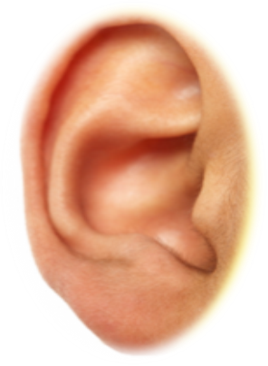

STORY BOARD

Slide 4
Get a car from the car pool, get on the 159
motorway and get to junction 17. Get off the
motorway and get into the city centre. Get to
the market and get all the shopping on the
list and get back before it gets dark.
Make sure you have got everything on the list,
don’t forget anything.
If the weather is getting bad on the way back drive carefully.

Slide 5


Get a car from the car pool, get on the 159
motorway and get to junction 17. Get off the
motorway and get into the city centre. Get to
the market and get all the shopping on the
list and get back before it gets dark
FETCH
RECEIVE
ARRIVE
ARRIVE
BECOMES

Slide 6
Make sure you have got everything on the list,
don’t forget anything.
If the weather is getting bad on the way back drive carefully.
OWNERSHIP
CHANGE

Slide 7
MAKE SOME EXAMPLES LIKE THIS
Get a car from the car pool, get on the 159
motorway and get to junction 17. Get off the
motorway and get into the city centre. Get to
the market and get all the shopping on the
list and get back before it gets dark.
Make sure you have got everything on the list,
don’t forget anything.
If the weather is getting bad on the way back drive carefully.

