Slide 1
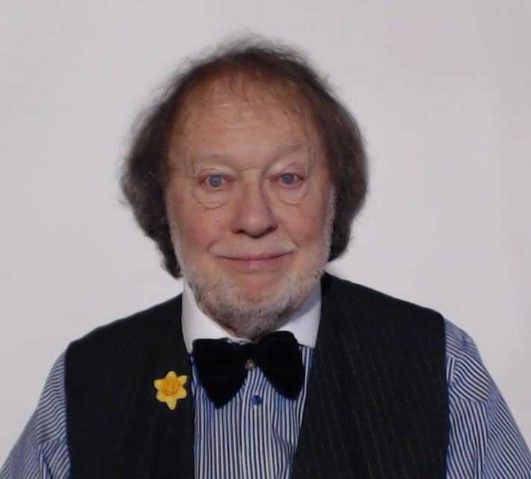

WELCOME TO THE GRAMMAR ZONE!

Slide 2



