Slide 1
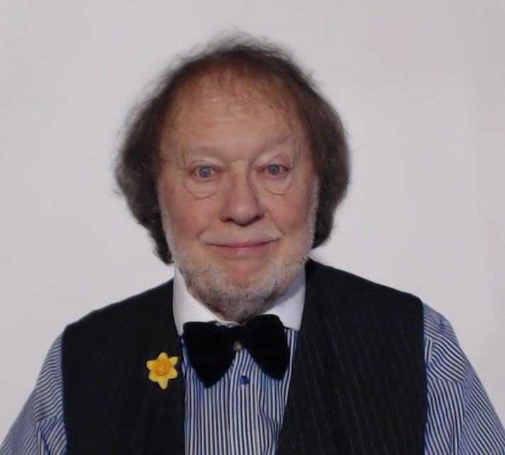
WELCOME TO THE GRAMMAR ZONE!

