Slide 1
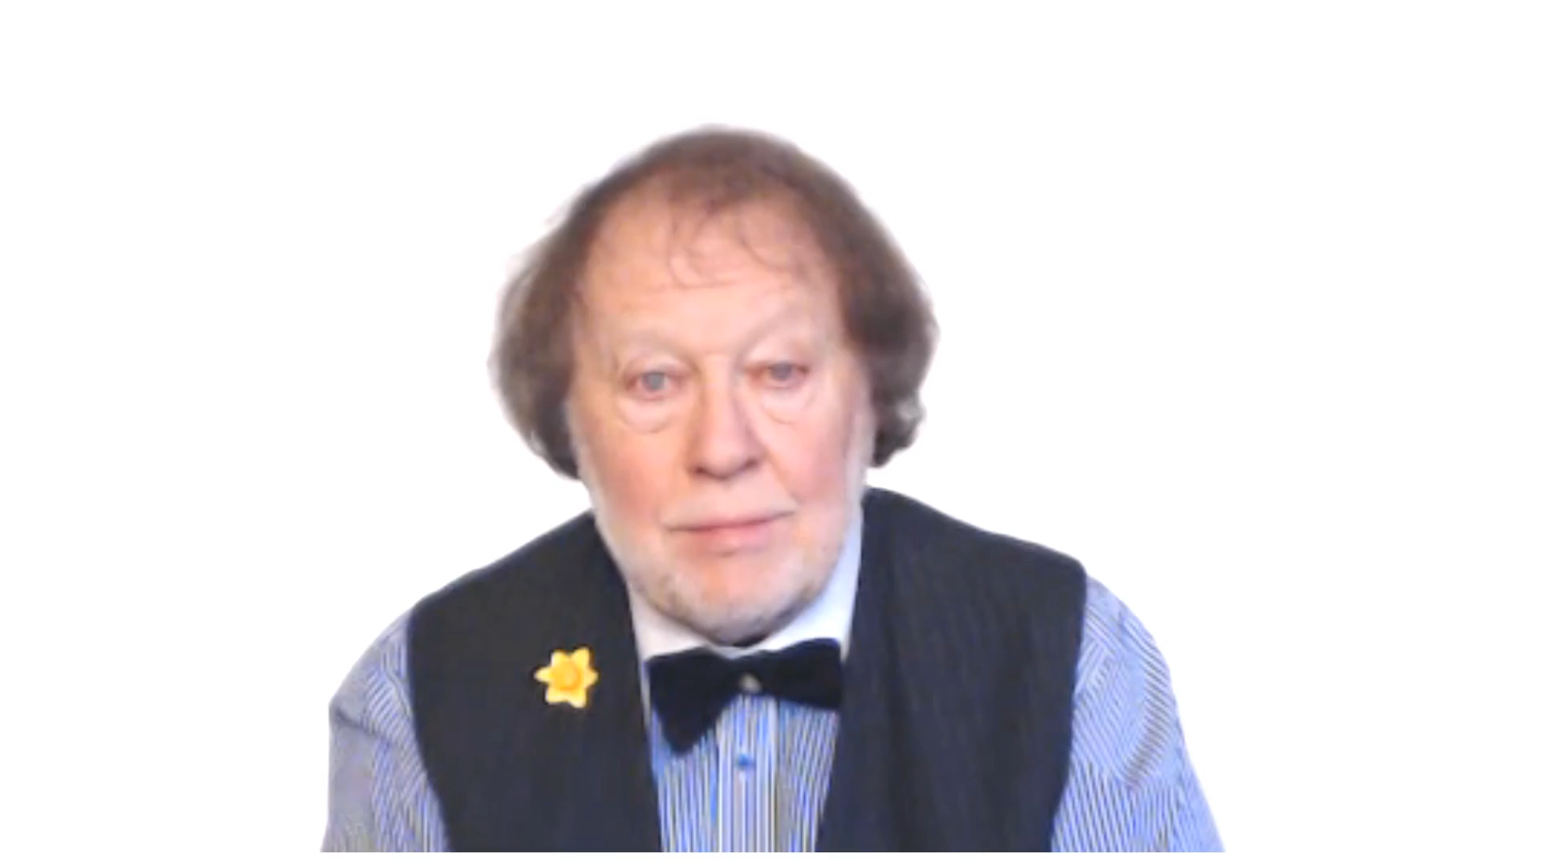
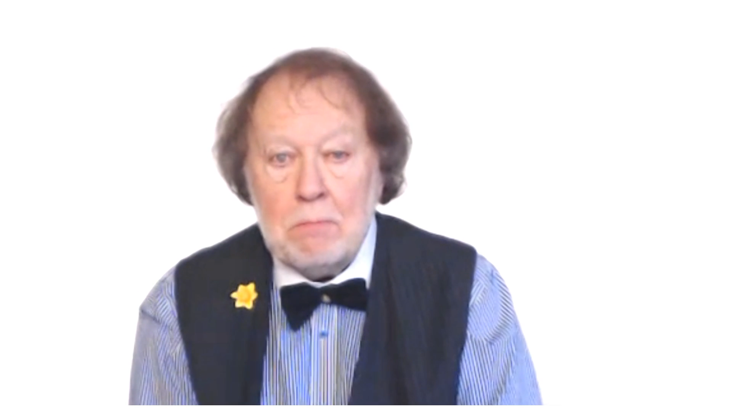
THE LANGUAGE WE USE
FOR OBLIGATION

