Slide 1
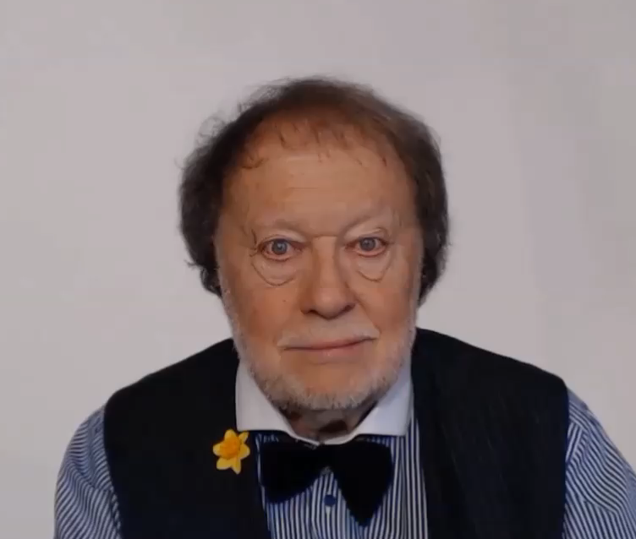
THE ‘ING’ THING-WHATEVER IS IT?

Slide 2
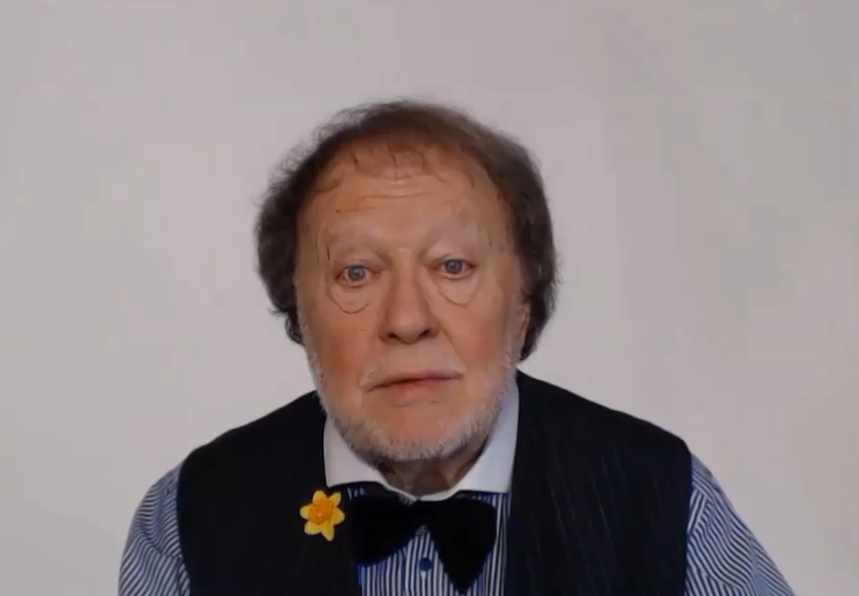
SOME ACTIVITIES ARE
SO IMPORTANT
THAT WE USE THE VERB AS A SPECIAL KIND OF NOUN

Slide 3
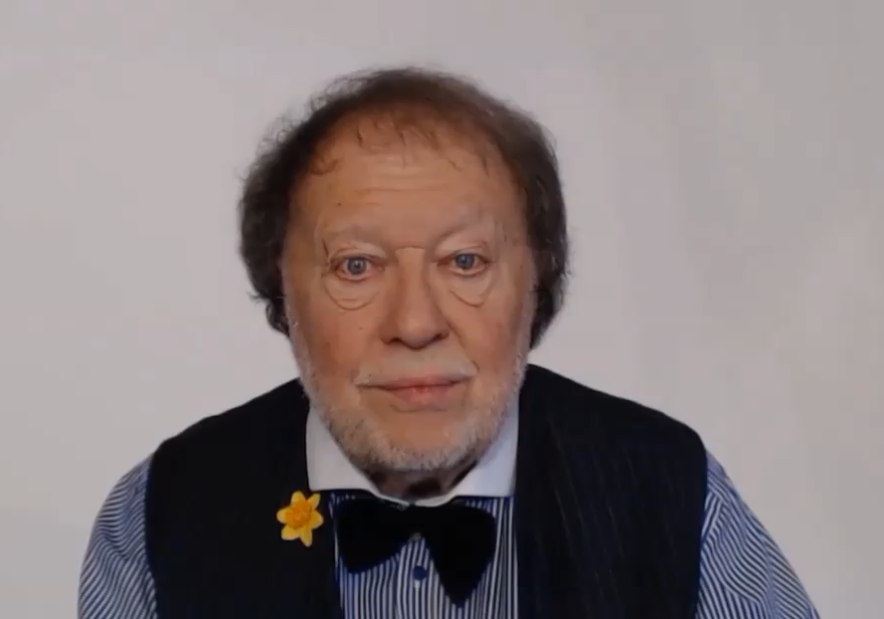
LET’S INVESTIGATE THIS STRANGE AND INTERESTING
LANGUAGE USE

Slide 4
SHOPPING
I WAS SHOPPING YESTERDAY
I MUST GET THE SHOPPING FROM THE CAR
VERB
NOUN

Slide 5
SIGHTSEEING
I WILL BE SIGHTSEEING IN MADRID
I ENJOYED THE SIGHTSEEING IN PARIS LAST WEEK
VERB
NOUN

Slide 6
SHOPPING
I WAS SHOPPING YESTERDAY
I MUST GET THE SHOPPING FROM THE CAR
SIGHTSEEING
I WILL BE SIGHTSEEING IN MADRID
I ENJOYED THE SIGHTSEEING IN PARIS LAST WEEK

Slide 7
FISHING
SWIMMING
CYCLING
RUNNING
DANCING

Slide 8
FISHING
SWIMMING
CYCLING
RUNNING
DANCING

Slide 10




INFINITIVE
GERUND
THE BASIC FORM OF A VERB
THE NOUN FUNCTION OF A VERB

Slide 11


EXAMPLES
TO DRINK
TO SING
TO SHOP
THE DRINKING
THE SINGING
THE SHOPPING

Slide 13
GRAMMAR AND LANGUAGE STUDY BOOKS LIST THIS AS MODAL AUXILIARY USE

Slide 14


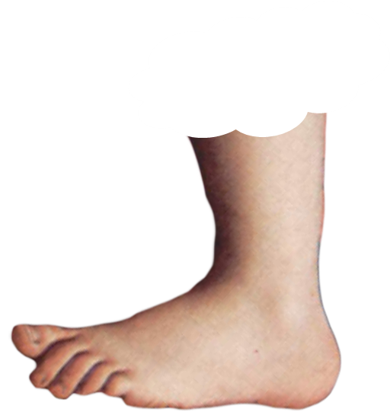
THE DICTIONARY NAME FOR THE ING THING
IS
THE
GERUND
FOOTNOTE

Slide 15
THE DICTIONARY NAME FOR THE ING THING
IS
THE
GERUND
FOOTNOTE

