Slide 2
THE HISTORYSCOPE
STEP
BACK IN TIME WITH
KEVIN SHAW

Slide 3
THE HISTORYSCOPE
STEP
BACK IN TIME WITH
KEVIN SHAW

Slide 4
THE HISTORYSCOPE
STEP
BACK IN TIME WITH
KEVIN SHAW

Slide 8
THE HISTORYSCOPE
STEP
BACK IN TIME WITH
KEVIN SHAW

Slide 9
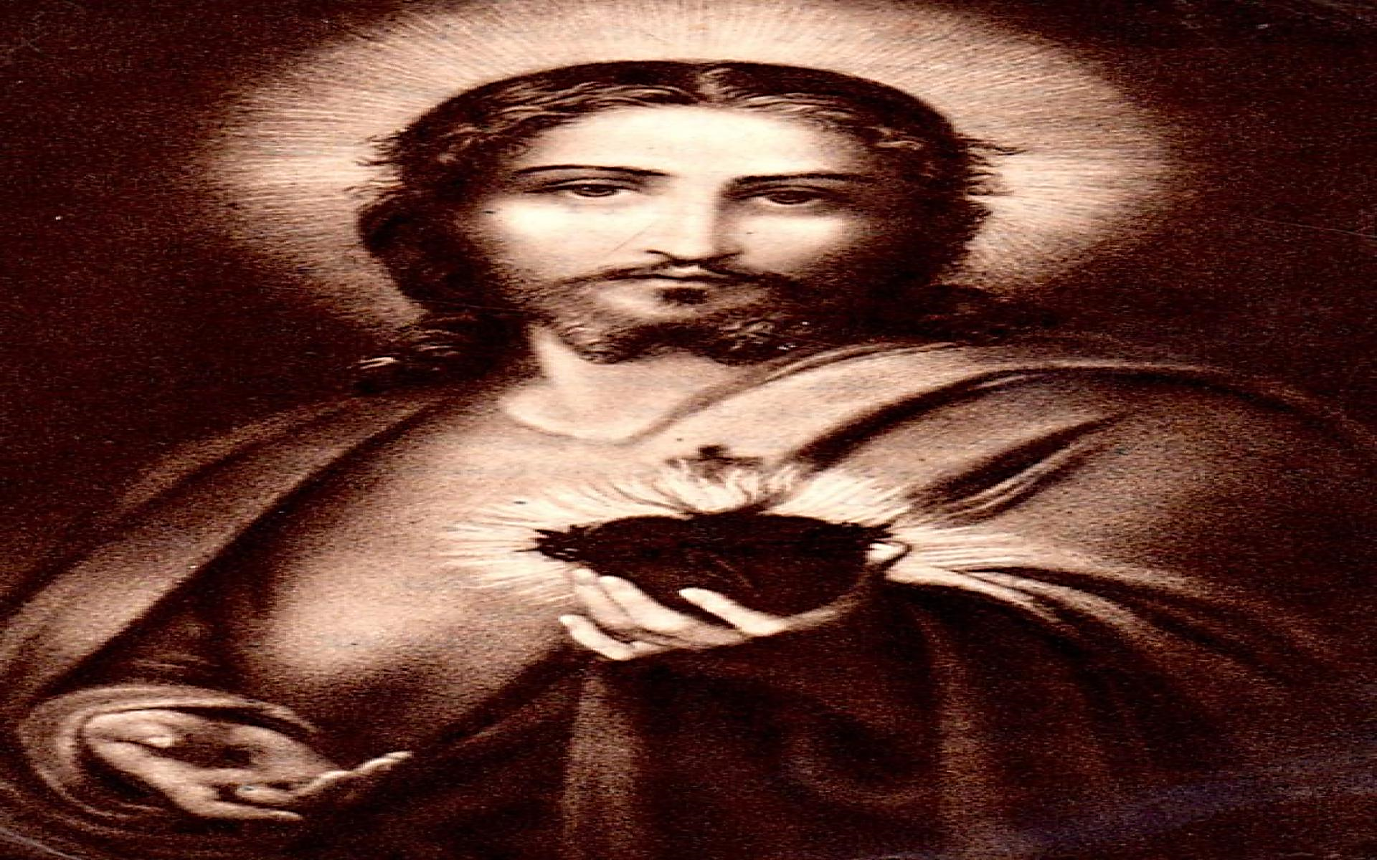
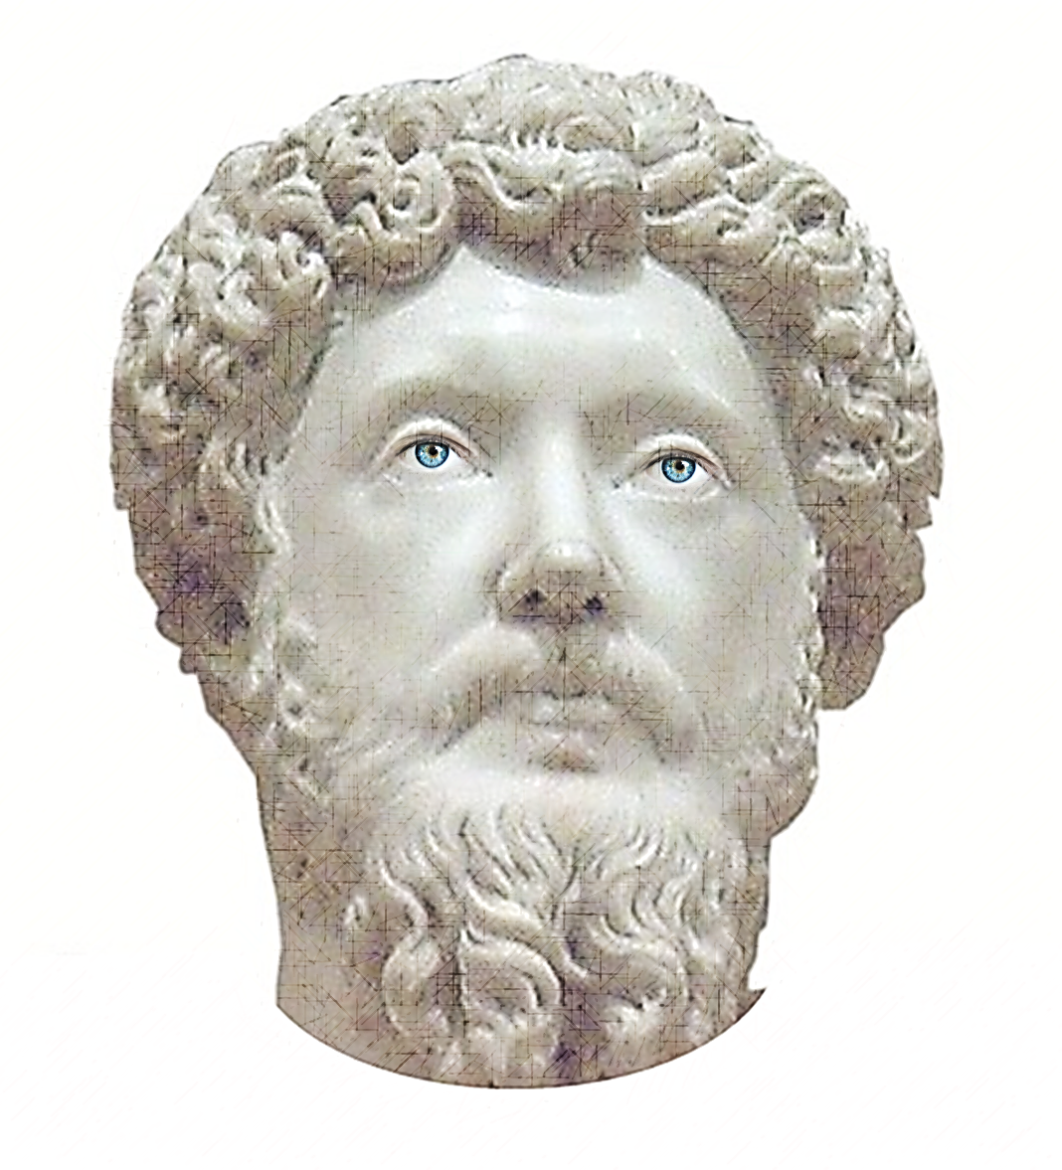
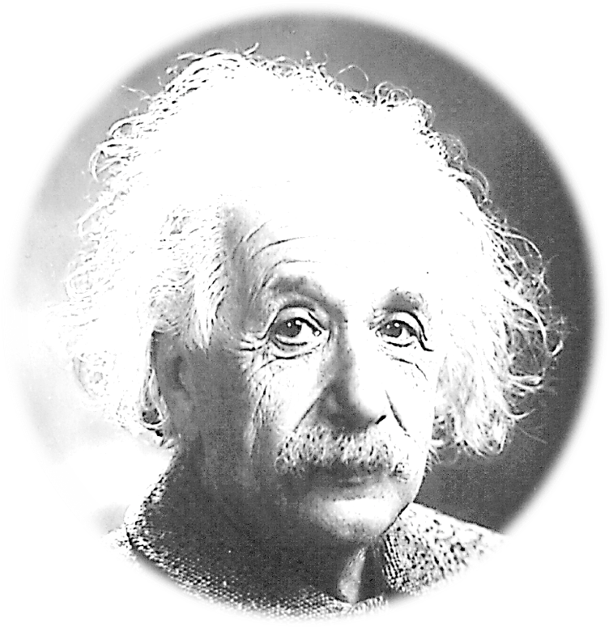
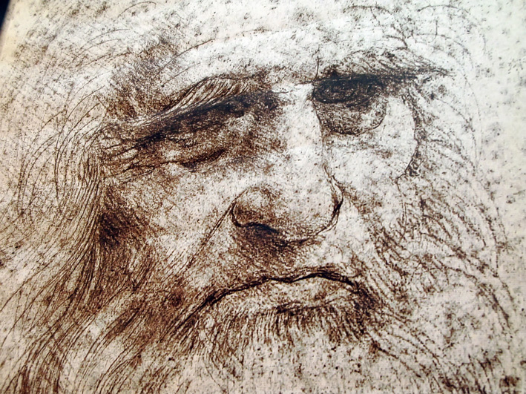

Slide 12
THE HISTORYSCOPE
STEP
BACK IN TIME WITH
KEVIN SHAW

Slide 14
STEP
BACK IN TIME WITH
KEVIN SHAW

Slide 15
1905

Slide 18
1905

Slide 19
1850

Slide 20
1905

Slide 22
1066
THE BATTLE OF HASTINGS

