Slide 1


Slide 2

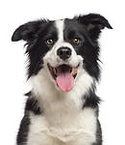

HAPPY
BIRTHDAY
TO LIZZY
FROM IKA AND WILL

