Slide 1
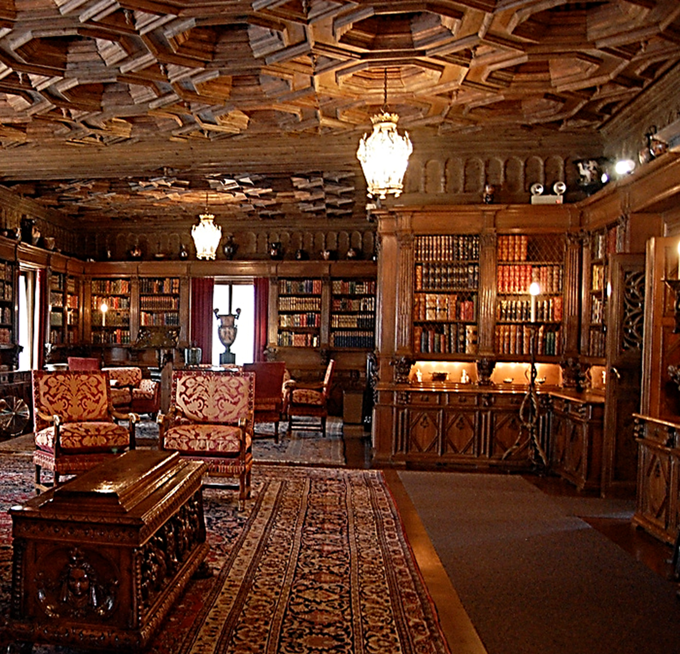
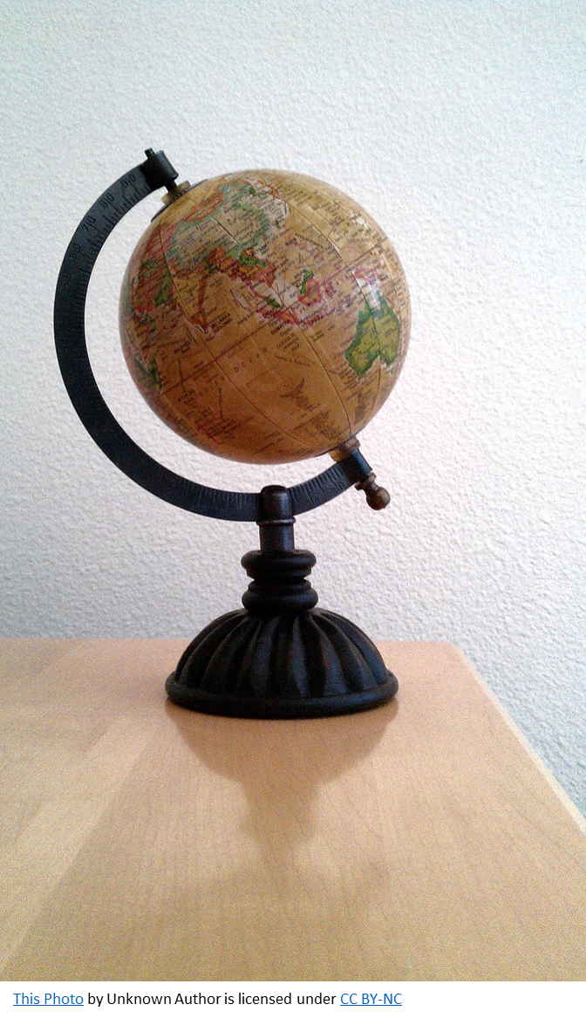

Slide 2

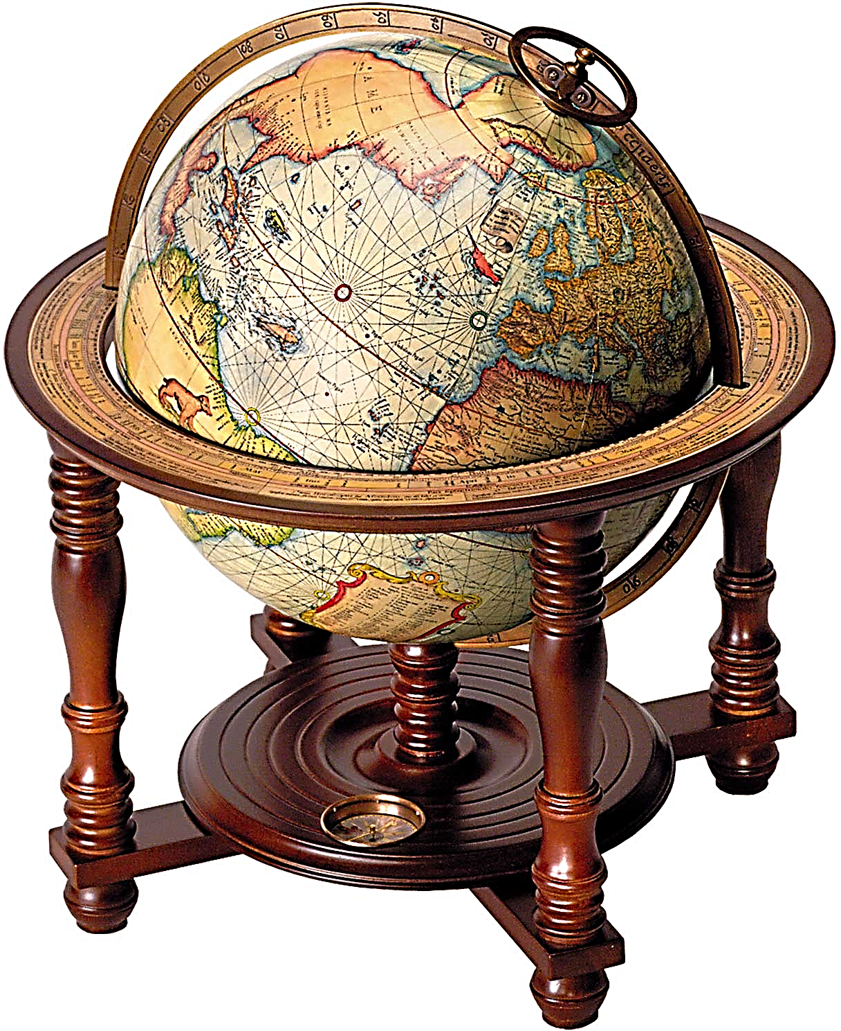
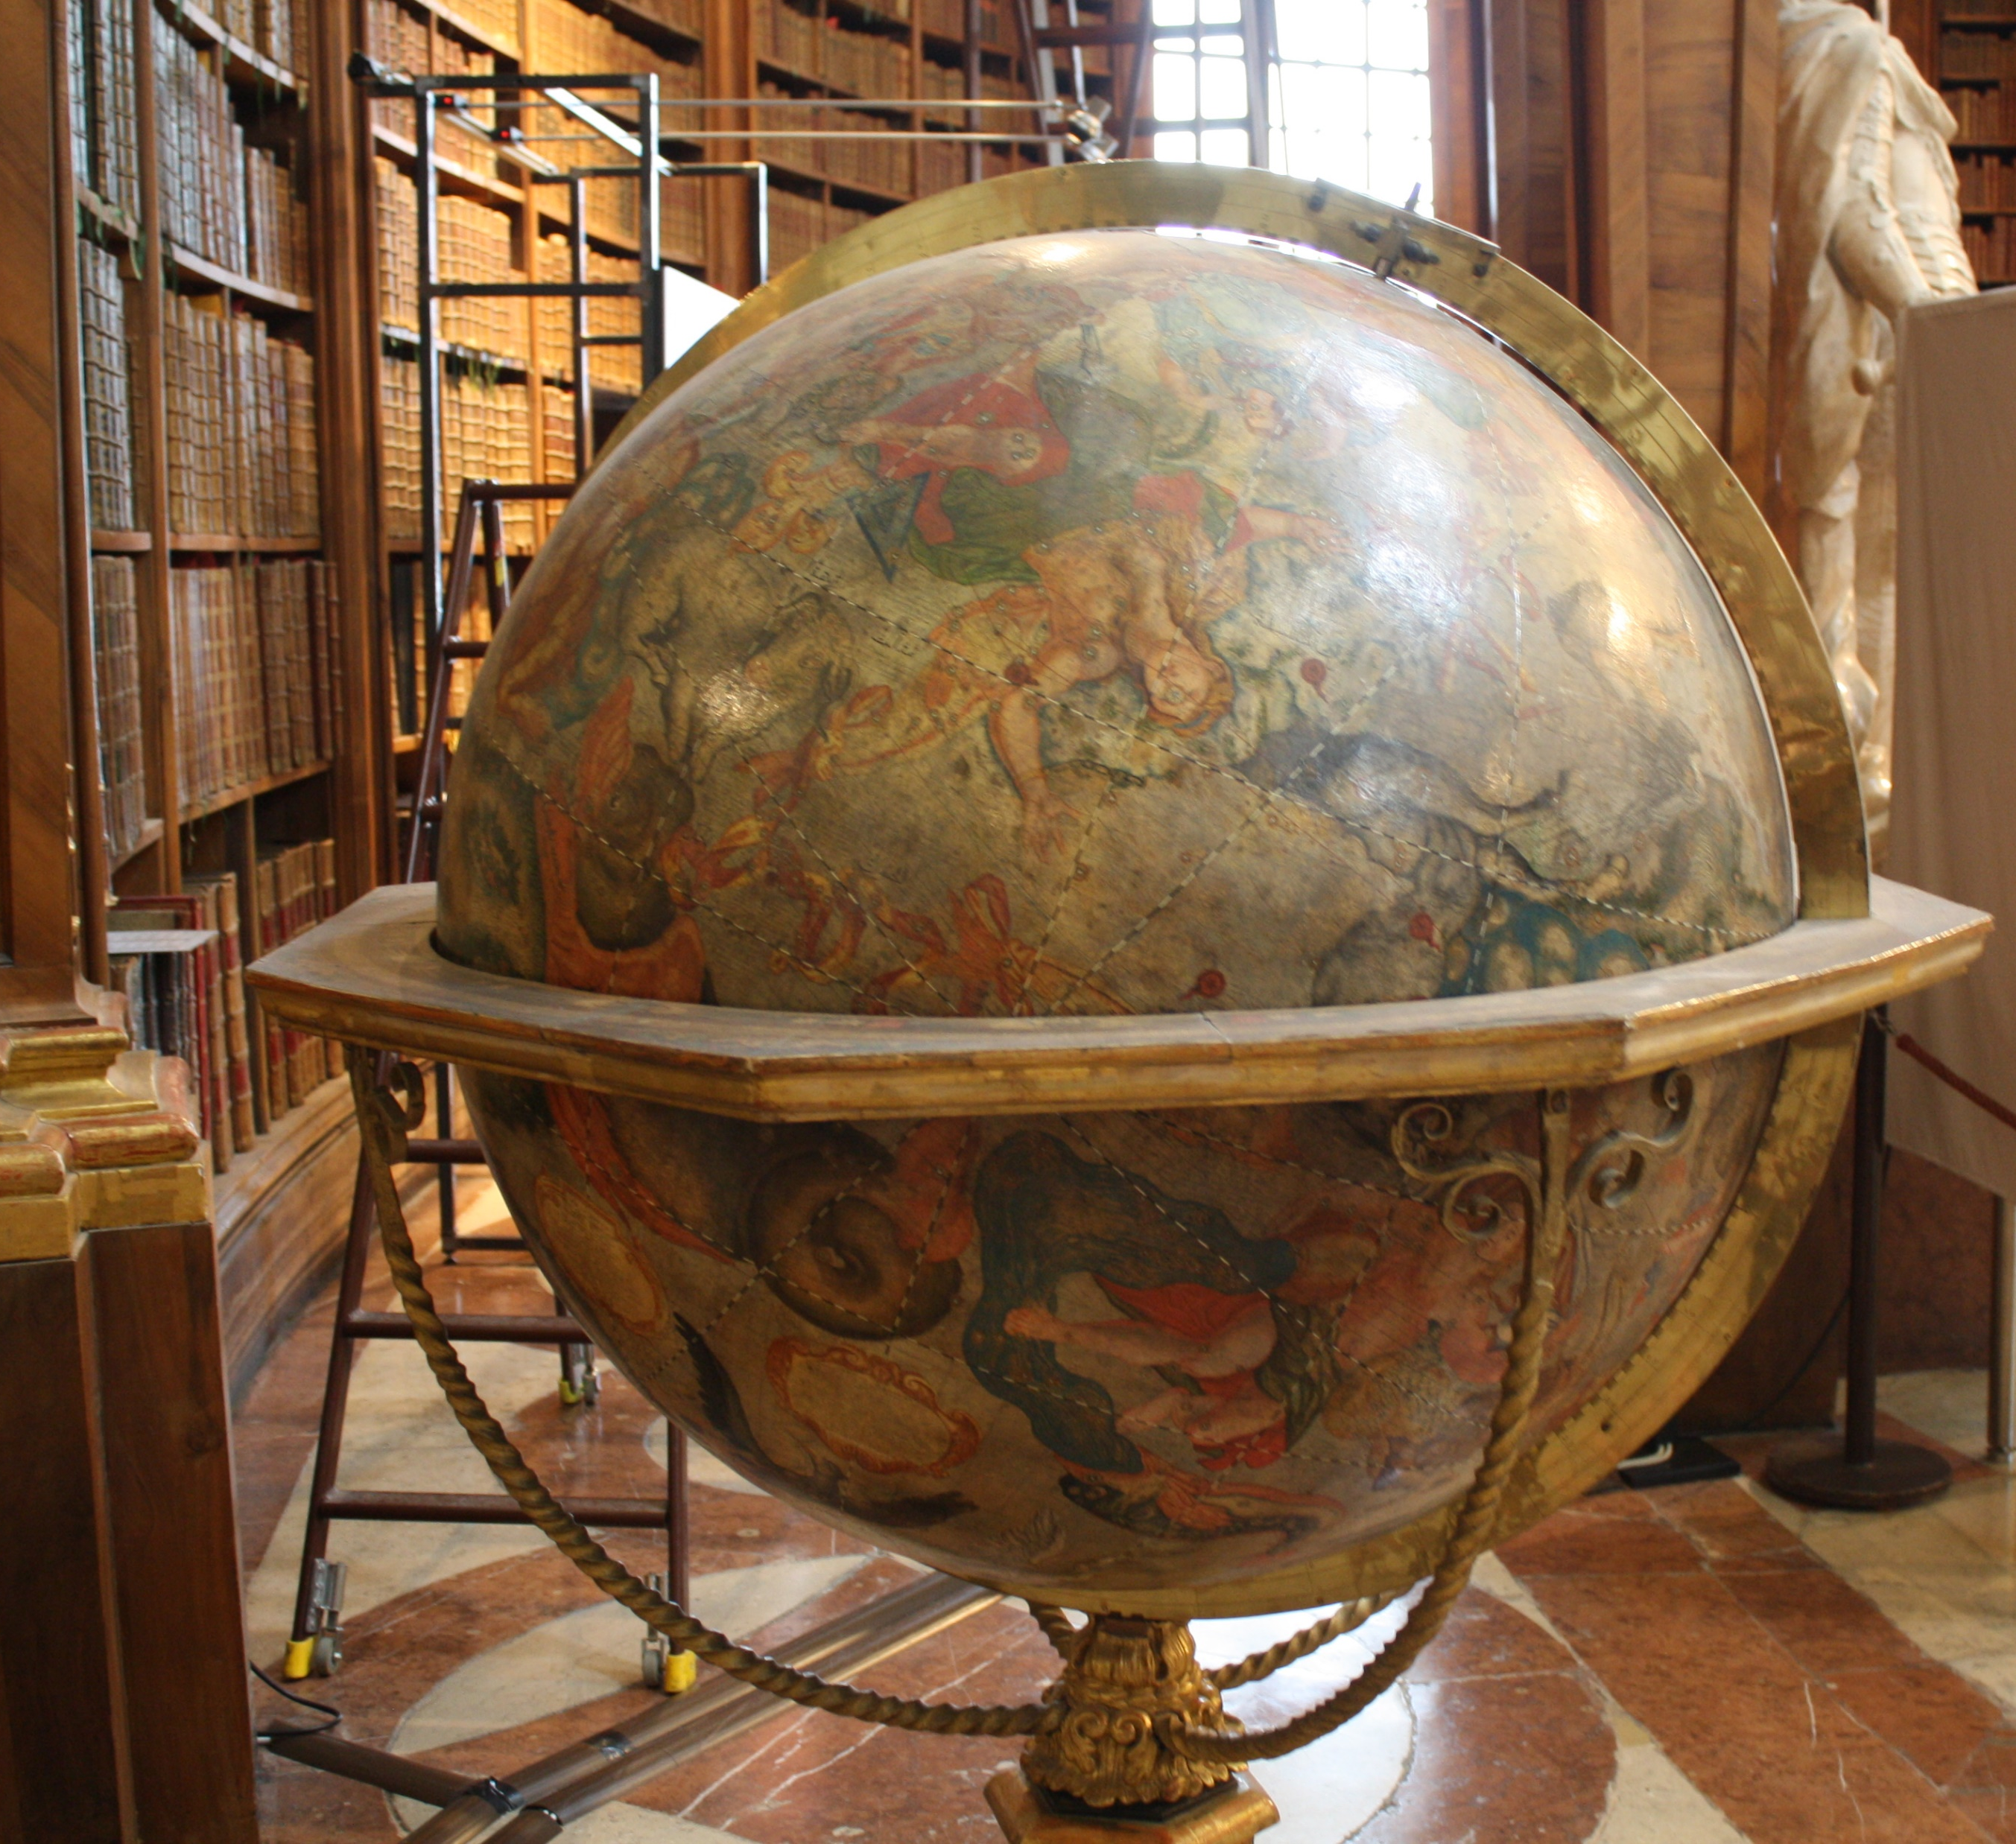
This Photo by Unknown Author is licensed under CC BY-SA-NC
This Photo by Unknown Author is licensed under CC BY-SA
This Photo by Unknown Author is licensed under CC BY-SA

Slide 3
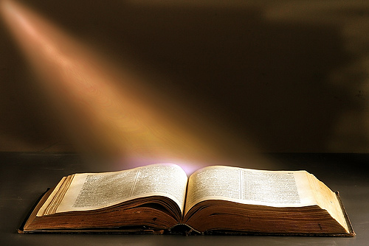

Slide 4
